Slide 1
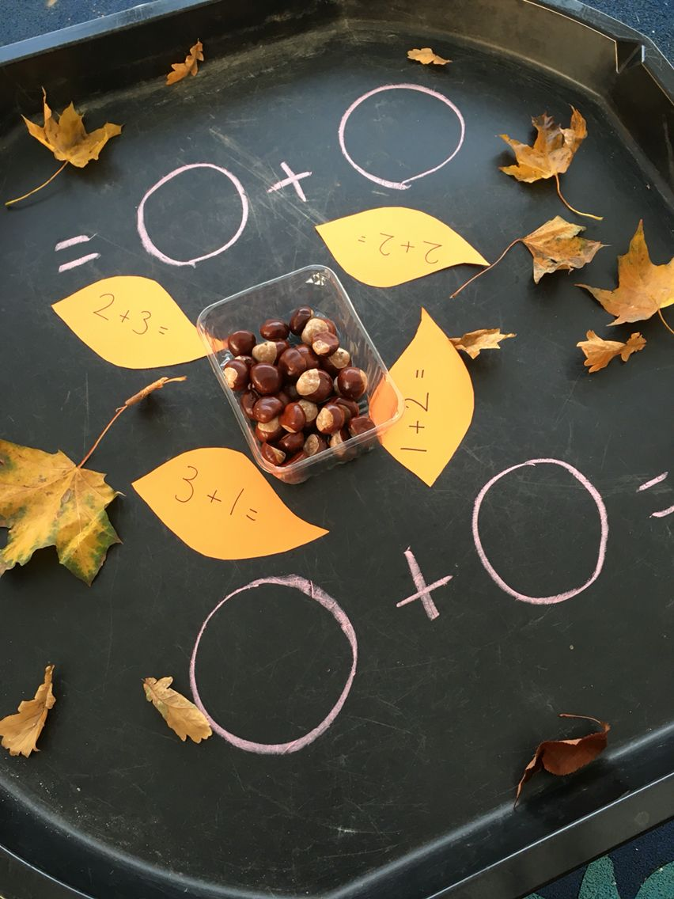
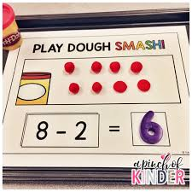
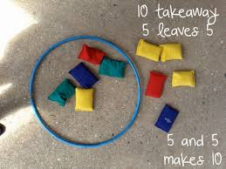
Reception – Here are some great fun ways to teach addition and subtraction at home.

Slide 2
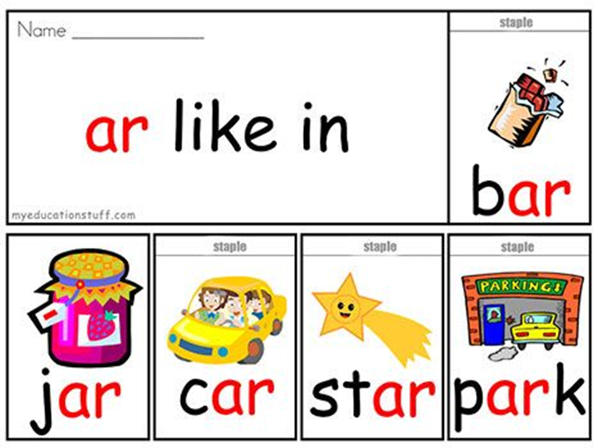
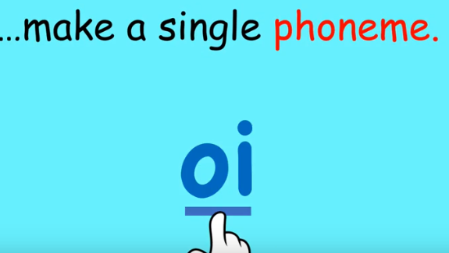
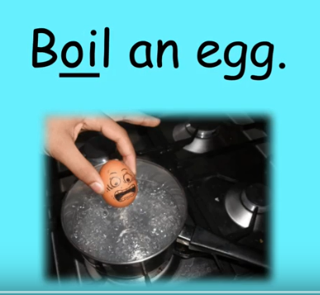
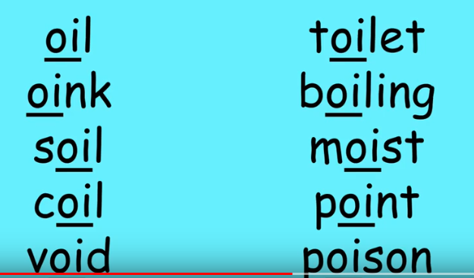
Reception phonics ‘ar’ sound.
Can you think of words that have the ar sound in . Have a go at spelling some and try writing them in a sentence.
‘I like the park’ .
Year 1/ 2 phonics oi sound.

Slide 3
Year 2 could look through a book and see if they can find any ‘ed’ words and decide on the rule.

Slide 4
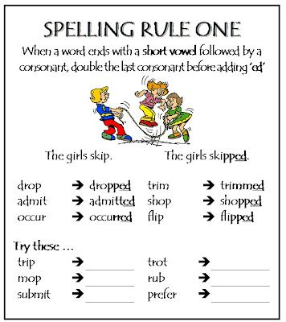
Can you write these words in a sentence?

Slide 5
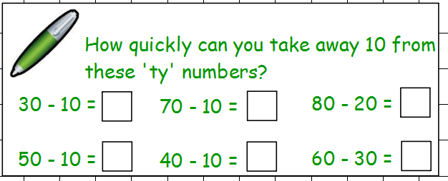
Year 1 and 2 - MATHS Learning objective - Subtract using a place Value Grid
WARM UP Counting in 2s to 100.
Challenge can you count backwards in 2s
Can you count in 2s from 3? What do you notice?
MENTAL MATHS

Slide 6
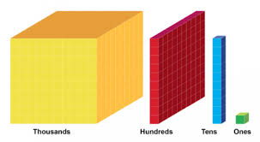
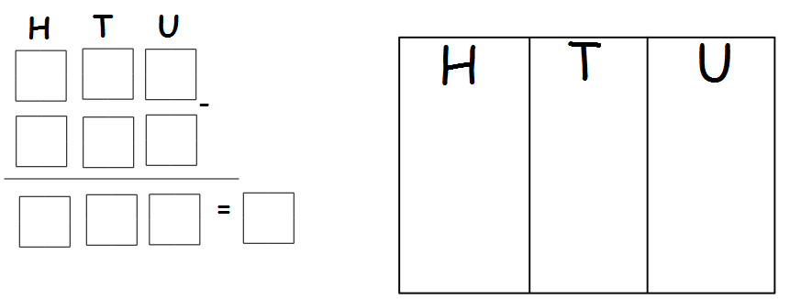
Key Vocabulary and explanation
Dienes are wooden or plastic cubes, rods and flats used to support children basic maths. Dienes are used by students when learning mathematical concepts such as addition, subtraction, number sense and place value. Dienes are also called base ten blocks or multi-base arithmetic blocks
Place value is the value of each digit in a number. It means understanding that 582 is made up of 500, 80 and 2, rather than 5, 8 and 2
Place Value Grid

Slide 7
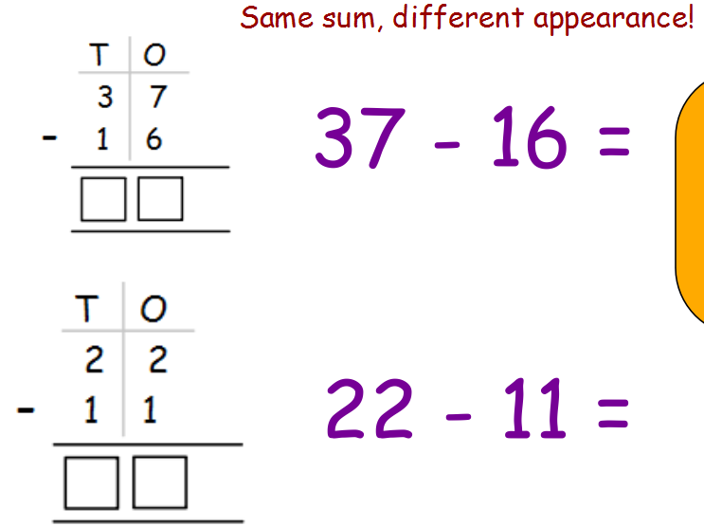
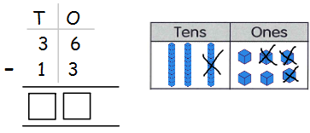
.
You can still partition the number into 10s and units. Draw the Chips and peas, children have ben practising this in class, and take away by crossing them out. Count the tens and units left to find the total.

Slide 8
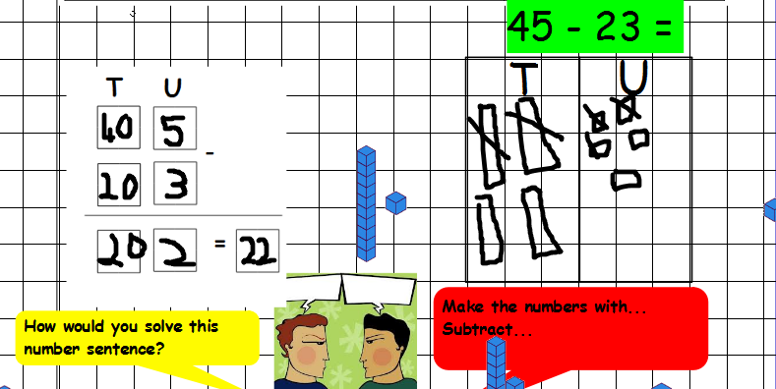
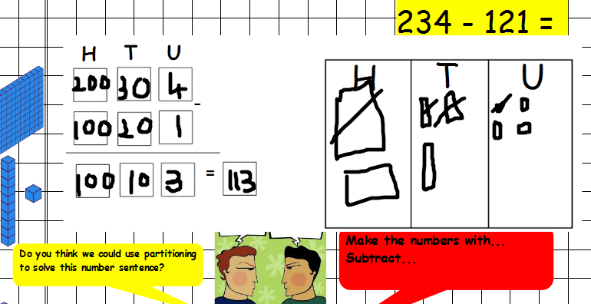
Remember partition into 10s and units or hundreds, tens and units.
Cross out the total you are taking away and count what is left.

Slide 9
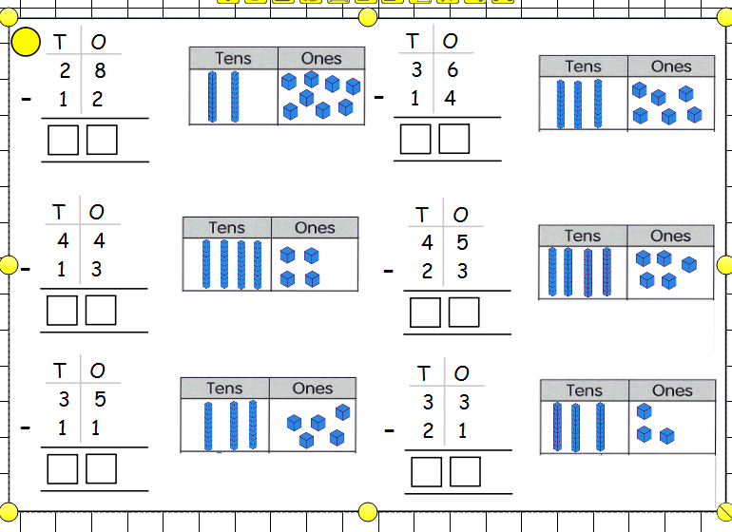
Red Challenge
Amber Challenge
45 - 21 = 32 - 22 = 29 - 19 = 36 - 26 = 47 - 25 =
246 - 121 = 332 - 222 = 228 - 117 = 336 - 126 = 347 - 225 =
Green Challenge

Slide 10
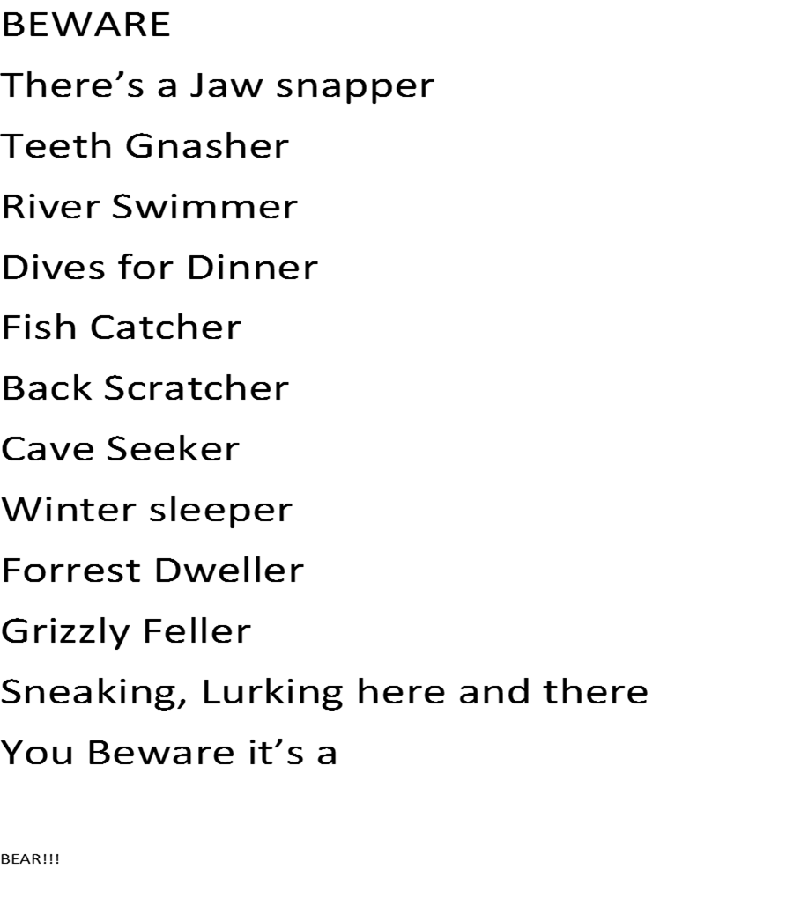
English Learning Objective To write a poem in the style of James Carter.
By James Carter
Last lesson we worked as a class on writing a poem
in the style of James Carter to describe The Egg Box Dragon after
he came to life. We noticed that in James Carters poem he used
The ‘er’ sound at the end of many words when describing the bear.
Our Poem used phrases like –
Cave Dweller
Bug Eater
Jelly Belly Wobbler
Teeth Snapper
Foot print Maker
Cheeky Feller
Fire Breather

Slide 11
I would like you to chose an animal, (maybe it could be your favourite animal), and have a go at writing you own James Carter style poem. Here is my example to help you , Can you guess what animal it is?
There’s a Fluffy Feller
Tail wagger
Ball catcher
Stick Chaser
Couch Sleeper
Barks for Dinner
Paw print leaver
Bouncing, chasing, jumps a log
Look out here comes the……

Slide 12
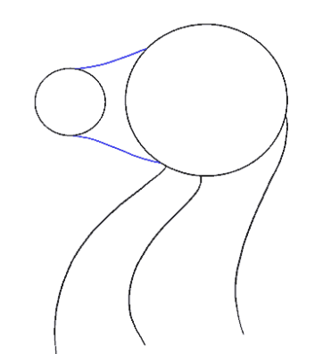
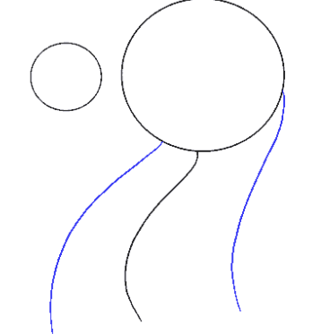
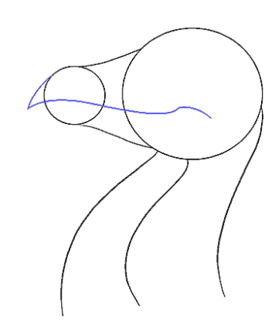
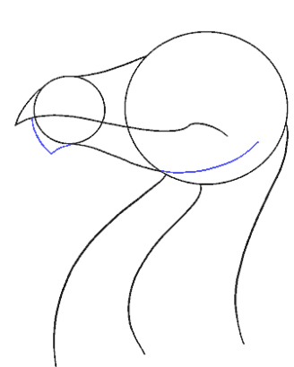
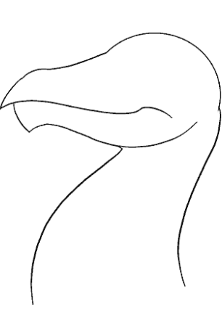
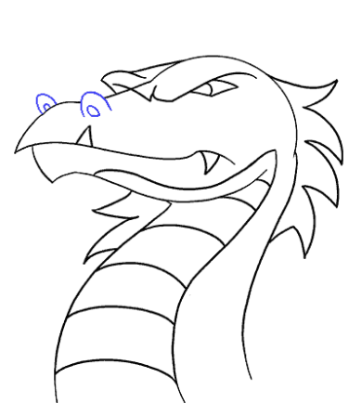
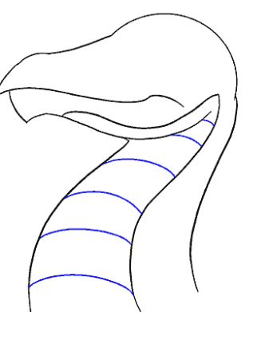
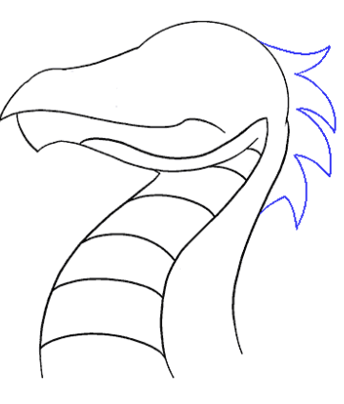
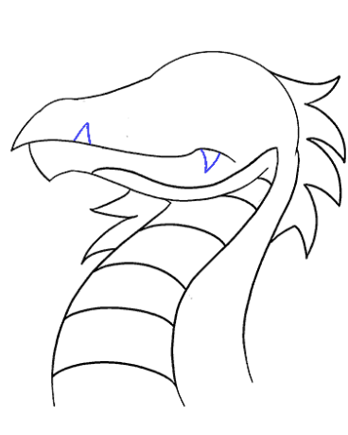
ART – To Sketch a Dragons Head.
You can follow this link on You tube if you have access or to help you could have a go at this step by step guide.
https://www.youtube.com/watch?v=AUTmqPhNV34
I am happy for you to design your own if you would prefer.

Slide 13
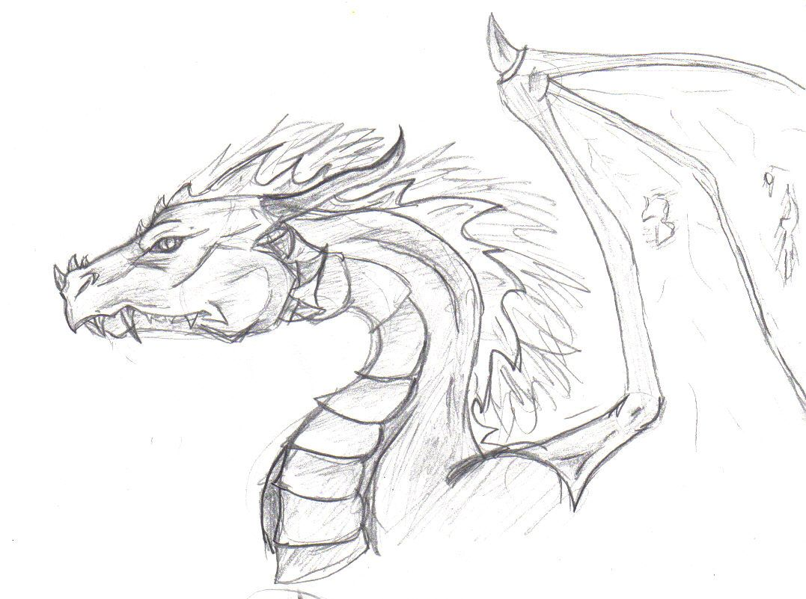
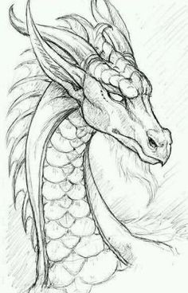
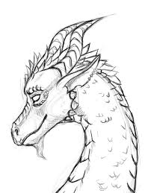
Some ideas for you to have a look at. Next Week you will be adding colours and shading.

Slide 14
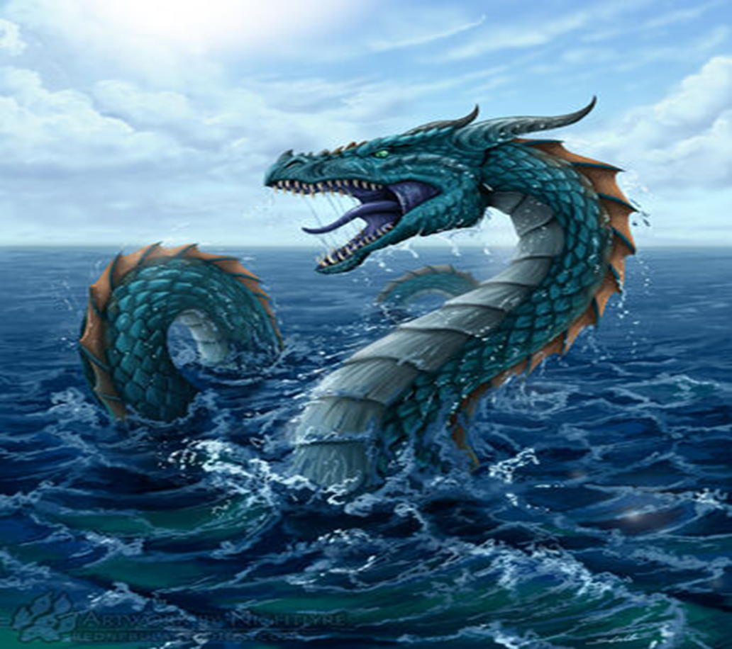
MUSIC – Learning Objective To decide which music best suits the dragon and explain why.
Can you think of adjectives to describe this dragon?
Think about how he would move ,
Slither, Glide etc.. Now listen to the 2 pieces on music and decide which one matches this dragon best and explain why.
https://www.youtube.com/watch?v=t3217H8JppI Beethove Symphony number 6
https://www.youtube.com/watch?v=QCPeOigAKek Piano edition of Let it Go – Frozen
If you do not have access to the videos maybe you could use you voices to make sounds that you think show how the dragon would move through the water.

