Slide 1
Friday March 20th 2020 OWLS LEARNING
Slide 1 – Ideas for hands on learning for reception.
Slides 2 to 3 phonics and spelling
Slides 5 to 8 – Maths To solve subtraction word problems
Slides 9 to 11 – English To write a character description
Slides 12 to 17 – Science To understand how ocean animals are suited to their habitat.
Slide 18 – As a reward for hard work through the week the children have Golden Time on a Friday afternoon were they can chose their own activity.

Slide 2
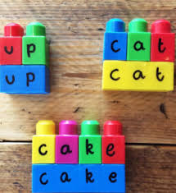
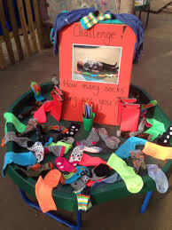
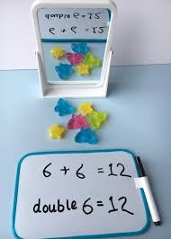
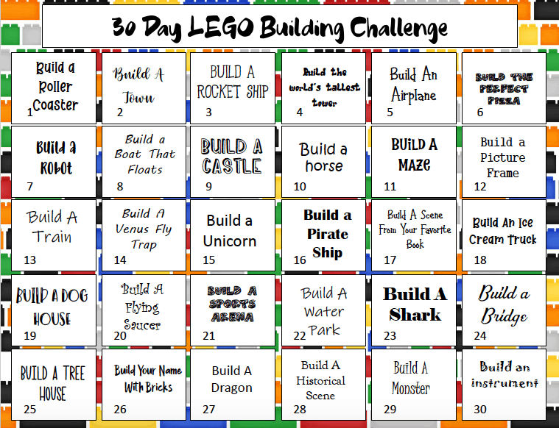
Reception – Here are some great fun ways for your child to continue their learning at home.
Use a mirror to show doubles!
Challenge your children to pair a pile of socks.

Slide 3
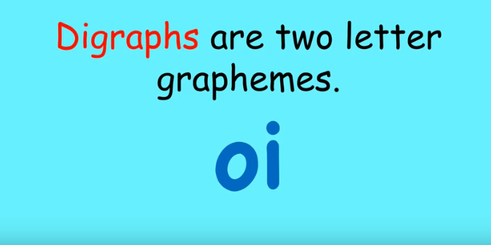
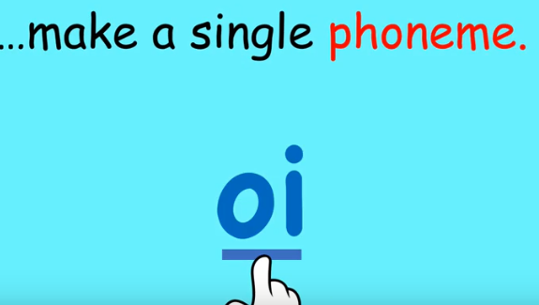
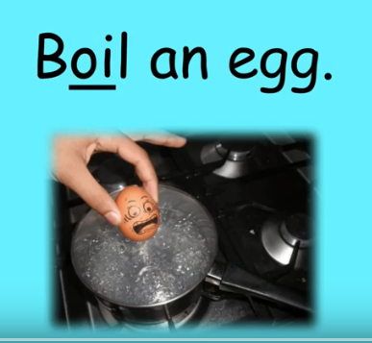
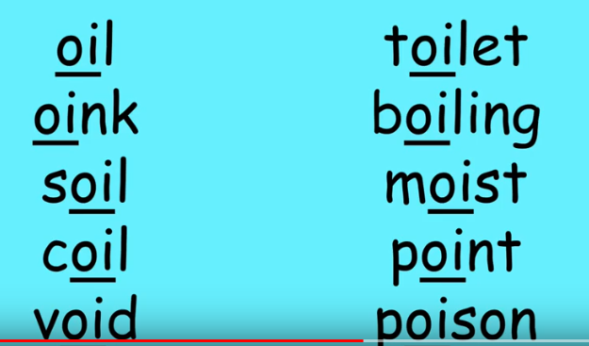
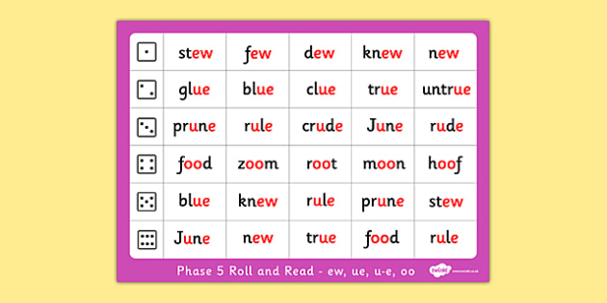
Reception phonics ‘oi’ sound.
Can you think of words that have the oi sound in . Have a go at spelling some and try writing them in a sentence.
‘I like the park’ .
Year 1/ 2 phonics eu/e-u/ ew sound.
You can now log onto phonicsplay.co.uk for free using
Username march20
Password home
There are lots of games and resources to support phonics at home.

Slide 4
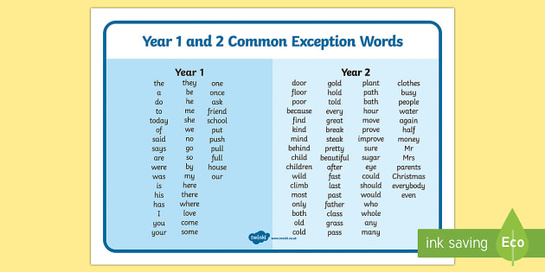
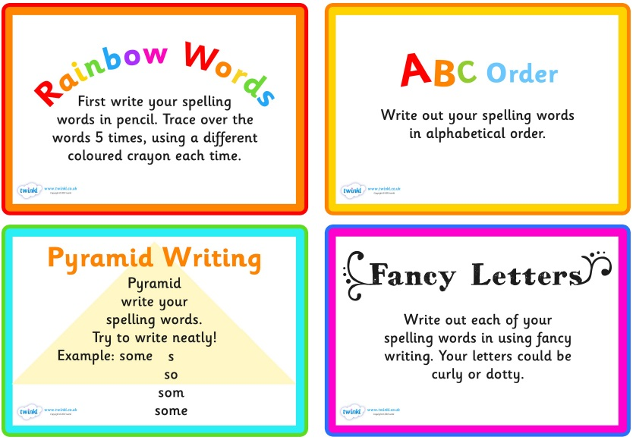
For spelling you can pick 5 to learn each week
Some ideas of fun ways to teach spelling

Slide 5
Can you have a go at writing some sentences adding es or s to these words?

Slide 6
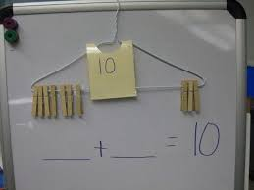
MATHS Learning objective - To solve subtraction word problems
WARM UP 5 times tables for year 2. Look at the link below for a song to help
Reception Counting forward and backward to 20. Sing counting songs like 1,2,3,4,5 once I caught a fish alive.
Number bonds to 10 for year 1
https://www.youtube.com/watch?v=TFcwMi8l040 A song for learning 5 times tables
https://www.youtube.com/watch?v=GyK8iEO5-GI A great song for recapping number bonds to 10.

Slide 7
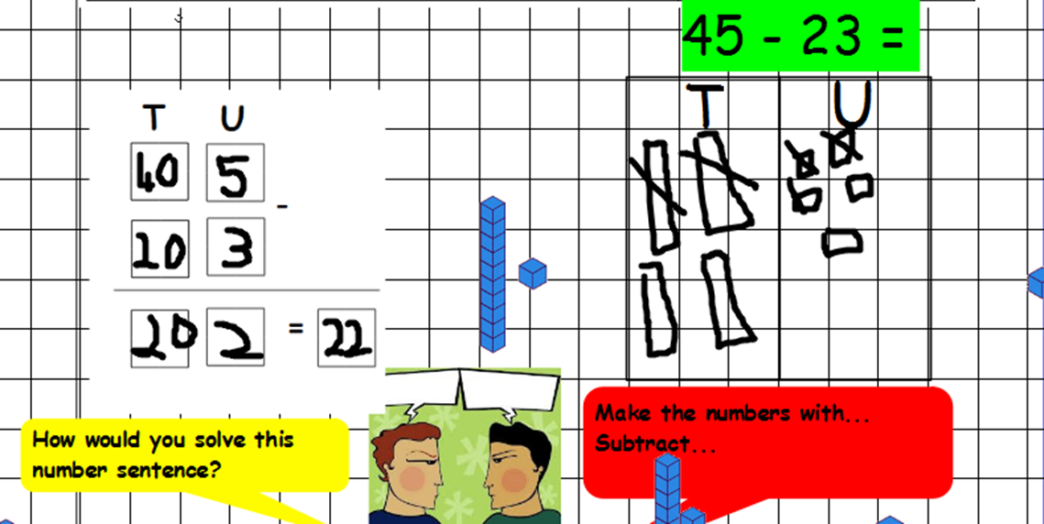
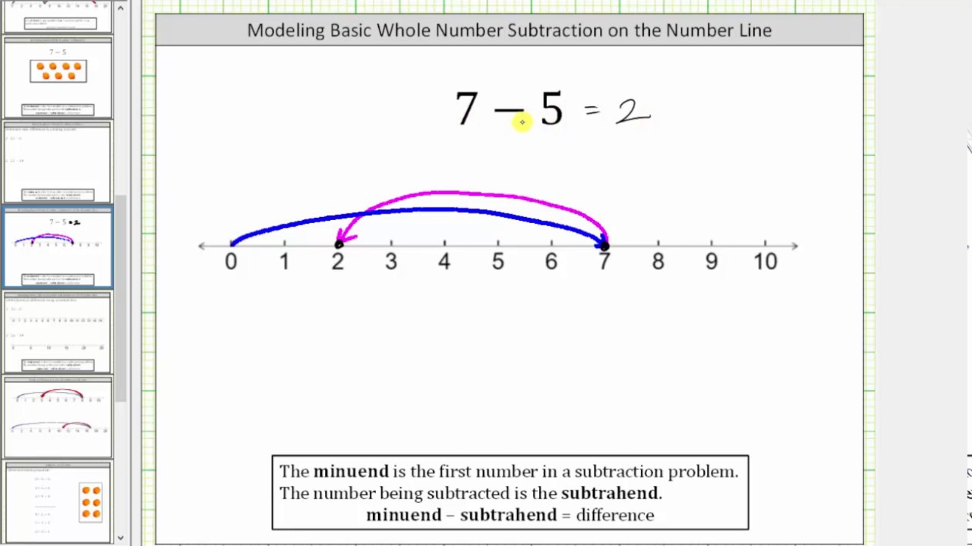
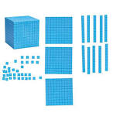
YEAR 1 and 2 - Now is your chance to show off all of the skills you have learnt to solve subtraction problems. Remember you can count backwards/count on by drawing a number line/you can partition into hundreds/tens/units drawing the dienes (chips and peas). You can have a go at the place value grid form yesterday.
Place Value
Grid
Read the question carefully so that you understand it.eahe Underline any important words or numbers
Choose the operation (+ - x or ÷)
Solve the calculation using a mental or written
method that you have been taught
Answer the question in its context
Check your working out
Number line
Dienes that you can draw (chips and peas)
Reception – Can you have a go at one of the maths activities at the beginning of this powerpoint.

Slide 8
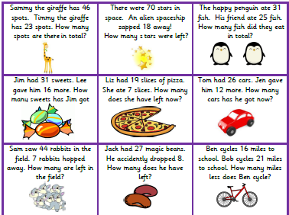
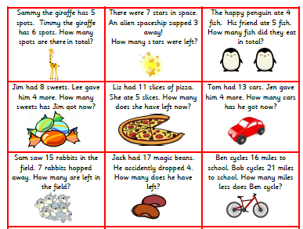
.
Red Challenge
Amber Challenge

Slide 9
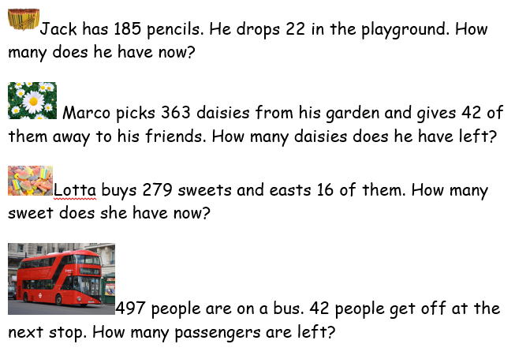
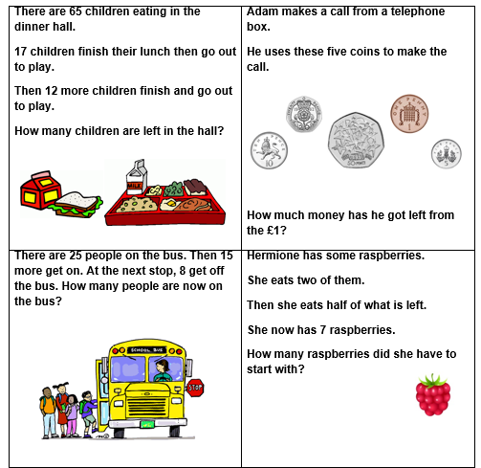
Green Challenge
Extension – These word problems involve 2 steps.

Slide 10
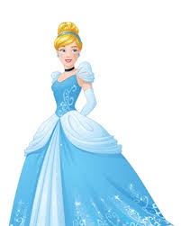

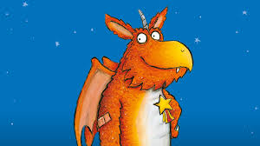
English Learning Objective To write a character description.
What is a Character?
Can you name any of your favourite characters?

Slide 11
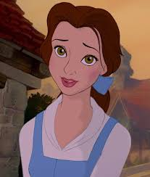
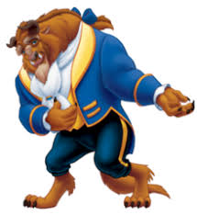
Appearance
Brown hair
Blue dress
Blue bow
Large eyes
Beautiful
Characteristics
Soft
Kind
Happy
Friendly
Appearance
Fur
Horns
Fangs
Claws
Characteristics
Fearsome
Angry
Scared
powerful

Slide 12
Reception – Draw your favourite character from a story. Have a go at writing words, (using your phonic knowledge to sound them out), or sentences to describe them.
YEAR1/2 Decide on your favourite character from a book. Draw a picture and write words to remind you of their appearance and characteristics. Now write a description of them. Read your description to your family, can they guess which character you are describing ?

Slide 13
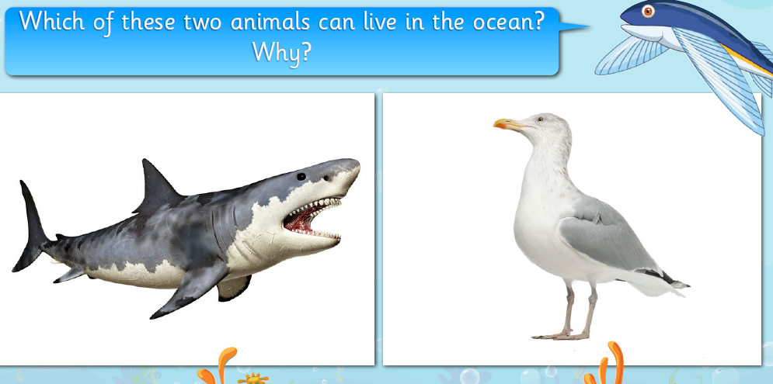
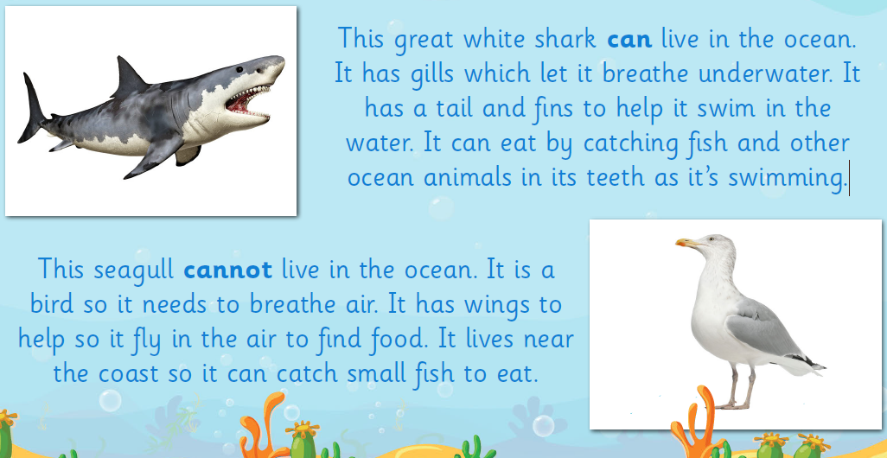
SCIENCE – Learning Objective To understand how ocean animals are suited to their habitat.

Slide 14
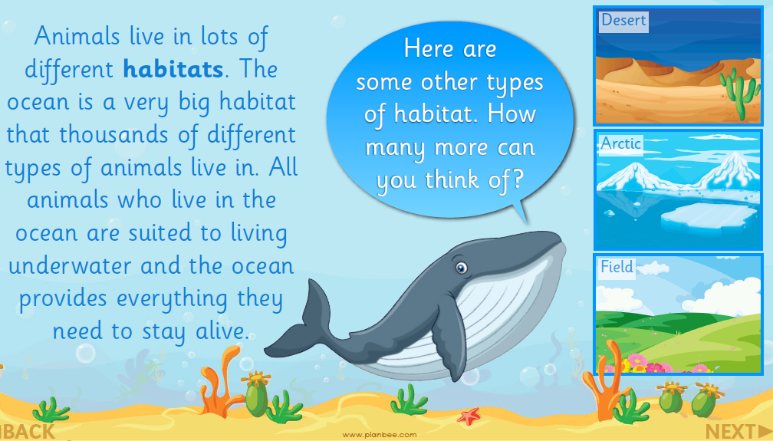

Slide 15
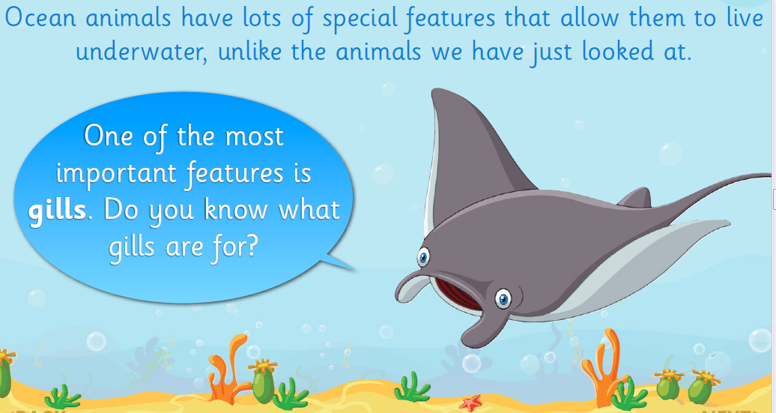
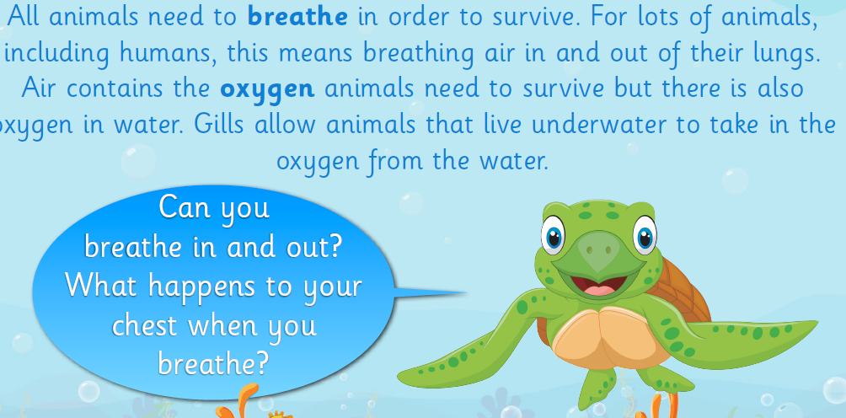

Slide 16
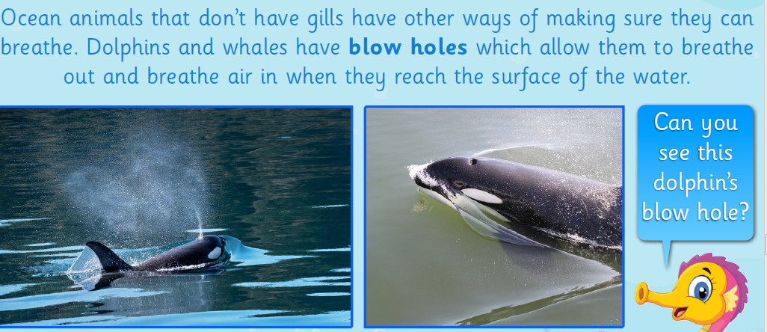

Slide 17
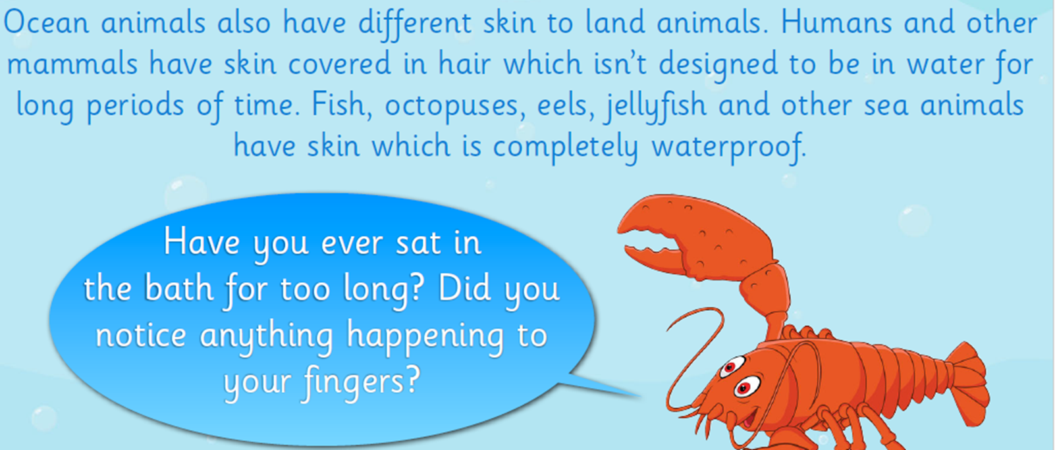

Slide 18
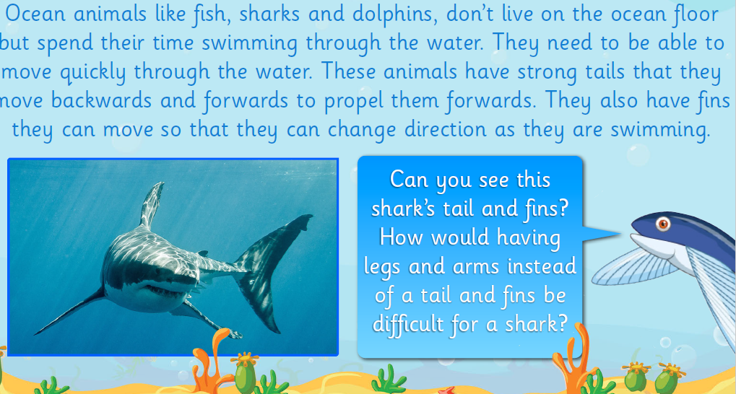
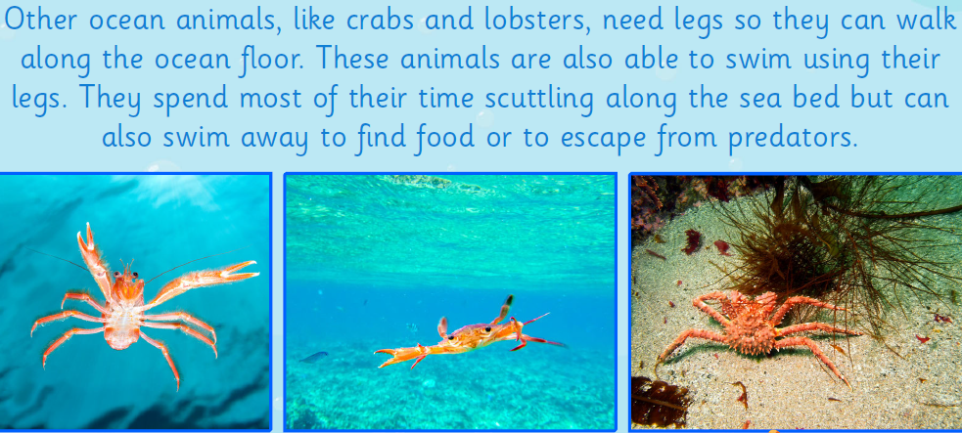
How are octopuses suited to their habitat?
How does it breathe under water?
How is it able to move in the water?
What is its skin like?

Slide 19
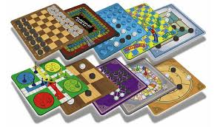
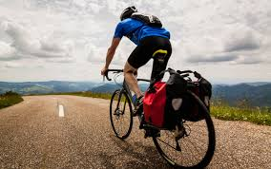

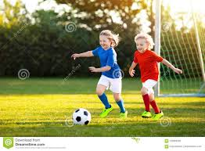
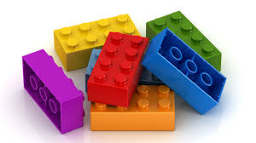
Its Friday!!! Time for some golden time. Thank you for all of your hard work. Have a nice weekend. Mrs Chisman.

