Slide 1
Monday March 23rd 2020 OWLS LEARNING
Slide 1 – Ideas for hands on learning for reception.
Slides 2-5 Phonics and spelling
Slides 6 to 9 – Maths To compare weight
Slides 9 to 11 – English To create a character. If you click on the link hopefully it will be a video of the story so far to go with the lesson.
Slides 17 – PE Basket Ball
Philosophy – consider the question, ‘How often do you have to be brave to be a brave person?’

Slide 2
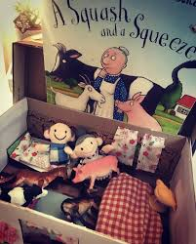
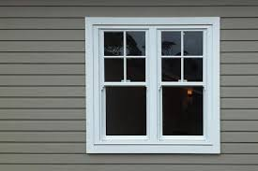
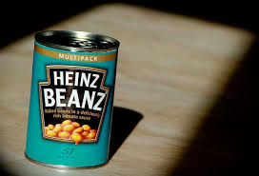
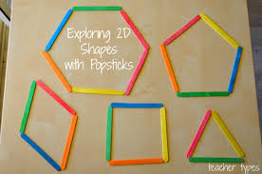
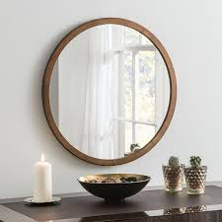
Reception – Here are some great fun suggestions for your child to continue their learning at home.
Explore 2D shapes with
Lollypop sticks or you could go on a nature walk and make shapes from sticks.
Challenge your children to find shapes in your home or out on a walk. Can they name the 2D and 3D shapes. Can they describe them.
You could read a favourite book together then create a box to help your child retell or act out the story. They could have a go at writing their version of the story using their phonics knowledge to help them.
Useful websites
https://www.topmarks.co.uk/
http://www.bbc.co.uk/schools/websites/4_11/site/science.shtml
https://www.bbc.co.uk/cbeebies/shows/alphablocks

Slide 3
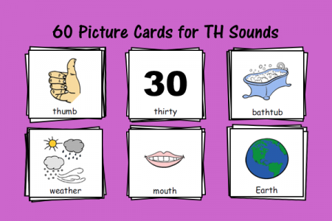
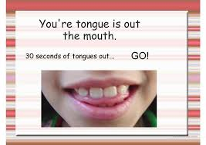
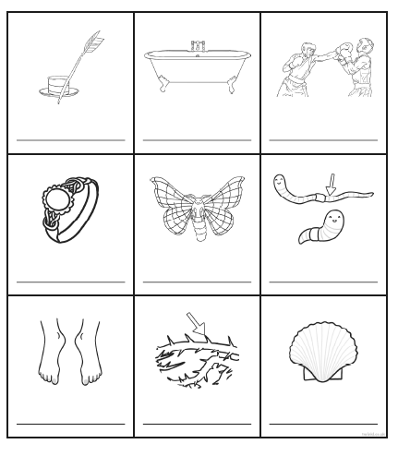
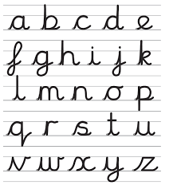
Reception phonics ‘th’ sound.
Can you think of words that have the ‘th’ sound in . Have a go at spelling some and try writing them in a sentence.
.
Which on of these pictures have the ‘th’ sound in? When you find them have a go at writing the word.
Can you practice your letter formation and remember the single sounds you have learnt so far? Perhaps you could have a go at writing the letters with you finger in flour?

Slide 4
Year 1 and 2 phonics
Ways to make the ‘ie’ sound.
Can you sound out the words on this sheet?
Have a go at writing a ‘silly sentence’ using all of these ‘ie’ sounds
For Example
Right I will eat pie on my bike and cry.

Slide 5
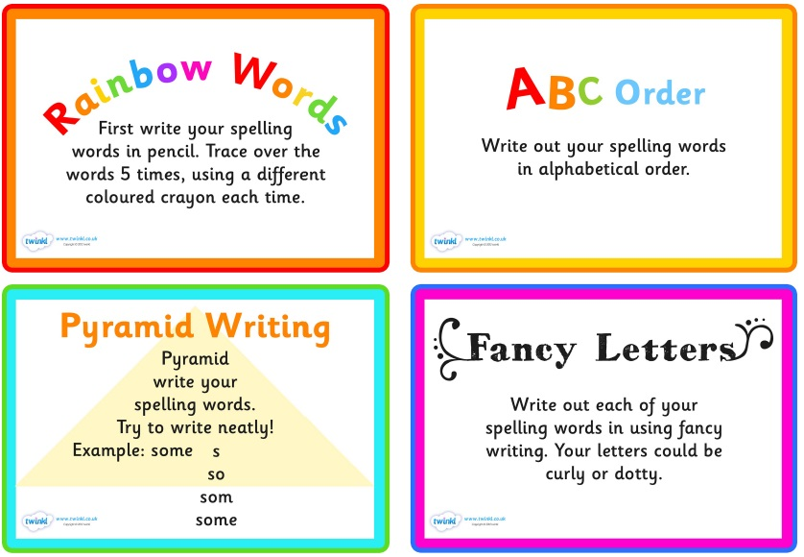
For spelling you can pick 5 to learn each week
Some ideas of fun ways to teach spelling

Slide 6
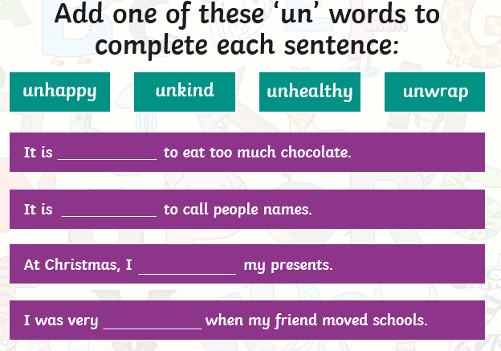
Year 2 Spelling Rule – adding ‘un’ to a word.

Slide 7
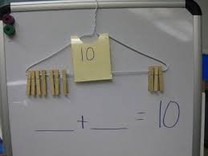
NOTE Year 1 - Number Bonds
Number bonds to ten or twenty are useful when calculating quickly. Once the addition facts, or number bonds, are learnt by heart, children may then learn the associated subtraction facts. For example, if 17 + 3 = 20, then 20 - 3 = 17 or 20 - 17 = 3
WARM UP 10 times tables for year 2. Look at the link below for a song to help
Reception Counting songs, there were 10 in the bed, 10 fat sausages.
Number bonds to 10 or 20 if secure with number bonds to 10) for year 1.
https://www.youtube.com/watch?v=8g6EJX_qLSU
A song to support learning 10 times tables
https://www.youtube.com/watch?v=GyK8iEO5-GI A great song for recapping number bonds to 10.

Slide 8
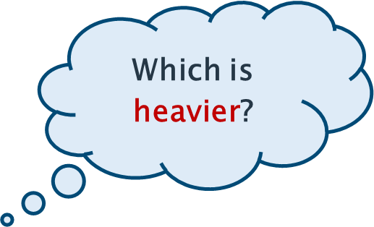
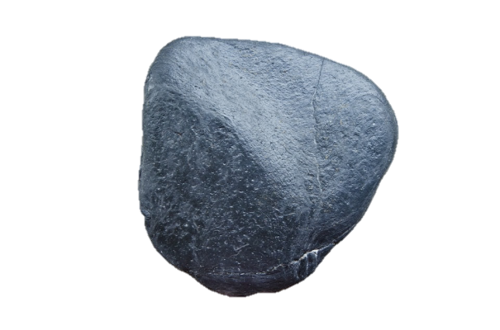
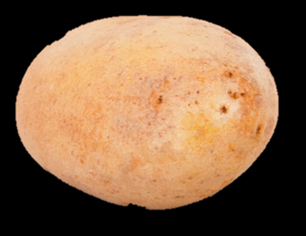
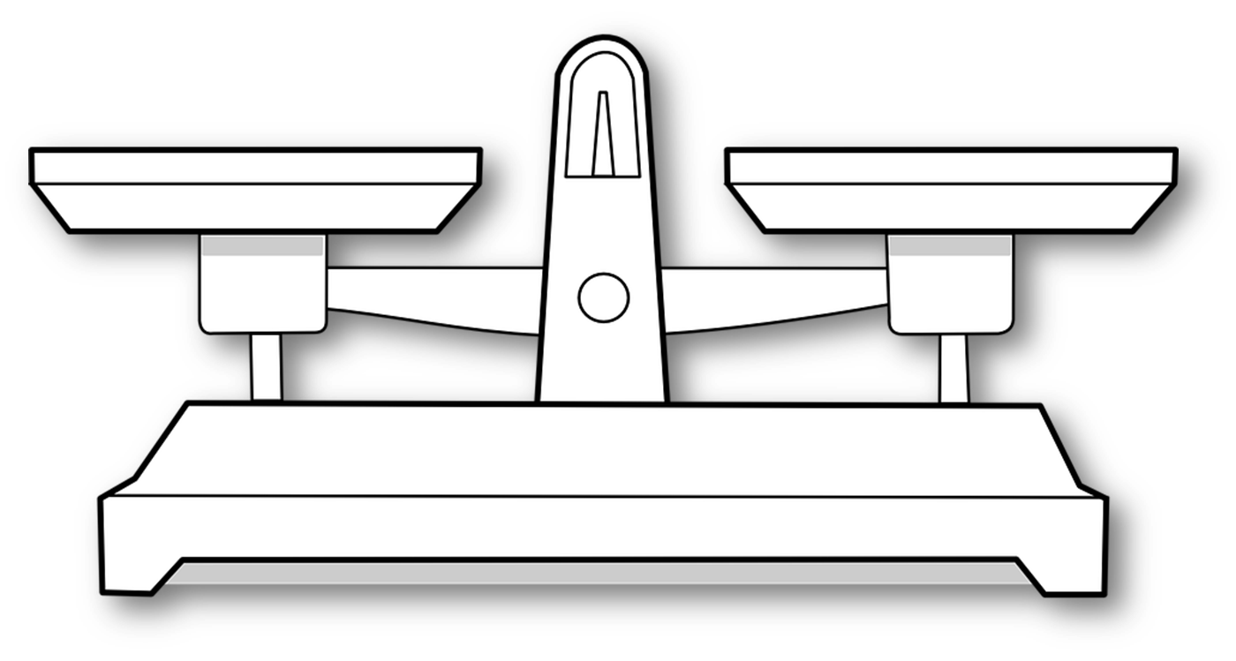
Learning Objective – To compare weight.
The scales act like a see-saw. The heavier object goes down while the lighter object goes up!
Find 2 objects and hold them a balance scale can you decide which arm would go up and which would go down? Which is lighter and which is heavier?

Slide 9
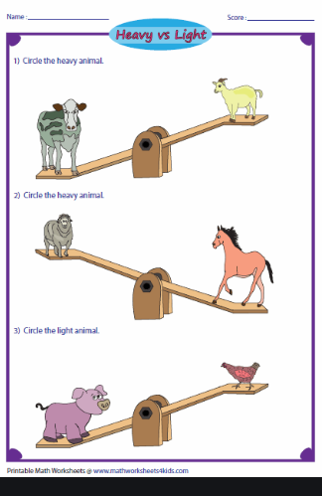
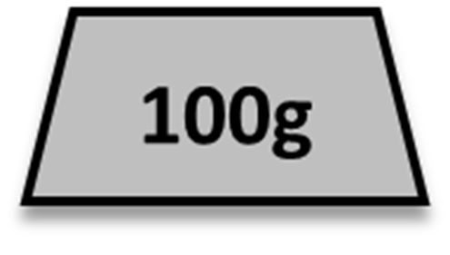
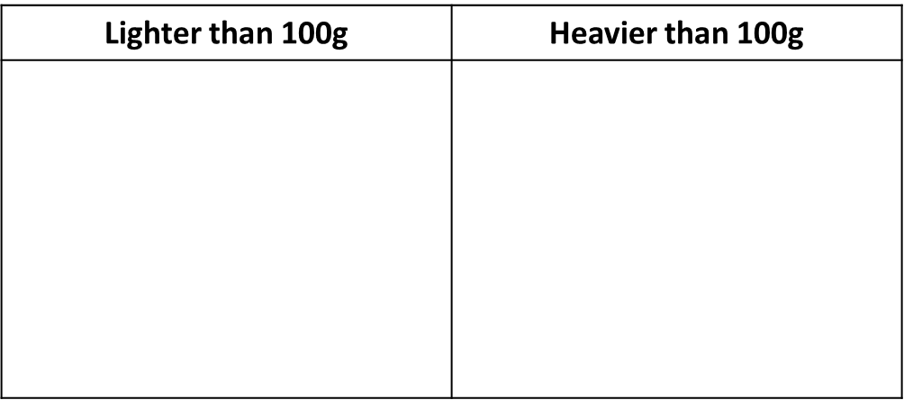
https://pbskids.org/peg/games/happy-camel You can use this game to
practise using your weighing skills
If you do not have scales have a look at the next slide and
sort those objects..

Slide 10
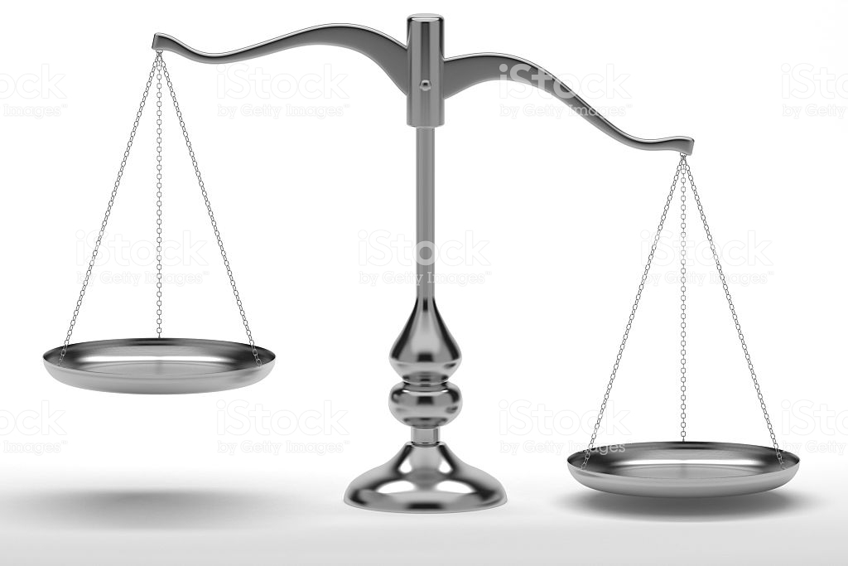
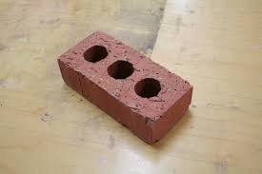
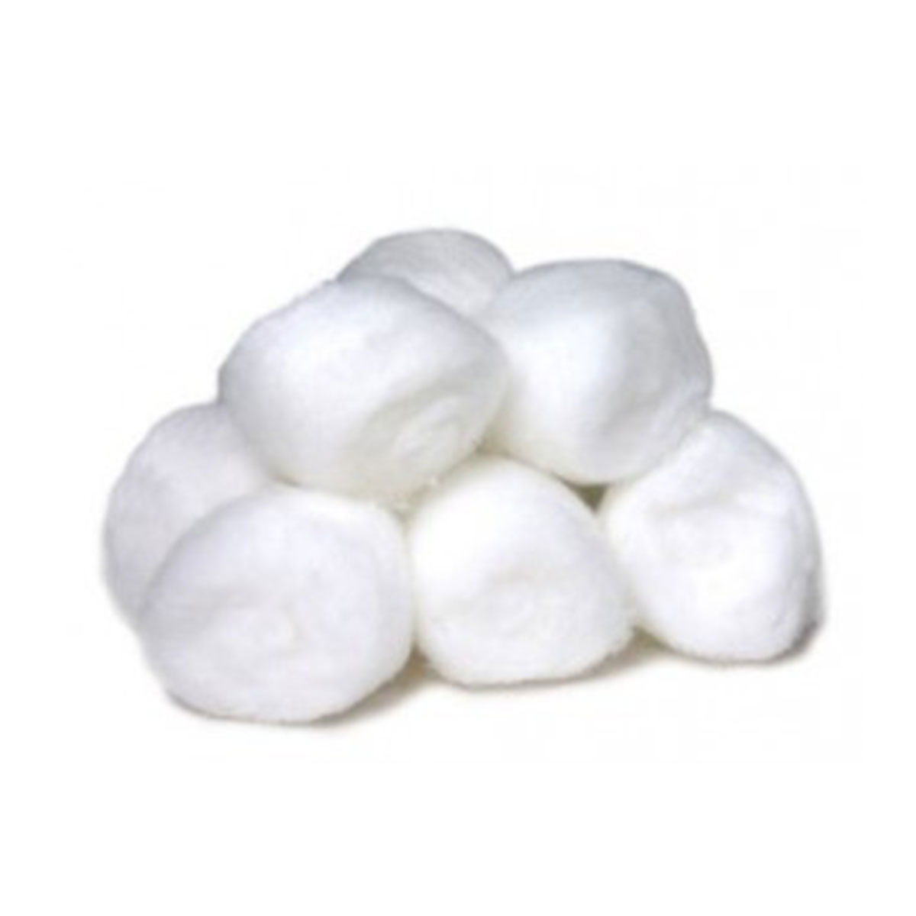
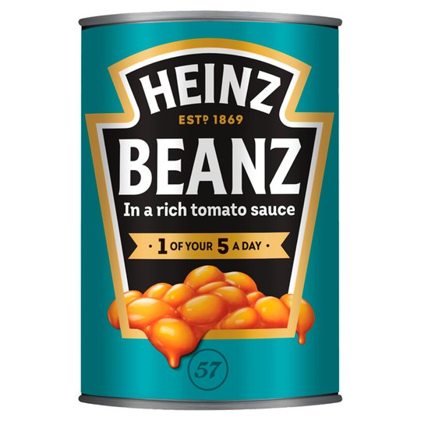
Extension –Is this correct? Can you explain why?

Slide 11
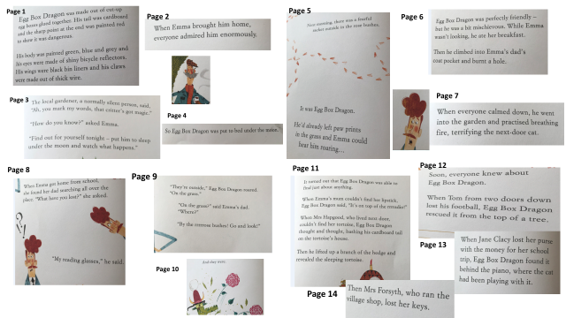
English Learning Objective To create your own character
Red the story of The Adventures of the Egg box Dragon so far below.

Slide 12
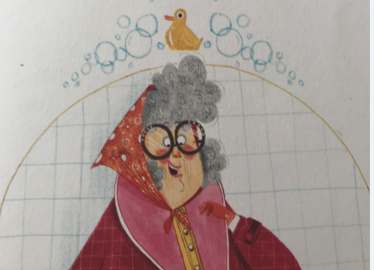
I hope you are enjoying the story so far.
Your task for today is to imagine you are a new character in the story. You can decide how old you are, What you like to do (for fun or for a job depending on your age.) Think about your name, what you look like and what item you might have lost. Have a go at role playing, being your character and explaining to someone what you have lost and how you feel about it. Note down your ideas as tomorrow you will be writing a letter to The Egg Box Dragon asking for his help to find your item.
You can draw a picture of your character and write all of the useful information around the edge. (For example he is 10 years old/ loves football.)

Slide 13
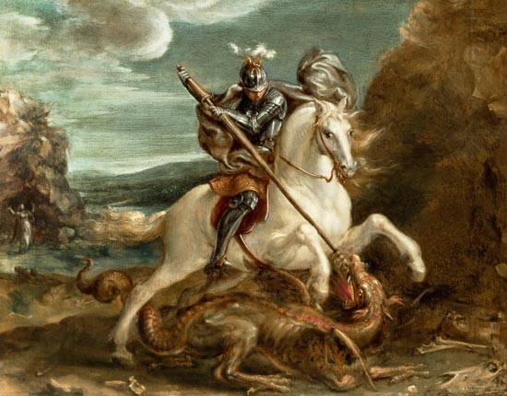
PE – In PE we have been learning the skills to play basketball. If you have access to a ball you could go out into the garden and practise your dribbling skills. If you do not have a ball why not try the Yoga linked on Gooderstone’s Facebook page. https://www.youtube.com/watch?v=iHoErQuFw_4&safe=active&fbclid=IwAR2p_gk245EEHDlPDbPu4f9TqObHIxUZCyypPxTgCoNXxKWC0bhdZ5N_3Bg
Philosophy
Children are often told they are brave in a range of circumstances – when they are hurt, when they visit the dentist, when they do something for the first time but can you answer the question ‘how often do you have to be brave to be a brave person?’

