Slide 1
Tuesday March 24th 2020 OWLS LEARNING
Slide 1 – Ideas to support hands on learning for Reception
Slide 2,3 and 4 – Phonics and spellings
Slide 5 – Using a question mark
Slide 6 – Arithmetic
Slides 7,8,9 and 10 – Maths
Slide 11,12 and 13 – English
Slide 14 History
Slide 15 - PSHE

Slide 2
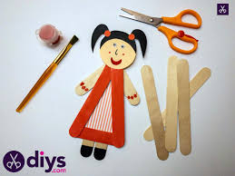
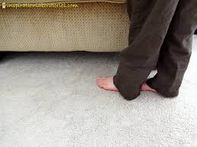
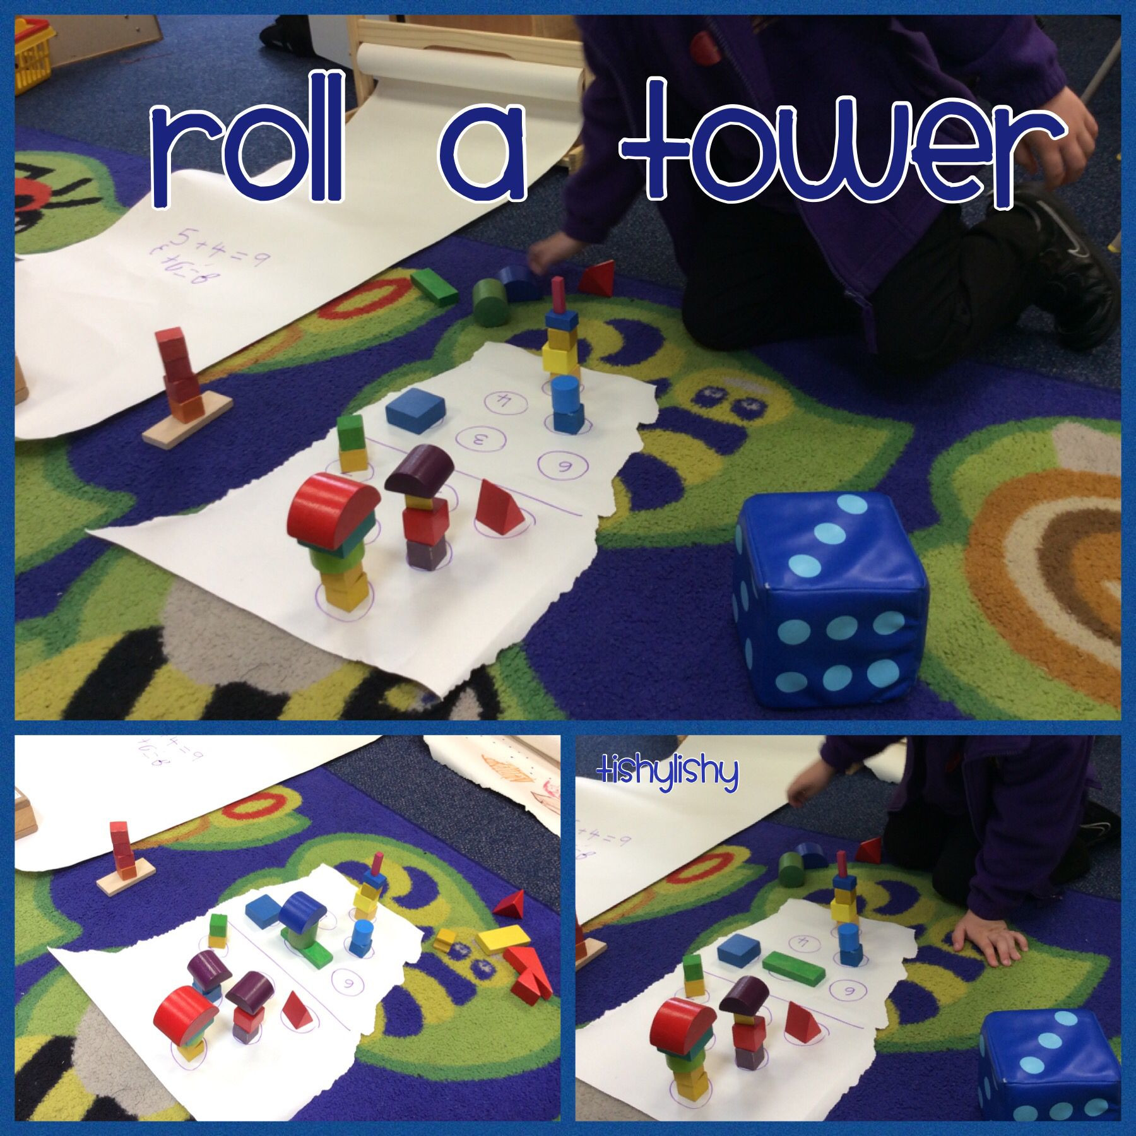
Reception – Here are some great fun suggestions for your child to continue their learning at home.
You could make puppets and have a go at putting on a show. You could retell one of your favourite stories or make up your own.
Roll the dice and stack the cubes, you could challenge yourself by using 2 dice.
Measure objects around the house by using footsteps. Can you find out how many feet tall the members of your family are.
Useful websites
https://www.topmarks.co.uk/
http://www.bbc.co.uk/schools/websites/4_11/site/science.shtml
https://www.bbc.co.uk/cbeebies/shows/alphablocks

Slide 3
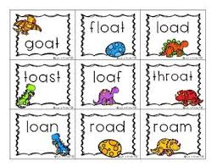
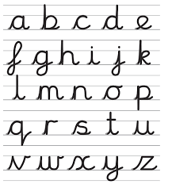
Reception phonics ‘oa’ sound.
Can you think of words that have the ‘oa’ sound in . Have a go at spelling some and try writing them in a sentence.
.
Can you practice your letter formation and remember the single sounds you have learnt so far? Perhaps you could have a go at writing the letters with paint?

Slide 4
Year 1 and 2 phonics
Ways to make the ‘oa’ sound.
Can you sound out the words on this sheet?
Have a go at spelling them and using them in sentences.
Use the phonics play website and play some phonics games to support your learning.

Slide 5
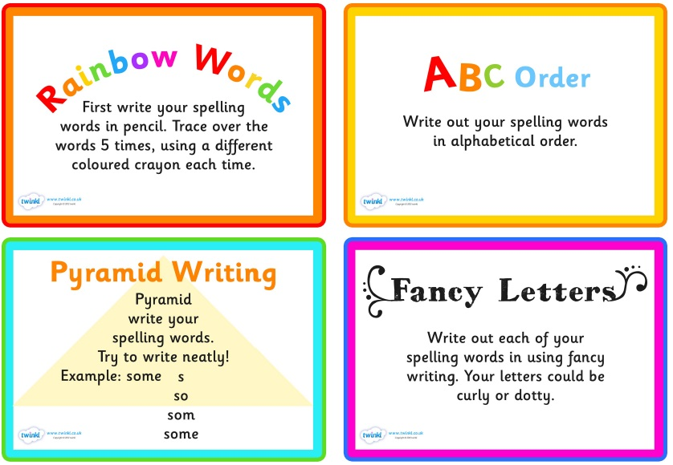
For spelling you can pick 5 to learn each week
Some ideas of fun ways to teach spelling

Slide 6
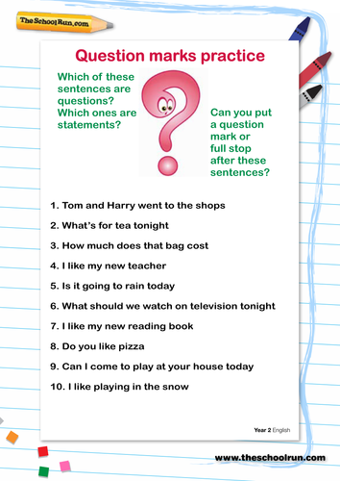
Year 1 and 2 grammar - Using a Question mark
Extension-
Now write 3 questions to ask someone in your family.

Slide 7
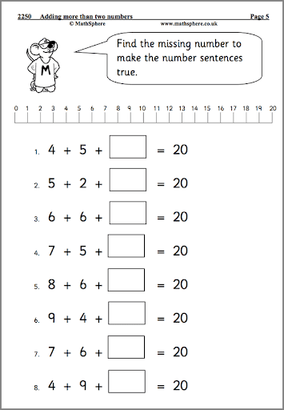
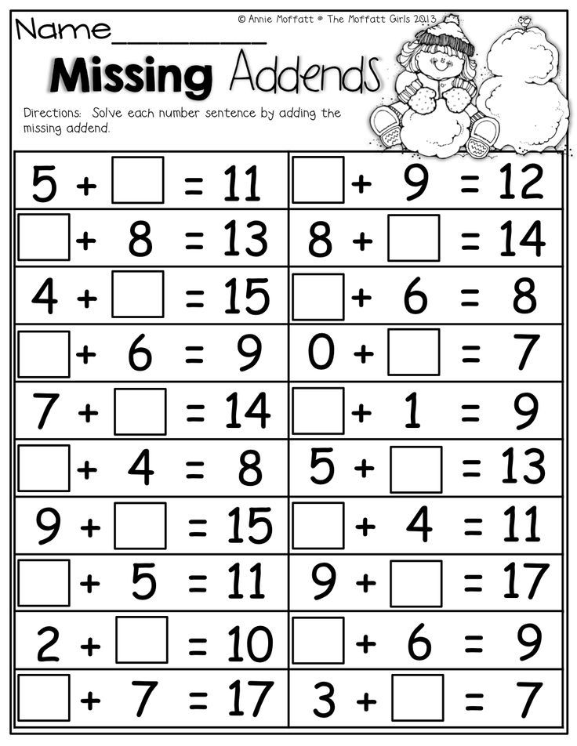
Year 2 Mental Arithmetic
WARM UP FOR ALL YEAR GROUPS Pick up a handful of small objects (beads, counters, pennies, it does not matter what it is) drop them on the table, can you estimate how many are there. Count them. Are you correct? Now try it again, do you think you have more or less than last time?
YEAR 1 mental arithmetic
Mental arithmetic

Slide 8
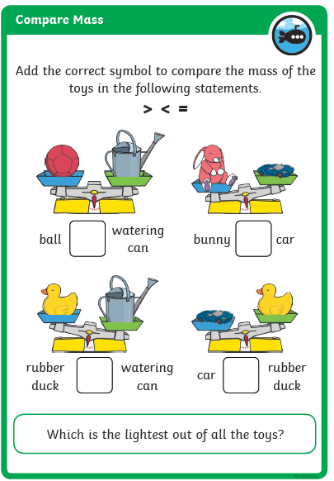
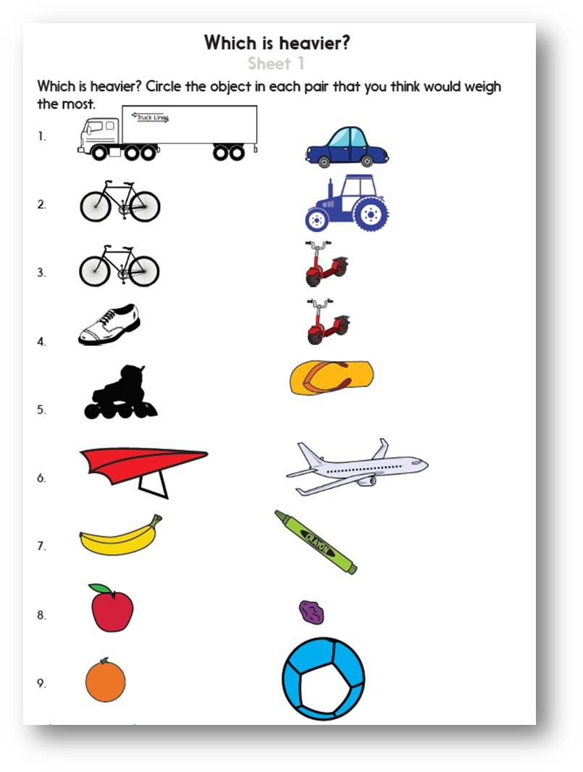
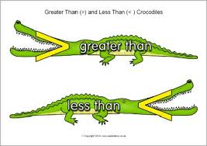
Learning Objective – Know that weight can be measured in kg and g.
To recap yesterdays learning can you decide which one of these objects is heavier.

Slide 9
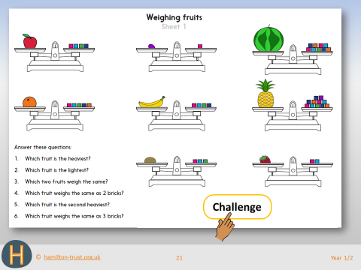
You can measure objects by using non-standard units like cubes or marbles.
These pieces of fruit are being weighed using cubes.
If the scales balance then you can work how many cubes they weigh.
For example the apple weighs the same as 4 cubes.
Have a go at these questions using the pictures to help you.

Slide 10
If you have access to some kitchen scales you could explore weighing further by seeing how much objects weigh. Can you estimate before finding out?

Slide 11
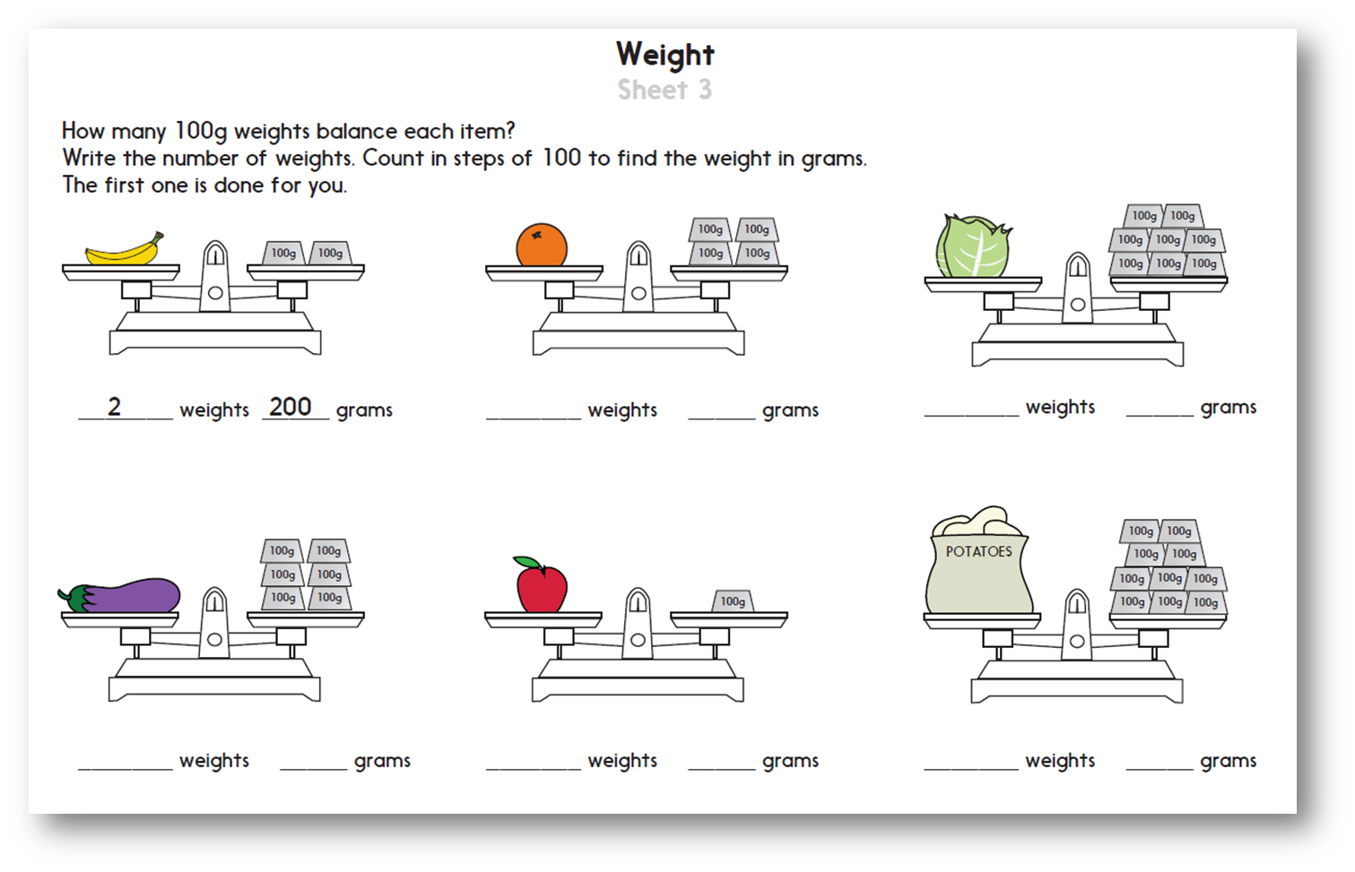

Slide 12
English Learning Objective To Understand the features of a letter.
What is the purpose of a letter?
Why do we use them?
What does a letter need?

Slide 13
Ist Paragraph….
Why are you writing to them...”I am writing to you to because…..”
Explain who YOU are….
Be polite! “I hope you don’t mind me writing to you but I had tell you about..”
You could ask them a question. “What do you like doing in your spare time?”
You can have more than one paragraph
Don’t make one enormous paragraph
Use conjunctions (and, but, so, therefore, because)
Do you have a letter at home you could look at? Can you find any of these features?
Signing off..
If you know them personally - Yours sincerely
If you don’t know them - Yours faithfully
Informal letters - From

Slide 14
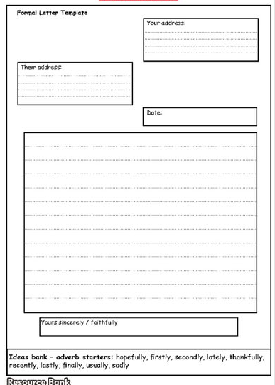
Your task. Tomorrow you are going to write a formal letter to The Egg Box Dragon from the character you created yesterday, asking him for his help to find the item you have lost.
Today I would like you to plan your letter. Note down words and phrases you will include, think of any questions you might ask him and make up an address you are sending the letter to.

Slide 15
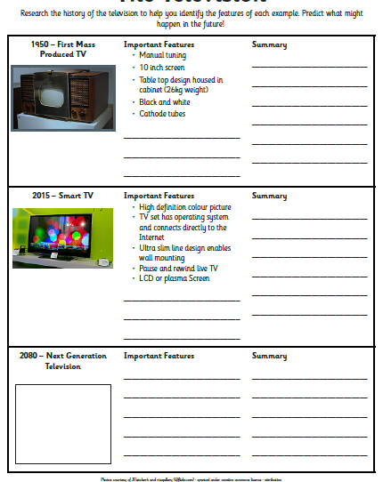
History – We have been learning about televisions and how they have changed overtime. We have considered what life would have been like without television and decided if we would prefer to have lived before it was invented or now.
Today I would like you to design a television for the future. Think about how they have already changed since they were invented and what new features they might have in the future.

Slide 16
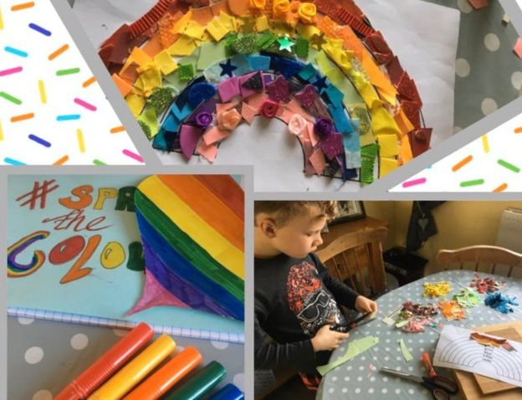
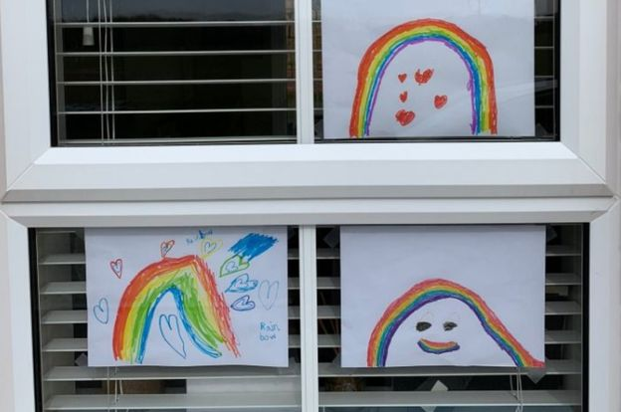
PSHE – Help spread a little bit of cheer and happiness by designing a rainbow and putting it up in your window.

