Slide 1
Wednesday 25th March 2020 – Owls home learning
Please find the suggested learning for Owls today. This is only a guide, so if your child decides they really want to learn about something else then that is fine. My children want to learn about Africa so we are doing some African masks, finding Africa on the map, talking about its climate and the similarities and difference between here and there. Creating landscape paintings and animal drawings. We are going to have a go at some SWAHILI and writing some descriptions of the animals and stories that can be set in Africa.
Remember to remind yourself you are doing an amazing job and most importantly don’t forget to have fun!

Slide 2
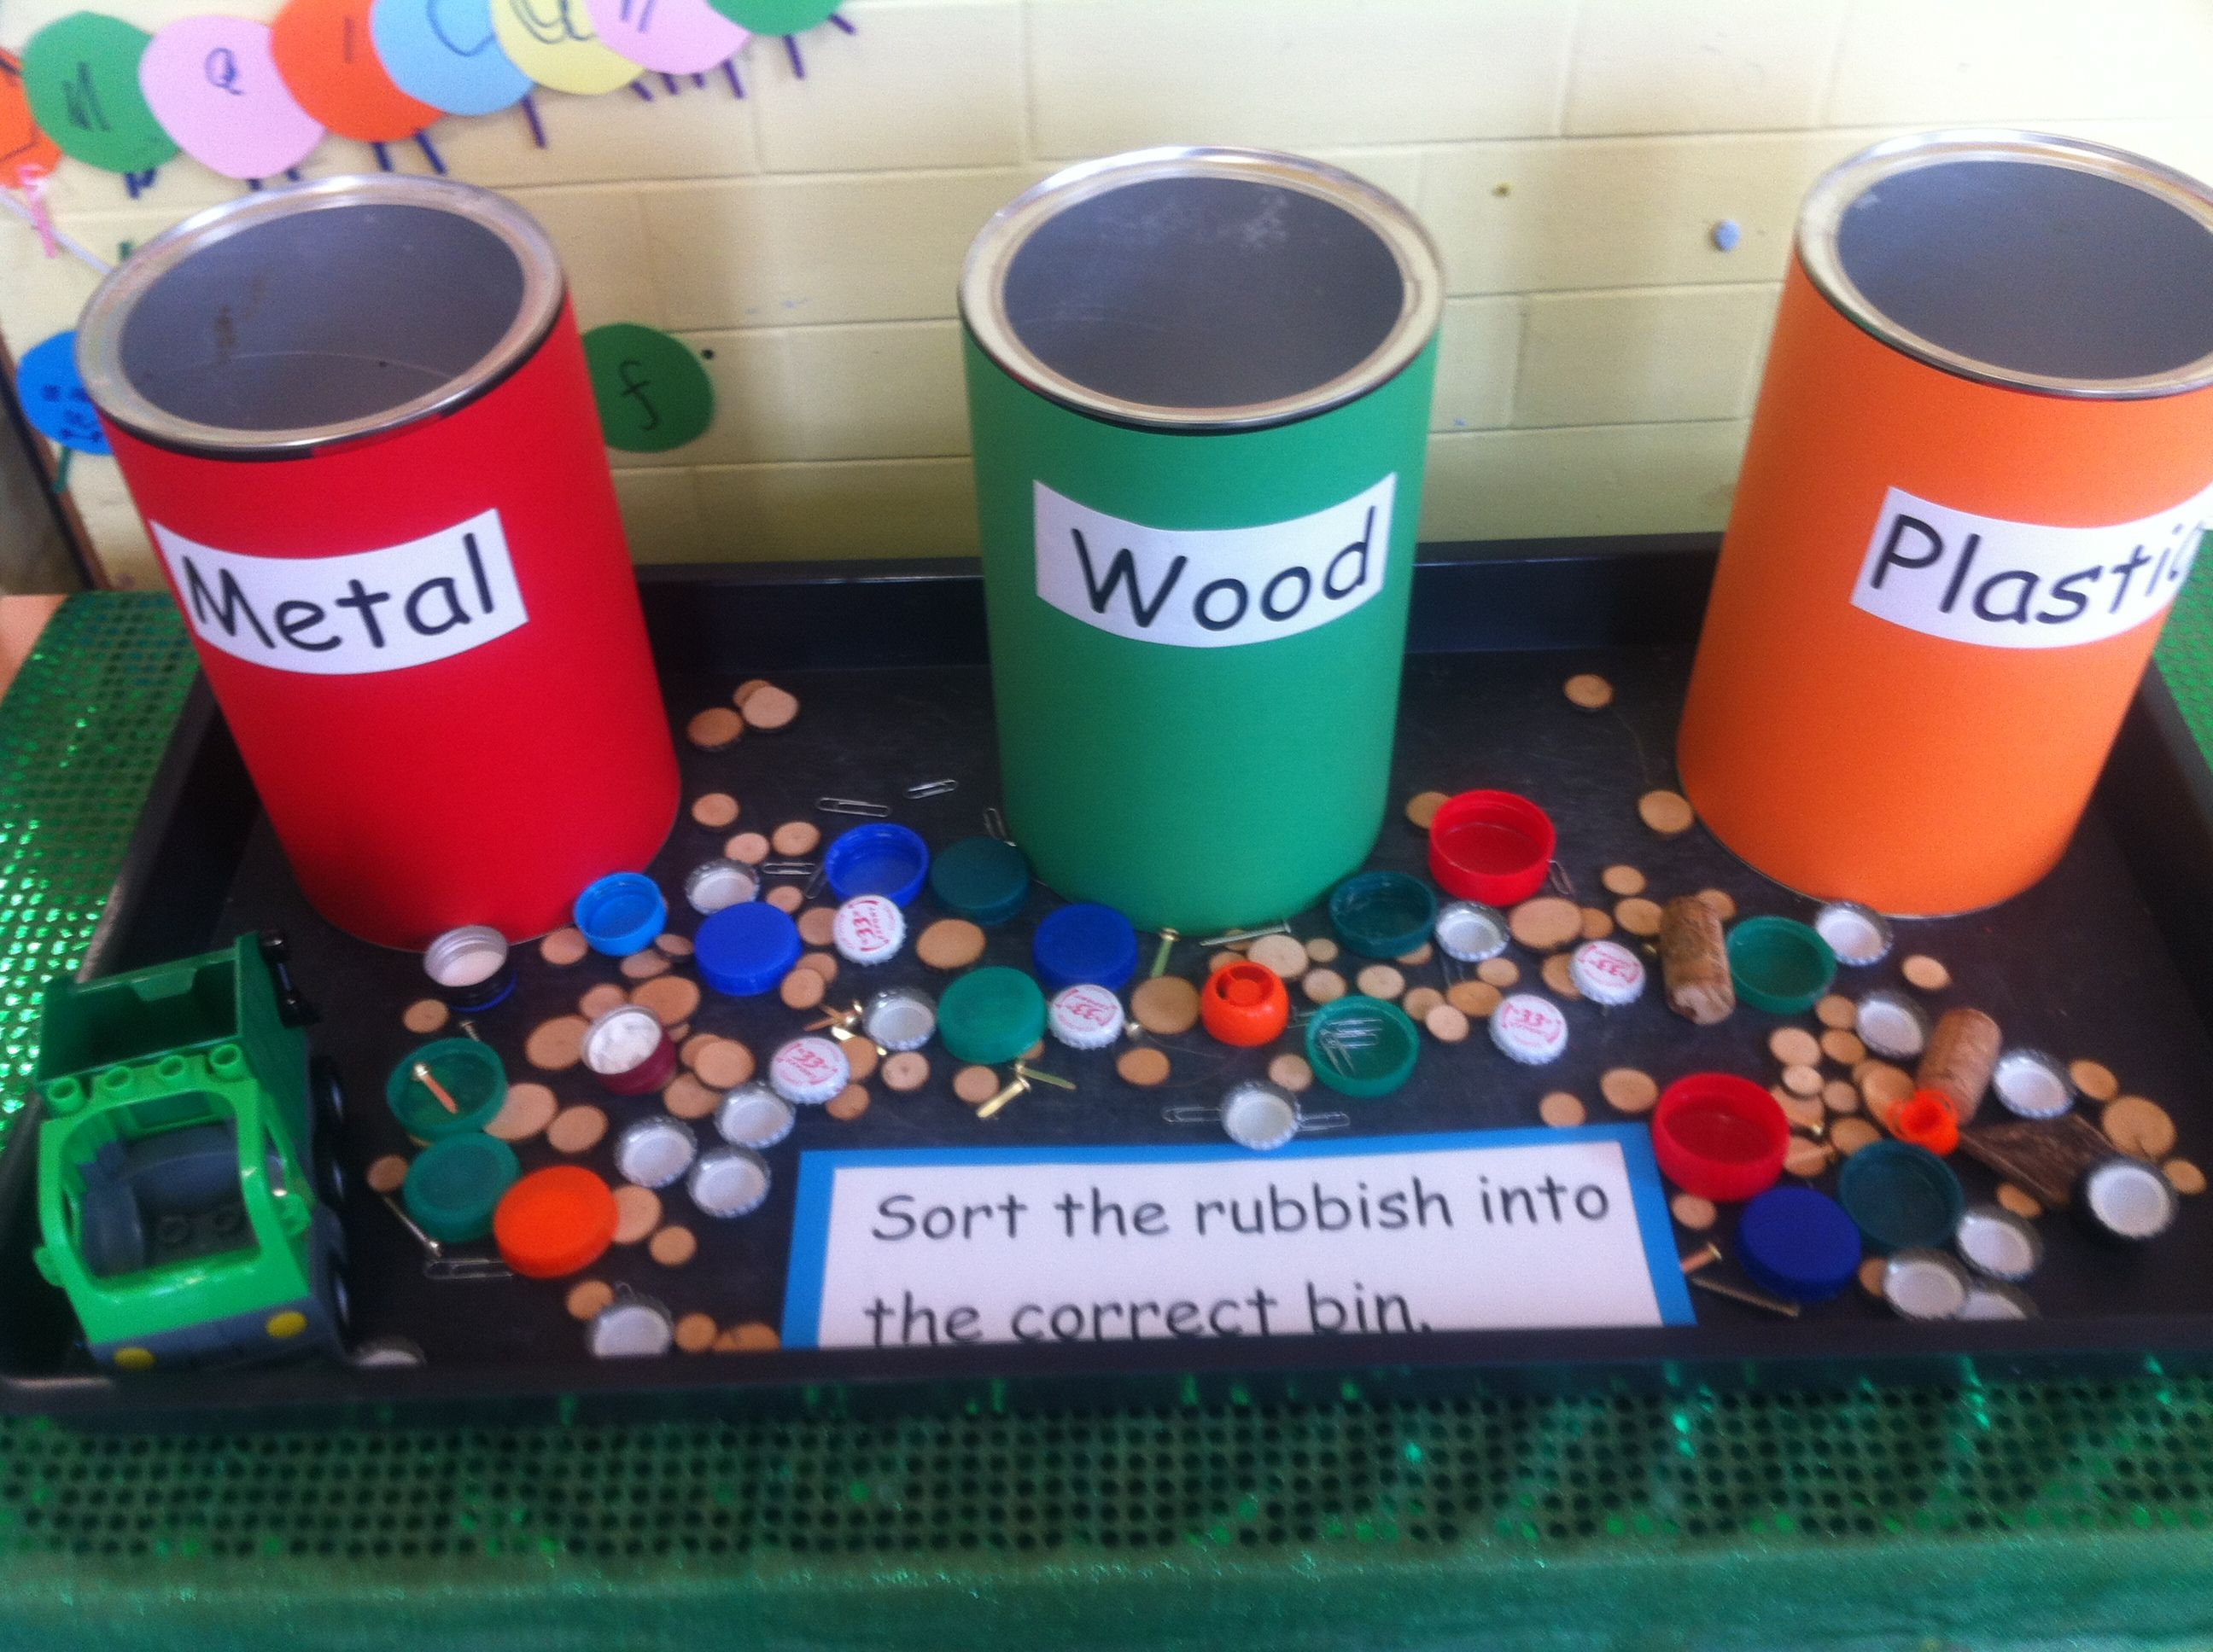
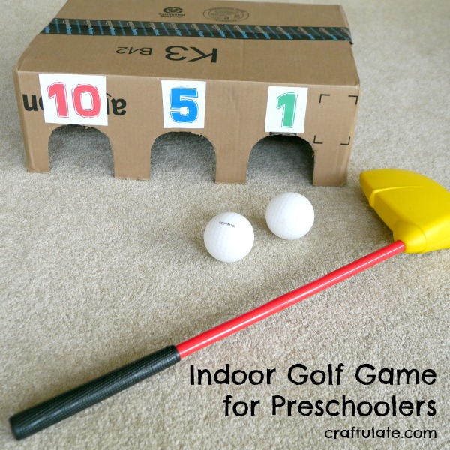
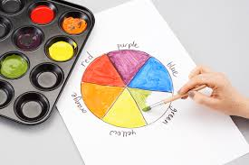
Reception – Here are some great fun suggestions for your child to continue their learning at home.
Sorting activity to support understanding materials. You could also talk about recycling!
You could make this together. It is good for target practise but also you could
add your total score. If you don’t have a golf club you could bowl the balls into the holes.
Have a go at some colour mixing. Talk about the primary colours. You could paint a spring flower using the colours you have mixed.
Useful websites
https://www.topmarks.co.uk/
http://www.bbc.co.uk/schools/websites/4_11/site/science.shtml
https://www.bbc.co.uk/cbeebies/shows/alphablocks

Slide 3
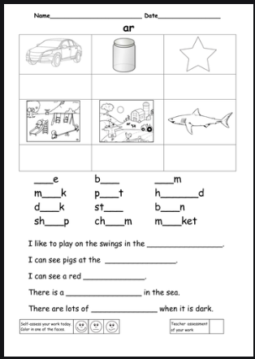
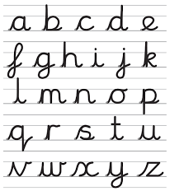
Reception phonics ‘ar’ sound.
Can you think of words that have the ‘ar’ sound in . Have a go at spelling some and try writing them in a sentence.
Can you practice your letter formation and remember the single sounds you have learnt so far? Perhaps you could have a go at writing the letters with paint?

Slide 4
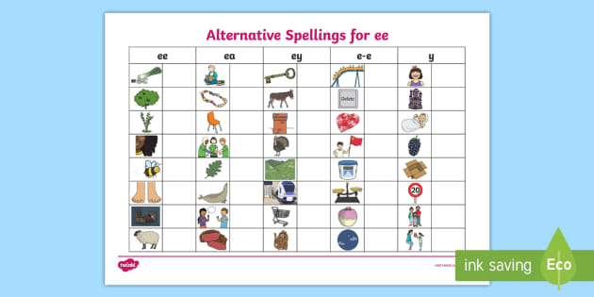
Year 1 and 2 phonics
Ways to make the ‘ee’ sound.
Can you sound out the words on this sheet?
Have a go at spelling them and using them in sentences.
Use the phonics play website and play some phonics games to support your learning.

Slide 5
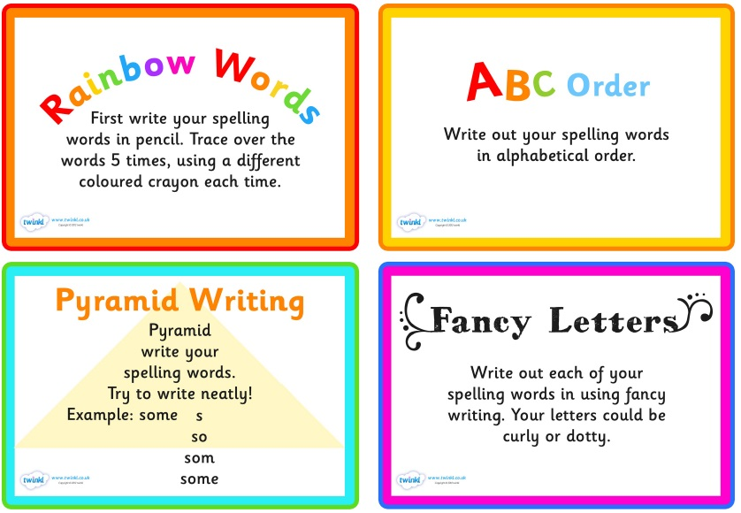
For spelling you can pick 5 to learn each week
Some ideas of fun ways to teach spelling

Slide 6
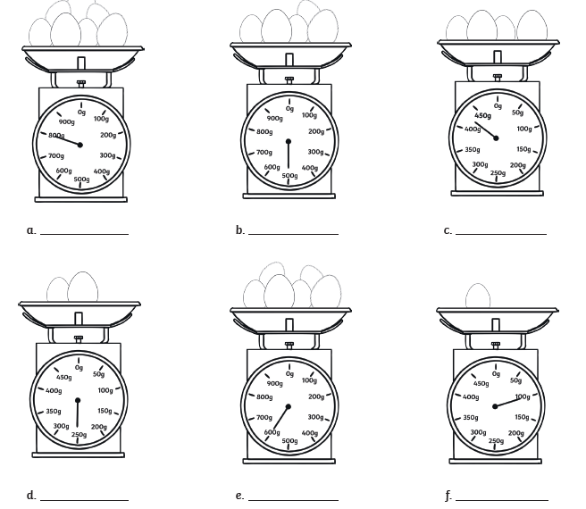
Year 1 and 2 - Can you work out in grams how much these eggs weigh? Can you put them in order from heaviest to lightest?
This is a fun weighing game you can play.
https://www.ictgames.com/mobilePage/mostlyPostie/index.html
Some interactive scales.
https://www.teacherled.com/iresources/scales/mass/

Slide 7
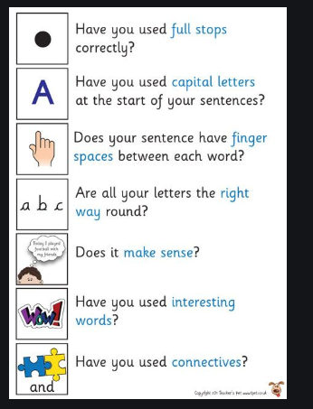
English – Using the plan you made yesterday write a letter to the Egg Box Dragon asking him to help you find an item you have lost.
Remember to include the features of the letter you learnt yesterday
Your Address
Their Address
Dear or To
Introduce yourself
Be polite
Can you ask him some questions ?
Can you write more than one paragraph?

Slide 8
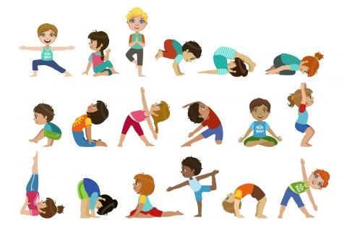
https://www.youtube.com/watch?v=iHoErQuFw_4
To help you stay active you could try some yoga. Ask the family to join you!

