Slide 1
Cedar class - 23rd March 2020
Timetable
Spelling – ‘ch’ or ‘tch’
Maths: converting pounds and pence, Ordering amounts of money.
Brain break!
English: to begin to write a poem.
Arithmetic: 3 times table skills.
Brain break!
History: investigating features of an Anglo-Saxon house
Art/English: illustrating our reading books.

Slide 2
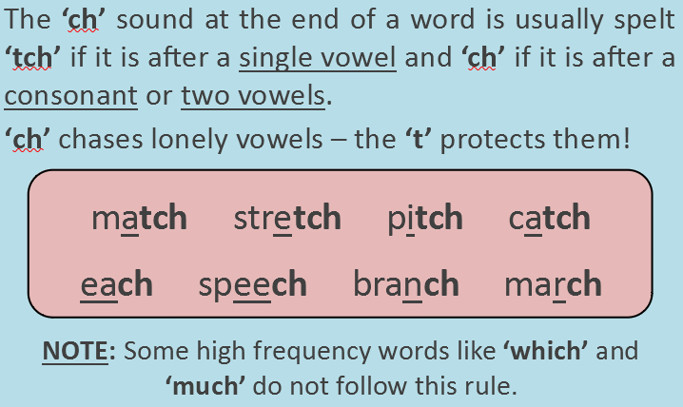
Spellings
Write a list of words which follow this rule: either ending in ch or tch.
Don’t forget, the ‘t’ protects lonely vowels!

Slide 3
Maths
LO: to convert pounds and pence and order amounts of money.
Year 3s – choose the challenge level you feel is best for you.
Year 4s – please try the gold challenge first. If you find it too difficult, go back to the silver one.

Slide 4
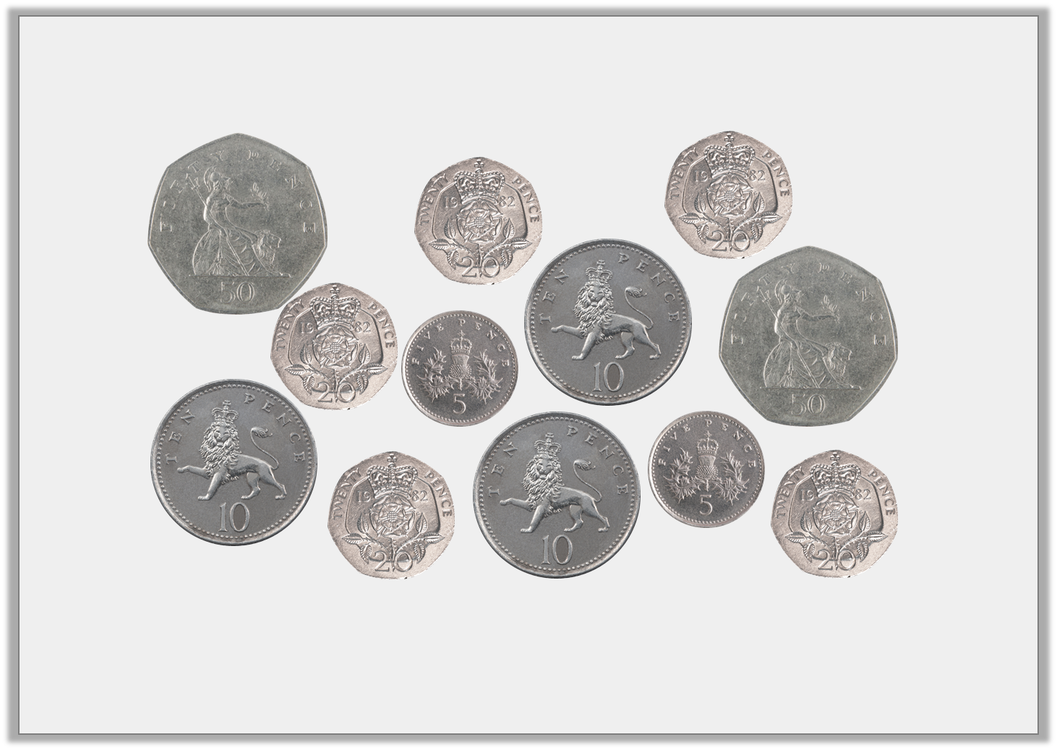
Starter
Find 4 different ways to make £1

Slide 5
Starter
Find 4 different ways to make £1
Various answers, for example:
50p + 50p = £1;
20p + 20p + 20p + 20p + 20p = £1;
50p + 20p + 10p + 10p + 10p = £1;
50p + 20p + 20p + 10p = £1

Slide 7
1p, 2p, 5p, 10p, 20p, 50p, £1, £2
10
2
5
20

Slide 8
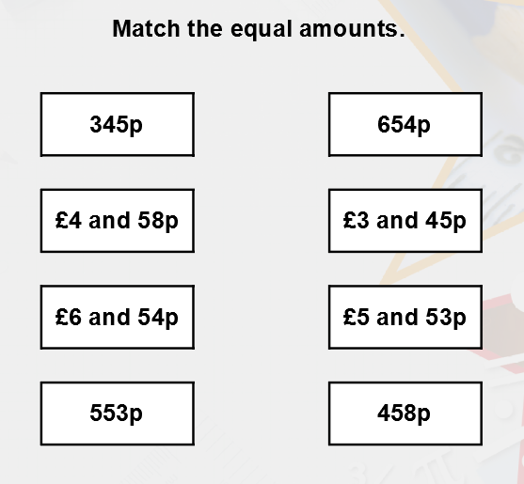
Example questions
100p = £1.
200p = £2
300p = £3
And so on…
To work out how many pounds and pence we have, take the tens and ones: these are your pence.
The hundreds of pence we have can be converted to pounds and then added to the pence.
E.g. 154p. Take the tens and ones – 54p.
We have 100p left – 100p = £1.
£1 + 54p = £1.54p

Slide 9
Example questions

Slide 10
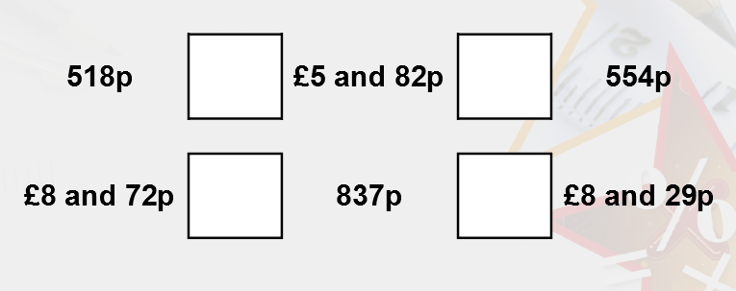
Complete the statements using <, > or =
Don’t forget, to remember what < or > mean, imagine it as a crocodile’s mouth!
The crocodile ALWAYS eats the bigger number!
E.g. 7 > 2

Slide 11
Complete the statements using <, > or =
<
>
>
>
Don’t forget, to remember what < or > mean, imagine it as a crocodile’s mouth!
The crocodile ALWAYS eats the bigger number!
E.g. 7 > 2

Slide 12
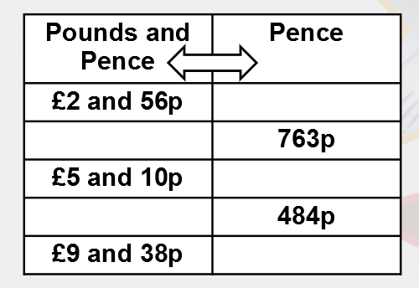
Complete the conversion table
Remember slide 8 and how we convert between pounds and pence, and just pence.

Slide 13
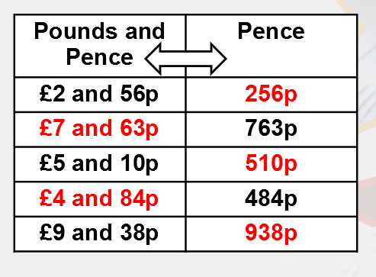
Complete the conversion table
Remember slide 8 and how we convert between pounds and pence, and just pence.

Slide 14
Copy your challenge questions out into your book before solving them.

Slide 15
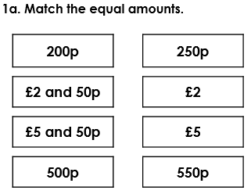
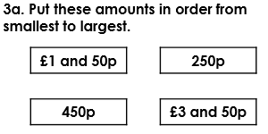
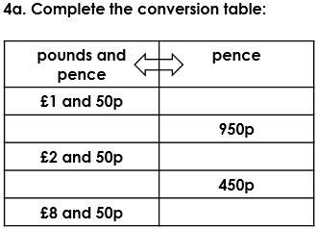
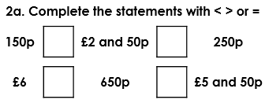
Bronze challenge

Slide 16
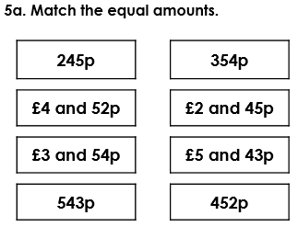
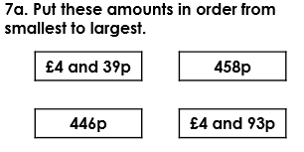
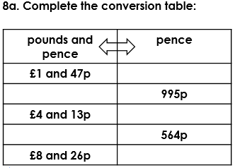
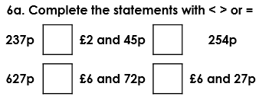
Silver challenge

Slide 17
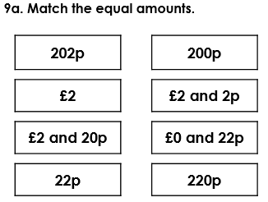
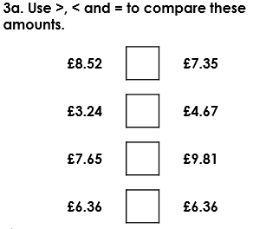
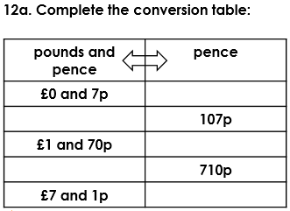
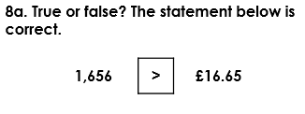
Gold challenge

Slide 18
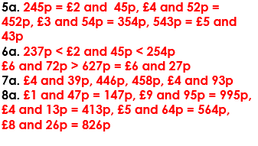
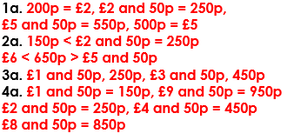
Answers – please mark your work.
Bronze answers
Silver answers
Gold answers

Slide 19
Brain break!

Slide 20
English
LO: to begin to create a poem.
We will be continuing with Arthur’s story in ‘Arthur and the Golden Rope’.
The last time we read, Arthur had captured the sounds of a cat’s footfall and had just climbed the world tree.
A branch had snapped and he was plummeting to the ground!

Slide 21
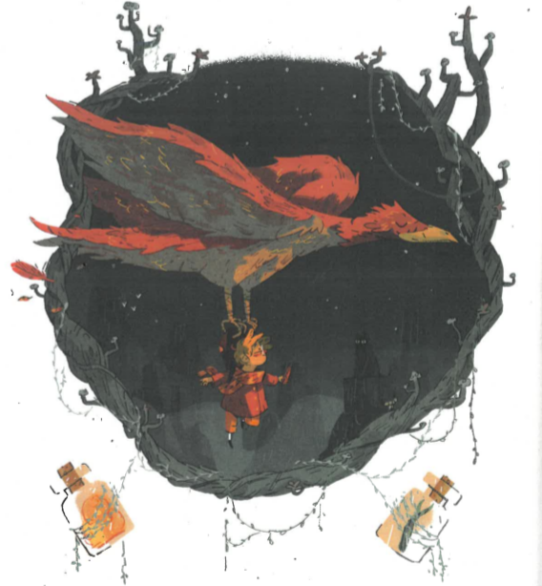

Slide 22
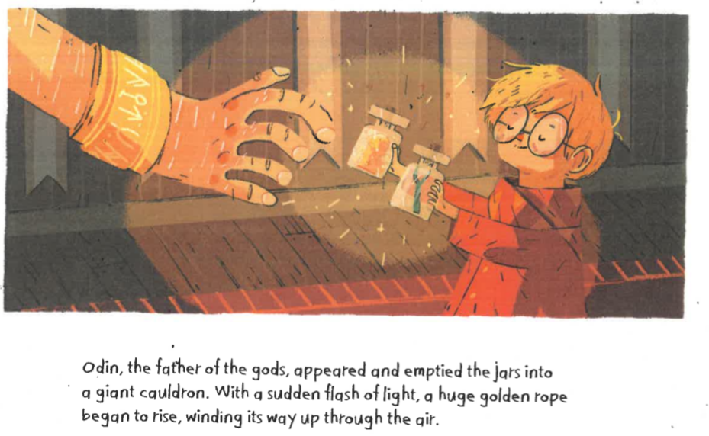

Slide 23
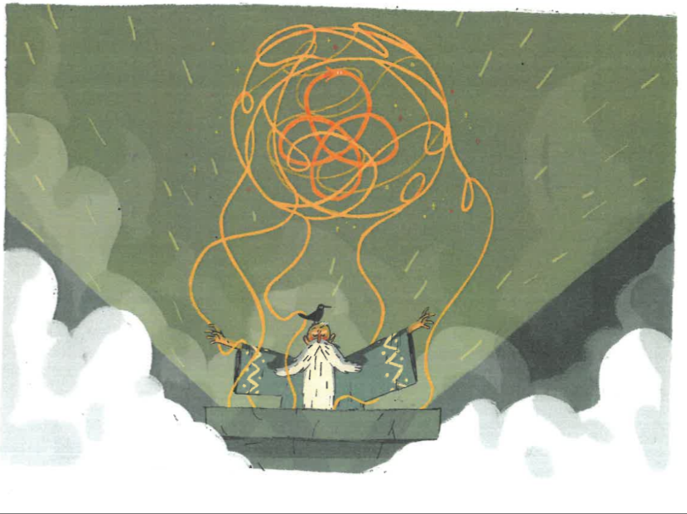
How could you describe the golden rope?
Write some ideas down under your golden rope.
Try and use a wide range of:
Adjectives,
Similes,
Metaphors.
Try for 5 at least.

Slide 24
The golden rope
Can you remember which two ingredients were required to make the golden rope?

Slide 25
The golden rope
Can you remember which two ingredients were required to make the golden rope?
1) The sound of a cat’s footfall,
2) The roots of a mountain.
In the original Norse myth further impossible items were needed to create the rope, including:
1) The breath of a fish,
2) The beard of a woman,
3) Spittle from a bird.

Slide 26
The golden rope
Task:
Can you think of any other impossible items which could be part of the recipe for the golden rope?
Write a subheading ‘Ingredients for Arthur’s Golden Rope’ and write your items down. Try and come up with at least 10. See my example on the next slide for what I am looking for!
Focus on:
Using adjectives, metaphors and similes.
Neat handwriting.
See the next slide for an example of what your book should look like.
We will be using these to create a poem tomorrow, so focus on great detail for your items.

Slide 27
Monday 23rd March 2020
LO: to begin to create a poem.
Descriptions of the golden rope.
Ingredients for Arthur’s golden rope
The pickled toe nails of an evil wizard from the fiery caves under Mount Zarg.
……
……
…...

Slide 28
Arithmetic

Slide 29
Arithmetic
Count in 3s up from the following numbers:
9 – down in 3s. 9, __, __, __.
15 – up in 3s. 15, __, __, __, __, __.
22 – up in 3s. 22, __, __, __, __, __.
122 – up in 3s. 122, __, __, __, __, __.

Slide 30
Arithmetic
Count in 3s up from the following numbers:
9 – down in 3s. 9, 6, 3, 0
15 – up in 3s. 15, 18, 21, 24, 27, 30
22 – up in 3s. 22, 25, 28, 31, 34, 37
122 – up in 3s. 122, 125, 128, 131, 134, 137
Can you see the pattern here?

Slide 31
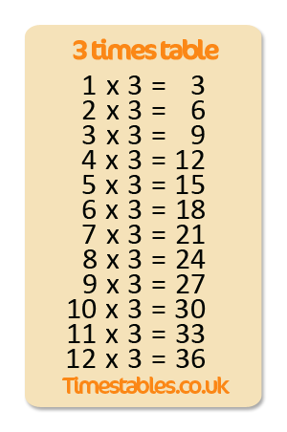
Practise your three times tables out loud.

Slide 32
We are going to focus on using our times tables quickly to solve problems.
Try these, please try and solve them using your mental maths knowledge of your times tables.
Write your answers in your book.
1) 3 X 3 = ?
2) 12 X 3 = ?
3) ? = 8 X 3
4) 9 ÷ 3 = ?
5) ? = 12 ÷ 3
6) 24 ÷ 3 = ?
7) ? ÷ 3 = 1

Slide 33
Brain break!

Slide 34
History
In History we have been studying the Anglo-Saxons and Vikings.
We have been focussing on the Anglo-Saxons over the past few weeks, but so far our lessons have been on what the Anglo-Saxons did in general.
Today, we are going to look at the layout of an Anglo-Saxon home.
You might remember when we did a very similar activity on a stone age house.
At the end of the activity, see if you can write a few sentences comparing and contrasting the Anglo-Saxon home to the stone age home.

Slide 35
The task:
On the next slide there is a bronze level labelling challenge. The slide afterwards has a silver level challenge.
1) Write the LO in your book (LO: to explore the features of an Anglo-Saxon house). Choose your challenge level.
2) If you have access to a printer, you could print the slide out to label the home, if not then do your best to copy the drawing of the Anglo-Saxon home. I want to see how well you can label the home, so don’t worry what the drawing looks like too much!
3) Use the wordbank to label the parts of the home.
4) Try and find and label the smoke hole.
5) Colour the drawing in.
6) Write a few sentences comparing and contrasting the Anglo-Saxon home to a stone age home.
7) Check and mark your work (bronze answers on slide 37, silver answers on slide 38.

Slide 36
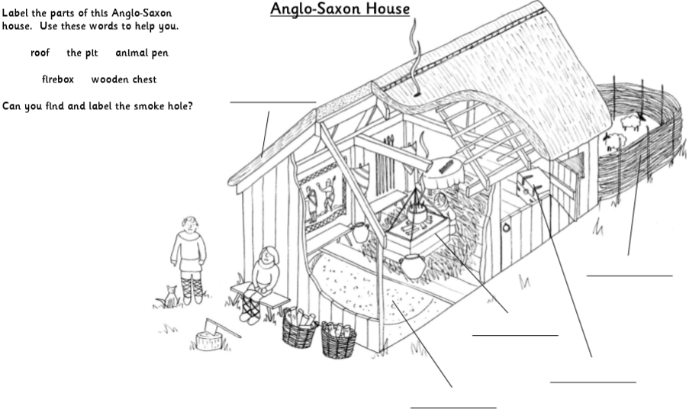

Slide 37
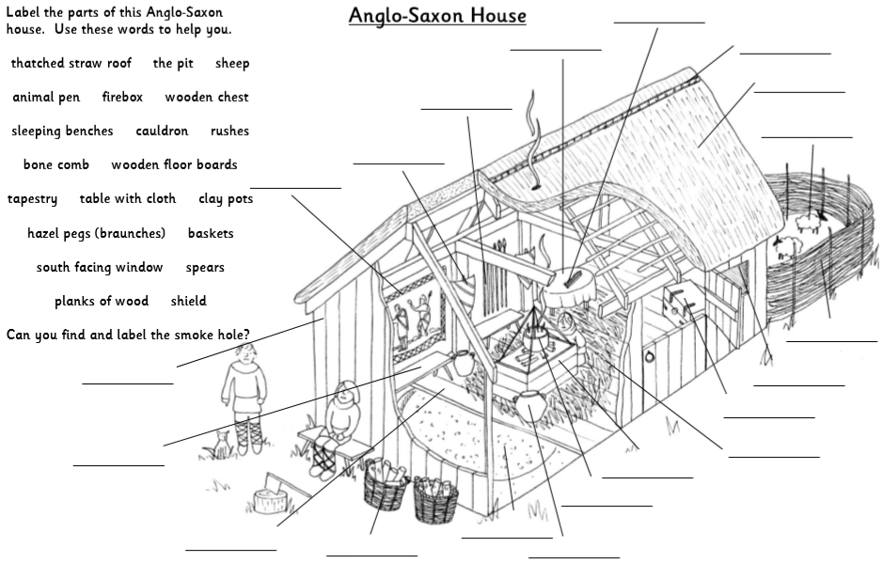

Slide 38
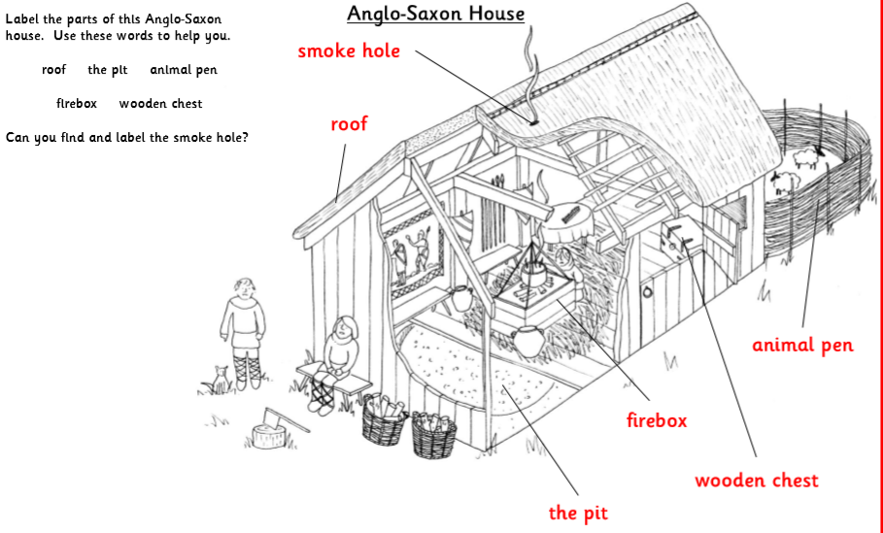

Slide 39
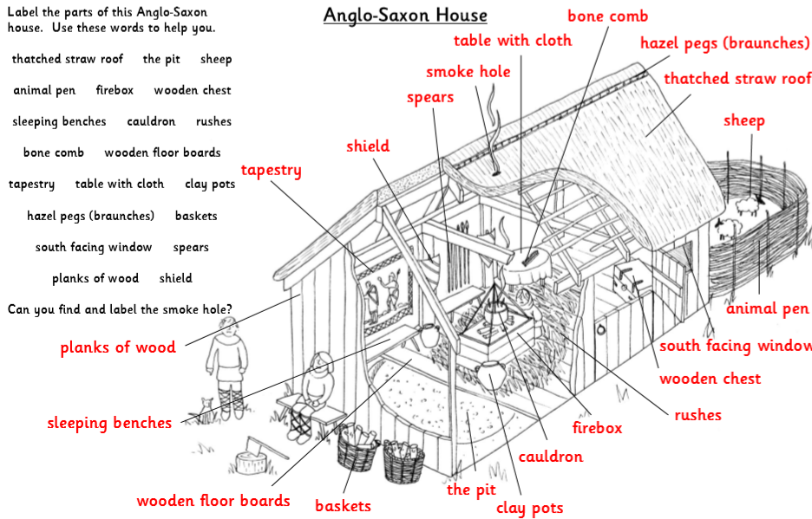

Slide 40
English/Art
Please make sure that you are reading for at least 20 minutes a day.
For Art today, I would like you to show me that you are reading by creating an illustration for part of your book.
Use 20 minutes of this lesson time to read your reading book. Then, choose a particularly exciting or action-packed part of the story.
Your task is to draw a picture which sums up what has just happened in the story.
Do this under the following LO.
LO: to illustrate my reading book.

