Slide 1
Cedar class – 24th March 2020
Timetable
Spelling – ‘ch’ or ‘tch’
Maths: to solve problems on counting and ordering money.
Brain break!
English: to create a poem.
Arithmetic: 3 times table skills.
Brain break!
P.E.: water safety.
PSHE: mindfulness drawing and colouring.

Slide 2
Spellings
Don’t forget, the ‘t’ protects lonely vowels!
Practise some of the words on your list. Try and say the rule in your head as you do this, it should help.

Slide 3
Maths
LO: to solve problems on counting and ordering money.
Year 3s – choose the challenge level you feel is best for you.
Year 4s – please try the gold challenge first. If you find it too difficult, go back to the silver one.

Slide 4
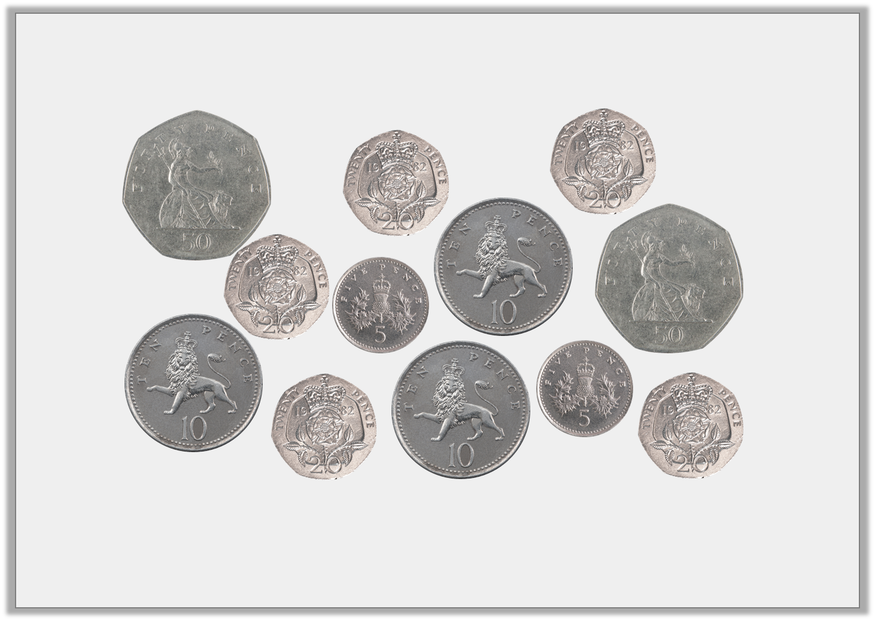
Starter
Find 4 different ways to make 50p.

Slide 5
Starter
Find 4 different ways to make 50p
Various answers, for example:
50p = 50p
20p + 20p + 10p = 50p
20p + 20p + 5p + 5p = 50p
10p + 10p + 10p + 20p = 50p

Slide 6
Example questions
Reasoning and problem solving questions:
The focus of these questions is getting you to use your reasoning and problem solving skills. This means that, often, the question will ask you to ‘prove it’. The next few slides go over a few examples of what ‘proving it’ can look like.
As a general rule, for the questions we are looking at today you will need to write a few sentences in order to answer the question.

Slide 7
Example questions
To work out this question we need to read it carefully and understand what is being asked of us.

Slide 8
Example questions
To work out this question we need to read it carefully and understand what is being asked.
The question is asking two things of us:
1) How much money is shown?
2) Is that amount of money greater than £4.50? If so, Fay can buy the pencil case. If not, Fay can’t buy the pencil case.

Slide 9
Example questions
I have counted up the money and can see that there is £4.30p. This means that Fay can’t buy the pencil case.
In my book, I would write something like this:
Fay does not have enough money to buy the pencil case because £2 + 50p + 50p + 20p + 20p + 20p + 20p + 10p + 10p + 10p + 10p +10p = £4 and 30p.
£4 and 30p is less than £4 and 50p.

Slide 10
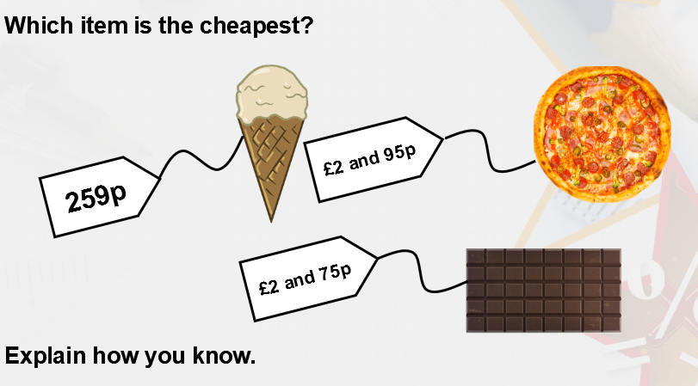
Example questions
In this question you are being asked to:
1) Work out which item costs the least.
2) Write a sentence explaining how you know that it is the least.

Slide 11
Example questions
In this question you are being asked to:
1) Work out which item costs the least.
2) Write a sentence explaining how you know that it is the least.
The ice cream is the cheapest because 259p is the same as £2 and 59p, which is less than both £2 and 95p and £2 and 75p.

Slide 12
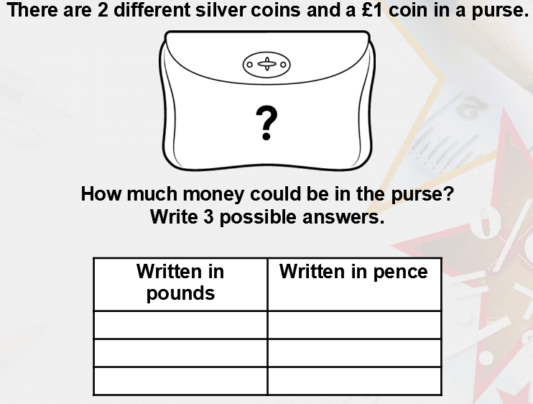
Example questions
This question has multiple possible correct answers.
All you need to do is write down 3 different combinations of money with:
Two different silver coins,
One £1 coin.
You then need to write it in pounds and pence, and just pence.

Slide 13
Example questions
This question has multiple possible correct answers.
All you need to do is write down 3 different combinations of money with:
Two different silver coins,
One £1 coin.
You then need to write it in pounds and pence, and just pence.

Slide 14
If you are going to start with Bronze or Silver challenges, go to slide 20 now.
The next 4 slides explain the Gold level challenges.
If you are a Y4 I would like you to try the gold challenge questions. If they are too tricky you can move to Silver.

Slide 15
Example questions
To answer this question, we need to understand what it means by:
£5.61 > £3.__
Remember, < or > meant greater than or less than. The crocodile always eats the bigger number.
This question is asking us to fill in the two blank cards to make the statement say:
£5.61 is greater than £3.__

Slide 16
Example questions
The question has multiple possible answers. We just need to put the coloured digit cards into the blanks in as many different ways as possible.

Slide 17
Example questions
The question has multiple possible answers. We just need to put the coloured digit cards into the blanks in as many different ways as possible.
A good way of writing the answer is below:
There are 12 different ways we can make the statement true: £3.13, £3.15, £3.16, £3.31, £3.35, £3.36, £3.51, £3.53, £3.56, £3.61, £3.63, £3.65

Slide 18
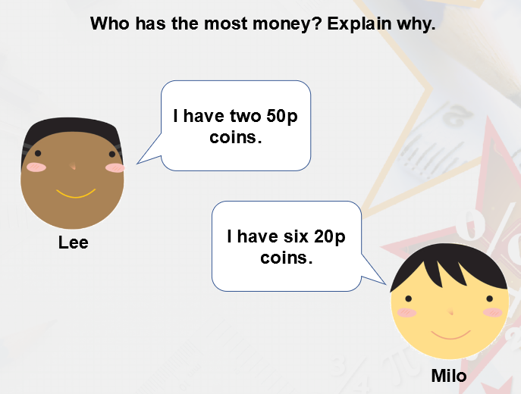
Example questions
This question is asking us to work out how much money each person has, and then say who has the most.

Slide 19
Example questions
Don’t forget to explain why in your answer.
For example:
Milo has the most money, because 6 20p coins makes £1.20. Lee has 2 50p coins which make £1.
£1 is less than £1.20

Slide 20
Copy the question number and then answer the question. Don’t forget you need to explain how you know.
If you finish one challenge, try some question from the next challenge!

Slide 21
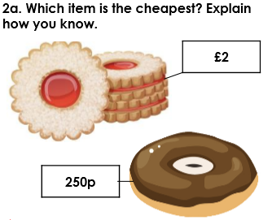
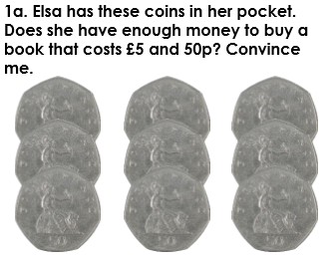
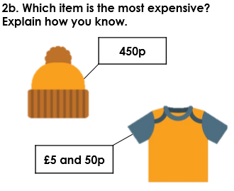
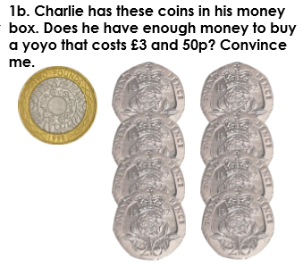
Bronze challenge

Slide 22
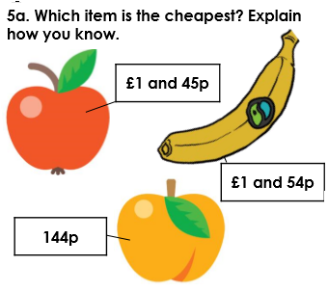
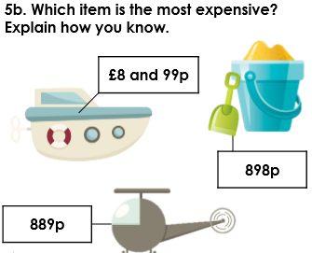
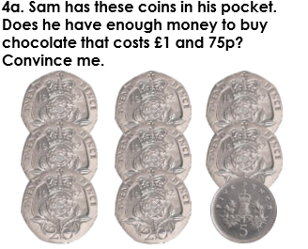
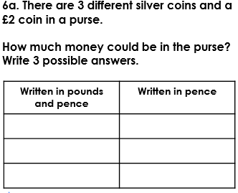
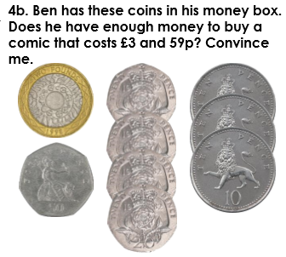
Silver challenge

Slide 23
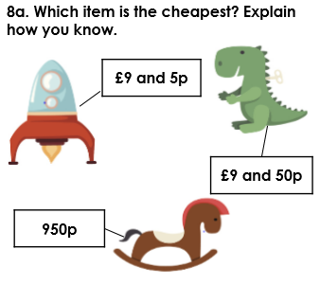
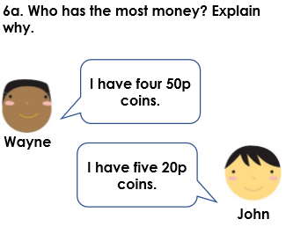
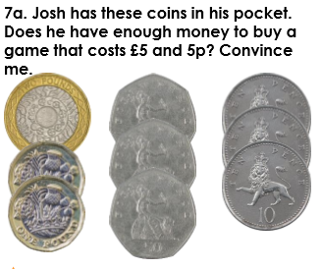
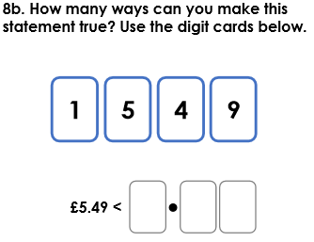
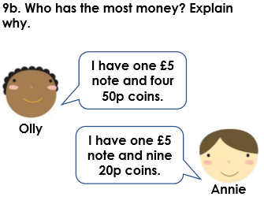
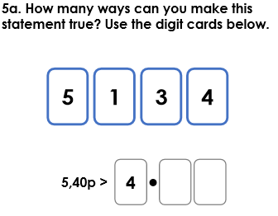
Gold challenge

Slide 24
Answers – please mark your work.
Bronze answers
Silver answers
Gold answers
1a. Elsa has 450p = £4 and 50p. £4 and 50p is less than £5 and 50p so she doesn’t have enough money.
1b. Charlie has 360p = £3and 60p. £3 and 60p is more than £3 and 50p so he does have enough money.
2a. The biscuits are the cheapest. £2 is the same as 200p, which is less than 250p.
2b. The t-shirt is the most expensive. £5 and 50p is the same as 550p, which is more than 450p.
3a. Any 3 of the following: £1 and 50p = 150p, £3 = 300p, £4 and 50p = 450p, £6 = 600p.
4a. Sam has 165p = £1 and 65p. £1 and 65p is less than £1 and 75p so he doesn’t have enough money.
4b. Ben has 360p = £3 and 60p. £3 and 60p is more than £3 and 59p so he does have enough money.
5a. The peach is the cheapest. 144p is the same as £1 and 44p, which is less than both £1 and 45p and £1 and 54p.
5b. The boat is the most expensive. 889p is the same as £8 and 89p and 898p is the same as £8 and 98p. Both are less than £8 and 99p.
6a. Any 3 of the following: £2 and 35p = 235p, £2 and 65p = 265p, £2 and 75p = 275p, £2 and 80p = 280p.
7a. Josh has 580p = £5 and 80p. £5 and 80p is more than £5 and 5p so he does have enough money.
5a. Various possible answers including; £4.13, £4.14, £4.15, £4.31, £4.34, £4.35, £4.41, £4.43, £4.45, £4.51, £4.53, £4.54.
8a. The rocket is the cheapest. The other toys are both £9 and 50p which is more than £9 and 5p.
6a. Wayne has the most because 4 x 50p = 200p and 5 x 20p = 100p.
8b. Various possible answers including; £5.91, £5.94, £9.14, £9.15, £9.41, £9.45, £9.51, £9.54.
9b. Olly has the most because 4 x 50p = 200p or £2.00, so he has £7.00 which is more than the £6.80 Annie has.

Slide 25
Brain break!

Slide 26
English
LO: to create a poem.
Today we will be continuing on from the work you did yesterday. By now, you should have a list of ingredients for the creation of the Golden Rope.
You should have written down some amazing descriptive phrases for these ingredients using adjectives, similes and metaphors.
I gave you an example of what I was looking for in the ingredient list:
The pickled toe nails of an evil wizard from the fiery caves under Mount Zarg.

Slide 27
Start off by looking at the ingredients you wrote.
Are they descriptive enough?
Do you have enough ingredients? I asked you to try and come up with 10, but as long as you have 6 that will be enough for a poem.
If you need to edit your writing to add more description or if you need to come up with some more ingredients, do this now.

Slide 28
To create our poem, we will be putting our ingredients into an order which sounds the best when we read it out loud. Take a look at my example ingredients below:
A rope made from spiders webs which is strong like forged steel.
A golden crown, from the tomb of an ancient Viking king.
The pickled toe nails of an evil wizard from the fiery caves under Mount Zarg.
The taste of rain in the middle of a gigantic thunder storm.
A sapphire as blue as the summer sky.
The breath of an ice troll from the top of the tallest mountain.
On the next slide, I will put them in an order which I think sounds good.

Slide 29
Ingredients for Arthur’s Golden Rope
A rope made from spiders webs which is strong like forged steel.
A golden crown, from the tomb of an ancient Viking king.
The pickled toe nails of an evil wizard from the fiery caves under Mount Zarg.
A sapphire as blue as the summer sky.
The breath of an ice troll from the top of the tallest mountain.
The taste of rain in the middle of a gigantic thunder storm.

Slide 30
Your turn!
In your book write the Date, LO and poem title.
Then, copy your ingredients out in an order that sounds good!
We are going to be doing some editing in a bit, before writing up a final version.
See the next slide for what your book should look like.

Slide 31
Tuesday 24th March 2020
LO: to create a poem.
Ingredients for Arthur’s Golden Rope

Slide 32
I am happy with how my poem reads, but want to make it a bit better!
Poems don’t have to rhyme, but I would like to see if I can change some words or add some lines to make it rhyme so that it is more fun to read.
The lines in italics are what I have added in.

Slide 33
A rope made from spiders webs which is strong like forged steel.
You might think that such a thing isn’t real.
A golden crown, from the tomb of an ancient Viking king.
Don’t take any other treasure, not even a tiny ring.
The pickled toe nails of an evil wizard from the fiery caves under Mount Zarg.
Watch out for dragons, they can be quite large.
A sapphire as blue as the summer sky.
To make the rope stand out, that’s why.
The breath of an ice troll from the top of the tallest mountain.
On your way back down be careful of the poisonous fountain.
The taste of rain in the middle of a gigantic thunder storm.
Be careful not to get attacked by the lightning bug swarm!
I think that my poem is a lot more fun to read now. See if you can add any lines to make your poem rhyme!
If you get stuck for finding rhyming words, you can search Google for ‘words which rhyme with ________’ to help you.

Slide 34
Once you have added in any extra lines, write up a final version of your poem on the next page.
Don’t forget your title!
Underneath, you might want to draw a picture to illustrate some of the ingredients in your poem.
Once done, perform it to someone at home and see what they think.

Slide 35
Arithmetic

Slide 36
Arithmetic
Count in 3s up from the following numbers:
15 – down in 3s. 15, __, __, __.
19 – up in 3s. 19, __, __, __, __, __.
23 – up in 3s. 23, __, __, __, __, __.
121 – down in 3s. 121, __, __, __, __, __.

Slide 37
Arithmetic
Count in 3s up from the following numbers:
15 – down in 3s. 15, 12, 9, 6, 3, 0
19 – up in 3s. 19, 22, 25, 28, 31, 34
23 – up in 3s. 23, 26, 29, 32, 35, 38
121 – down in 3s. 121, 118, 115, 112, 109, 106

Slide 38
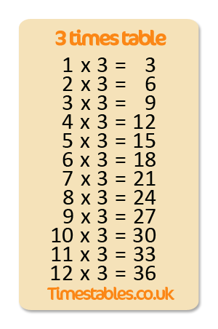
Practise your three times tables out loud.
Then, say the division facts out loud:
3 divided by 3 is 1,
6 divided by 3 is 2,
9 divided by 3 is 3,
12 divided by 3 is 4,
…
…

Slide 39
We are going to focus on using our times tables quickly to solve problems.
Try these, please try and solve them using your mental maths knowledge of your times tables.
Write your answers in your book.
1) 3 X 4 = ?
2) 11 X 3 = ?
3) ? = 7 X 3
4) 27 ÷ 3 = ?
5) ? = 18 ÷ 3
6) 36 ÷ 3 = ?
7) ? ÷ 3 = 4

Slide 40
We are going to focus on using our times tables quickly to solve problems.
Try these, please try and solve them using your mental maths knowledge of your times tables.
Write your answers in your book.
1) 3 X 4 = 12
2) 11 X 3 = 33
3)21 = 7 X 3
4) 27 ÷ 3 = 9
5) 6 = 18 ÷ 3
6) 36 ÷ 3 = 12
7) 12 ÷ 3 = 4

Slide 41
Brain break!

Slide 42
P.E.
On a Tuesday we normally go swimming.
This week, I would like you to think about how we act when at a swimming pool, and around water in general.
Look at the following slides, which provide some good water safety tips.

Slide 43
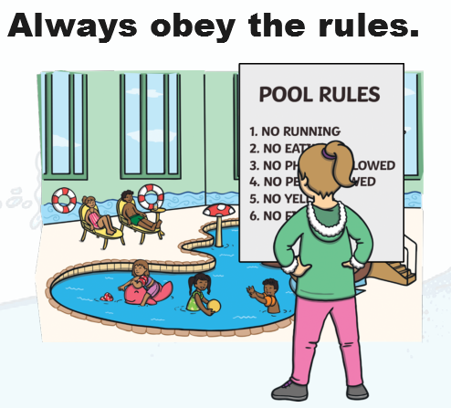
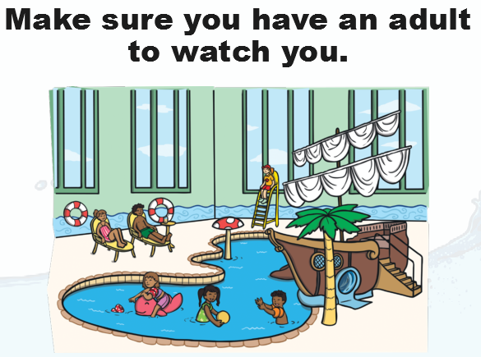

Slide 45
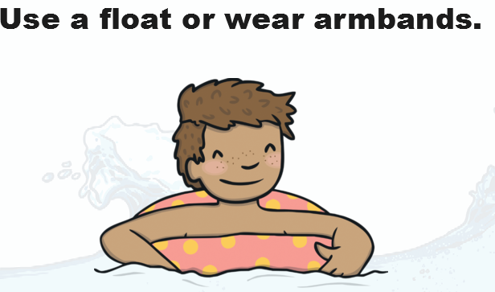

Slide 48
P.E.
Your task is to create a water safety poster. Your poster needs to tell people how to act around water, and give some rules for things that they should and shouldn’t do.
You can choose to do a poster on:
1) Water safety as a whole,
2) Water safety at the beach,
3) Water safety at a swimming pool.
Make sure your poster is detailed, but also makes people look at it. A poster with just writing is not going to make people look at it as much as a poster with pictures and colour on it.

Slide 49
PSHE
If you can, take some plain paper and go outside
Sit down somewhere quiet and take note of any smells, sounds and sights.
Take a deep breath in and out and choose something to draw which you find calming.
Take your time drawing it, and then choose appropriate colours to add detail.
Underneath, write down any thoughts you had as your were colouring and how you are feeling.
Are your thoughts mostly positive? If not, find an adult to share your thoughts with.

