Slide 1
Kestrels – Friday 20th March 2020
Maths- Going through Arithmetic test 8.
Brain break!
English- Editing an opening paragraph for a news report.
Grammar, punctuation and spelling- direct speech- where do the speech marks go?, I before e except after c.
Brain break!
R.E.- Investigating the resurrection of Jesus. What did the witnesses say they saw?
Computing- Create a poster about World War 2 on Microsoft Word (or a similar programme).

Slide 2
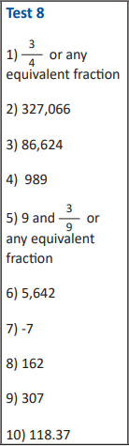
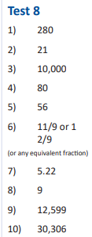
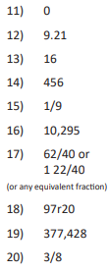
Year 5
Arithmetic answers for test 8
Year 6
Arithmetic answers for test 8
Check your answers and then complete some of the practice questions in the next few slides. (Do all of them even if they weren’t in your test).

Slide 3
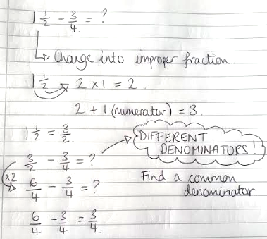
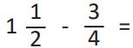
Method

Slide 4
Your go…
2 2/3 + 5/6 =?
3 ¾ - 2/8 = ?
1 1/5 – 8/10 = ?
1 7/8 – ¼ = ?
3 11/12 + ¾ = ?

Slide 5
Your go… ANSWERS
2 2/3 + 5/6 = 21/6 or 3 1/2
3 ¾ - 2/8 = 28/8 or 3 1/2
1 1/5 – 8/10 = 4/10
1 7/8 – ¼ = 13/8 or 1 5/8
3 11/12 + ¾ = 56/12 or 4 2/3
You may have found equivalent fractions/ simplified fractions for these. This is fine!

Slide 6
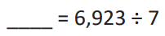
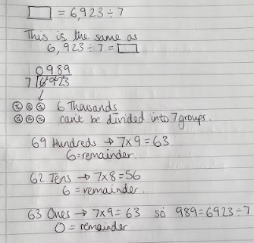
Method

Slide 7
Your go…
5536 ÷ 8 = ?
2892 ÷ 6 = ?
2148 ÷ 4 = ?

Slide 8
Your go… ANSWERS
5536 ÷ 8 = 692
2892 ÷ 6 = 482
2148 ÷ 4 = 537

Slide 9
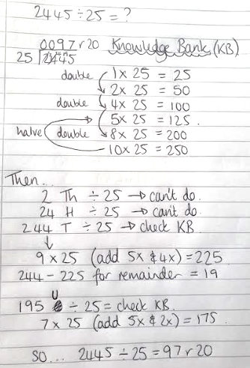
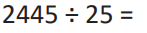
Method
This method is slower to write out in full than to actually do!
This part should be done mostly mentally but with some short calculations/ jottings.

Slide 10
Your go… (if you have another method which works, that’s great!)
4758 ÷ 12 = ?
2562 ÷ 16 = ?
2658 ÷ 24 = ?

Slide 11
ANSWERS… (if you have another method which works, that’s great!)
4758 ÷ 12 = 396 r 6
2562 ÷ 16 = 160 r 2
2798 ÷ 24 = 116 r 14

Slide 12
English
L.O: To edit the orientation paragraph of a newspaper article.
Using the list of features which you compiled yesterday, you are going to edit and improve the first paragraph of a newspaper article.
Write out the article and then edit it (remember to check for misspellings!)
Underneath your edited paragraph, tell me why you made these edits.

Slide 13
English
L.O: To edit the orientation paragraph of a newspaper article.
Snap, Bang, Crackle!
Dragon attacks the town of Gooderstone!
The other day a dragon came to Gooderstone and attacked it.
It came out of nowhere and we have no idea why it was here.
Someone who saw it said it was big and scary and I’m were quite worried that it is going to come back and steal mine sheep. The dragon was big and scary and looked like dragons which you have seen in books. I think it’s maybe here because of that curse we all know about and fear massively.
Don’t panic though, it’s probably all going to be fine- a pint of milk costs 87p in the local shop.
Write out the article and then edit it (remember to check for misspellings!)
Underneath your edited paragraph, tell me why you made these edits.

Slide 14
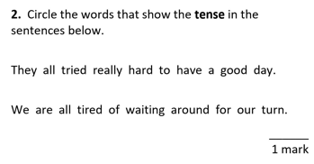
Grammar and Punctuation – answer to yesterday’s task…
Verbs tell us if the events of the sentence happened in the past, present or future (the tense).

Slide 15
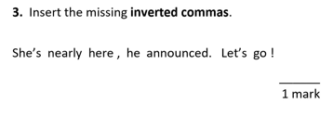
Grammar and Punctuation – Today’s task
Extension task:
Write some of your own sentences using direct (with inverted commas) and reported speech to use in a newspaper report.

Slide 16
Further examples
e before i
(after a c)
Note
NOTE: Many of these words can be written with various suffixes and prefixes
e.g. receiver, received, receiving, disbelieve, unbelievers.
Use some of these words in some sentences.
Can you add on some prefixes/ suffixes?
i before e
Exceptions
chief
niece
diesel
field
brief
relief
pierce
priest
grief
thief
believe
retrieve
achieve
hygiene
handkerchief
receive
perceive
receipt
ceiling
deceive
conceive
conceit
e before i
(NOT after a c)
Words that end in ‘cy’ may change to ‘cie’ when suffixes such as ‘er’, ‘ed’, ‘es’ are added (Rule 14).
E.g. fancy > fancied.
There are many other words spelt with ‘ei’ or ‘ie’ that do not make the ‘ee’ sound, e.g. their, science.
seize
weird
protein
caffeine
seize
neither
either

Slide 17
R.E.
L.O: To investigate the witness accounts of the resurrection.
Today you are going to recap the Easter story and the resurrection before assessing further evidence to see how credible (believable) it is.
The Resurrection of Jesus
For this session you are going to be a detective of the Jerusalem Police Department trying to solve the mystery of the missing body which was in the tomb.
You will investigate a number of pieces of evidence: statements from the witnesses; evidence from the crucifixion; and additional evidence from the Bible.
Recap:
Jesus was seen dying on the cross on Friday but according to followers of Jesus by Sunday morning the body was no longer there.

Slide 18
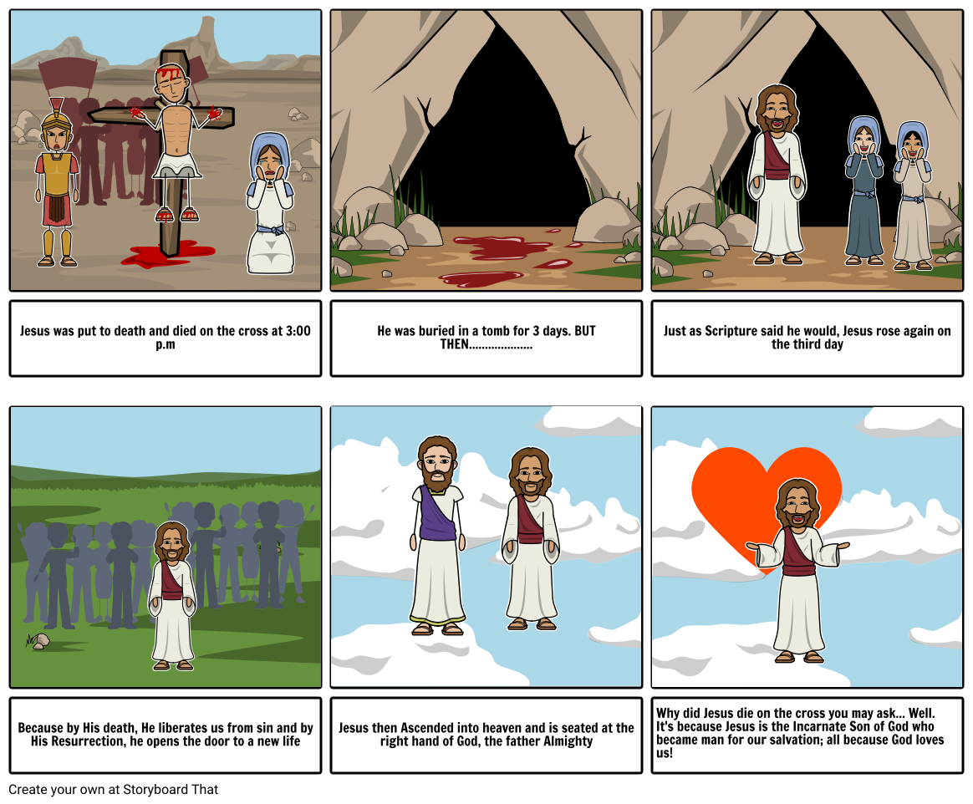
The Resurrection of Jesus

Slide 19
Third task: Time to weigh the evidence (not literally…)
Reflect on each statement from a witness- does it support any of your conclusions from yesterday? Why/ why not?
Name: Caiaphas
Occupation: High Priest of the temple in Jerusalem.
I don’t deny that we never liked this Jesus. He caused a lot of problems for us: He kept getting crowds of people all excited with His magic tricks and was claiming He was the son of God. We wanted to silence Him but we were afraid of what the people might do. He had a lot of supporters and they all wanted Him to be the Messiah they’ve been waiting for. Eventually, we managed to get Him arrested and crucified by the Romans.
After He died, He was taken down from the cross and put in a tomb in a secluded garden outside of town. We stationed some guards outside because we thought His disciples may steal the body and claim He had risen from the dead as Jesus had apparently said that this would happen.
Then we heard that the body had gone. We don’t know where it is. The guards said they saw an angel but I think they were asleep and useless at their jobs. We paid them to say that the disciples had stolen the body. We didn’t want a riot on our hands!

Slide 20
Third task: Time to weigh the evidence (not literally…)
Reflect on each statement from a witness- does it support any of your conclusions from yesterday? Why/ why not?
Name: Marcus Fabius
Occupation: Roman soldier
As a Roman soldier, it’s my job to kill people. I’ve always called myself the best in the business and have never failed- except for this once. They brought me the Jewish teacher called Jesus of Nazareth. They told me that He was due to be nailed to a cross – what we normally do for trouble-makers. As far as I could tell He had done nothing wrong, but I just had to follow orders. So I did what I was told.
There’s no way he didn’t die that Friday. When you crucify someone, you nail their hands and feet to the cross which eventually leads to suffocation. It usually takes a while for people to die in this way so sometimes we break their legs to speed up the process. I didn’t break this guy’s legs. I didn’t have to because He died quite quickly. To double check that He was dead, we speared Him in the side. He bled. He was definitely dead.
We took Him down and a rich man called Joseph took Him to the tomb. We were asked to guard the tomb by some people from the temple. I heard that they were worried that His disciples would try to steal the body and pretend He had come back to life. I was guarding the tomb with 3 others.

Slide 21
Third task: Time to weigh the evidence (not literally…)
Reflect on each statement from a witness- does it support any of your conclusions from yesterday? Why/ why not?
Name: Marcus Fabius
Occupation: Roman soldier
I don’t really know what happened next. All I know is that we saw what looked like an angel and then I woke up and noticed that the body was gone. We went to the Jewish leaders and explained what had happened. They bribed us to say that the disciples had stolen the body.
He was definitely dead, I guarded the tomb well and then He was gone. That’s all I know…

Slide 22
Third task: Time to weigh the evidence (not literally…)
Reflect on each statement from a witness- does it support any of your conclusions from yesterday? Why/ why not?
Name: Mary Magdalene
Occupation: N/A- Woman
I was a close friend of Jesus. I was devastated when they killed Him. I watched it happen with some others. It was horrible and we couldn’t understand why He didn’t just save Himself. He had saved so many people from illness and death but wouldn’t save Himself.
He went limp, we assumed He was dead, and a person removed Him from the cross. We saw him take Jesus to a tomb. We watched as they placed Him inside and rolled a massive stone across the entrance. We wanted to come back at some point to put some spices on the body so we made sure we knew where the tomb was. We would however have to wait a few days as it was nearly Saturday- the Sabbath- and we cannot work then.
On Sunday at daybreak, we returned to the tomb. When we got there the stone had already been rolled away and the body was gone. We double checked that we were in the correct tomb. It definitely was the right one. I broke down in tears. Then someone approached me.
He said “Mary” and I instantly recognised the person as Jesus! He told me not to be afraid and to inform the disciples that He was back. I did and then they saw Him too. He’s alive!

Slide 23
Third task: Time to weigh the evidence (not literally…)
Reflect on each statement from a witness- does it support any of your conclusions from yesterday? Why/ why not?
Name: Simon, also known as Peter.
Occupation: Former Fisherman, now disciple of Jesus
I didn’t see the death close up. The night before, I had even denied that I knew Him, just in case they came for me too. Because of this, I felt like I couldn’t face Him that day. But I heard what happened from the other disciples. Afterwards, we kept a low profile. Some of us stayed together hiding in a room out of the way. We were too scared to show our faces.
Then, a few days after it had all happened, we were all together- all except Thomas. Suddenly, Jesus appeared to us. We were speechless! We couldn’t believe our eyes! He told us to touch His hands and feet and to feel His side- where He had been pierced by the nails and the spear. He told us not to be afraid. We excitedly ran to tell the others. Thomas didn’t believe us. He said he had to see Jesus for himself.
A few days later Jesus appeared to us again and told Thomas to feel His wounds. He couldn’t doubt it then. He is definitely alive- we saw Him and touched Him. He definitely isn’t a ghost!

Slide 24
What do you think happened?
This is now your chance to write about what you believe.
After this, consider why this is such an important story to Christians.
Write a few sentences explaining your thoughts.

Slide 25
Computing:
L.O: Create a poster on Microsoft Word (or similar programme) about World War 2.
Using Microsoft Word, please create a poster with everything you now know about World War 2.
Please ensure that you save your work at the start and then every few minutes and then again at the end. Save your file with a sensible name.

