Slide 1
Friday 20th March Schedule Quick morning work: Matching prefixes MATHS: Introduction to bar charts Arithmetic: Multiplying a 2-digit number by a 2-digit number. brain break! ENGLISH: To design a leaflet Brain break! ART: To use different pencil techniques to replicate textures of fur in a soft toy. PE:Dance – To create the next sequence to add to our Vikings and monks dance.

Slide 2
Matching prefixes - Can you match the picture to the correct prefix?
SUB
AUTO
UNDER
MARINE

Slide 3
write
pen
auto
graph
super
group
anti
hero

Slide 4
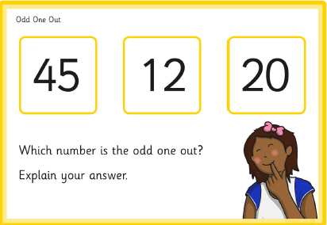
MATHS STARTER:

Slide 5
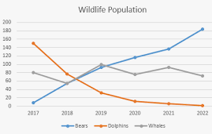
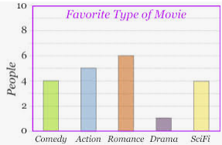
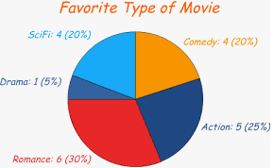
Bar charts
Today we will be looking at different graphs to show data, moving on from pictograms.
Can you identify the types of chart/graph shown below? Move the coloured rectangles to find out if you are correct!
pie chart
line graph
bar chart

Slide 6
Vocabulary
When we are learning about bar charts we use these words:
Horizontal (x axis)
Vertical (y axis)
Scale
Width
What do you think these words could mean?

Slide 7
Horizontal – when something goes across, for example a line or row.
Vertical – when something goes up, for example a line or column.
Scale – The numbers that something goes up in. For example, the y axis might go up in 2s, 5s or 10s depending on the data.

Slide 8
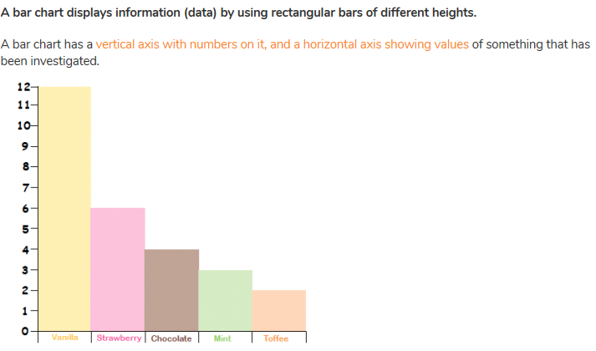
Talk time: What could this bar chart be investigating?
Can you think of suitable labels for the y (vertical) and x (horizontal) axis?

Slide 9
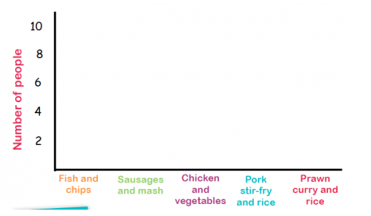
Can you draw the bars on for the following data? Remember, it is important to keep each bar the same width!
Fish and chips – 8
Sausages and mash – 5
Chicken and vegetables – 3
Pork stir-fry and rice – 1
Prawn curry and rice - 4

Slide 10
How to choose a scale:
Sometimes it can be difficult to know what scale to use on your bar chart – to figure out what your top number needs to be you need to look at the highest number in your data.
Look at the following set of data:
TV programmes | Number of children who like it best
Spongebob Squarepants | 12
Descendants | 14
Pokemon | 6
Newsround | 8

Slide 11
TV programmes | Number of children who like it best
Spongebob Squarepants | 12
Descendants | 14
Pokemon | 6
Newsround | 8
The highest number is 14 – therefore the top number on your y axis should be 14.
The next step is to work out what your y axis should count up in – it must start at 0 and end at 14. It needs to include the numbers 6, 8 and 12.
This y axis would be best to count up in 2s. This is because it would go: 2, 4, 6, 8, 10, 12, 14.

Slide 12
Challenge 1: Think of appropriate scales for the following sets of data.
Favourite animals: | Number who like it:
Polar bear | 10
Giraffe | 15
Elephant | 25
Brown bear | 30
Dolphin | 40
Meal choices for lunch: | Number ordered:
Pizza | 10
Baked potato | 15
Chicken salad | 25
Cheese omelette | 30
Ham toastie | 40
Colour of cars in a garage: | Number:
Red | 10
White | 30
Blue | 40
Black | 50
Yellow | 40
1.) This y axis should count up in:
2.) This y axis should count up in:
3.) This y axis should count up in:
Trees in a park: | Number:
Birch | 4
Palm | 12
Oak | 24
Fir | 36
Pine | 8
Favourite holidays: | Number who like it:
Beach | 16
City | 32
Camping | 24
Caravan | 40
Disneyland | 56
Hair colours in school: | Number:
Blonde | 9
Brown | 18
Red | 6
Dark brown | 15
Black | 12
4.) This y axis should count up in:
5.) This y axis should count up in:
6.) This y axis should count up in:

Slide 13
Challenge 2: Think of appropriate scales for the following sets of data.
Favourite animals: | Number who like it:
Polar bear | 21
Giraffe | 14
Elephant | 70
Brown bear | 49
Dolphin | 28
Meal choices for lunch: | Number ordered:
Pizza | 18
Baked potato | 9
Chicken salad | 9
Cheese omelette | 27
Ham toastie | 45
Colour of cars in a garage: | Number:
Red | 11
White | 44
Blue | 33
Black | 88
Yellow | 121
1.) This y axis should count up in:
2.) This y axis should count up in:
3.) This y axis should count up in:
Trees in a park: | Number:
Birch | 6
Palm | 12
Oak | 24
Fir | 42
Pine | 36
Favourite holidays: | Number who like it:
Beach | 60
City | 120
Camping | 100
Caravan | 40
Disneyland | 80
Hair colours in town : | Number:
Blonde | 25
Brown | 75
Red | 125
Dark brown | 200
Black | 150
4.) This y axis should count up in:
5.) This y axis should count up in:
6.) This y axis should count up in:

Slide 14
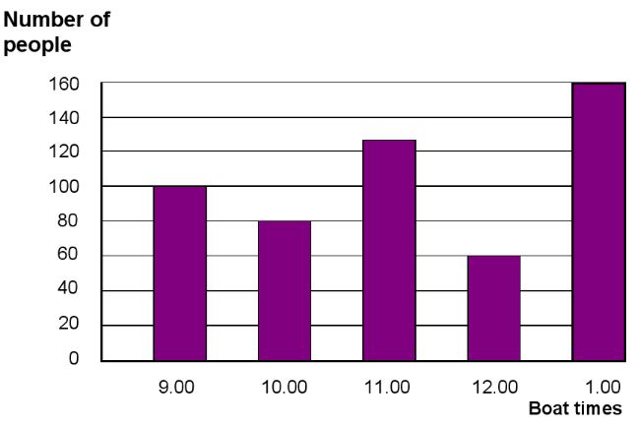
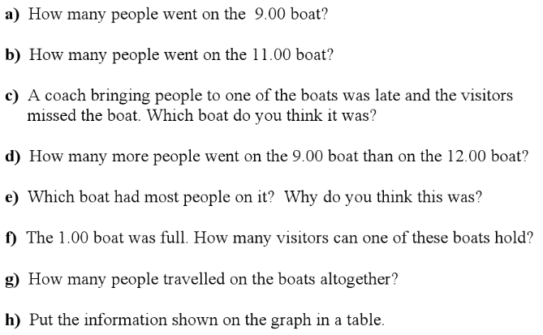
Challenge 3: Answer one and two-step questions about the bar chart below.

Slide 15
Arithmetic: Multiplying a 2-digit number by a 2-digit number.
Method 1: Grid method 45 x 17
1.) Split your numbers into tens and ones. Set them up in your grid like the example to the left.
2.) Start by multiplying 10 x 5 = 50
3.) Then multiply 10 by 40 = 400
4.) Now you need to multiply 7 x 5 = 35
5.) And finally 7 x 40 = 280
6.) Once you have done that, add up your totals.
x
40
5
10
7
Total: 400 + 280 + 50 + 35 = 765

Slide 16
Use grid method to multiply these numbers:
Year 3: Year 4:
1.) 35 x 12 1.) 43 x 56
2.) 64 x 18 2.) 87 x 34
3.) 23 x 14 3.) 61 x 90
4.) 15 x 15 4.) 79 x 18
If you can remember how to multiply using column method you can do it this way instead!

Slide 17
English:
Using a piece of paper design a template for your leaflet about the country you think the Vikings should invade:
You might like to include:
Boxes for pictures/facts and figures
Caption boxes
Different boxes for different paragraphs
A catchphrase or slogan – example: ‘Vikings! Voyage here now!’
A map of your country

Slide 18
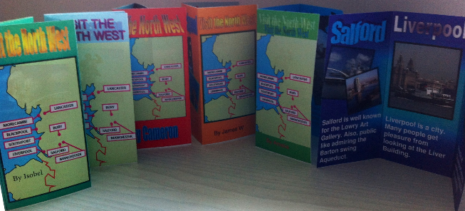
Here are some leaflet design ideas you could use to inspire you:

Slide 19
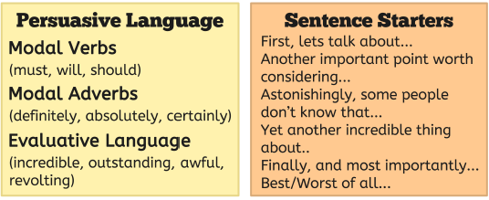
What makes a persuasive argument?

Slide 20
Brain break!

Slide 21
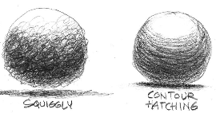
ART: To replicate different textures using pencil shading techniques.
In class we looked at the following techniques:
Can you remember any others?

Slide 22
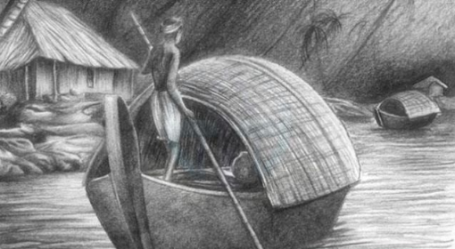
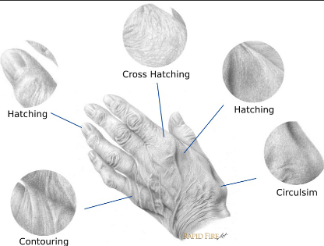
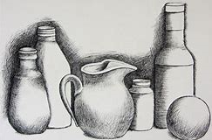
These techniques can create amazing pencil sketches!
Can you spot any of the techniques from the previous slide in these pictures?

Slide 23
Task: I would like you to choose one of your favourite teddies and spend some time looking closely at their fur. Then draw your teddy and show detail on their fur by using shading techniques.
What is the texture like?
Which of the techniques that we have looked at might create an effect similar to how your teddy’s fur looks?
Once you have looked closely at the texture and thought about how you might recreate it, use a clean page in your pink work book to sketch the shape of your teddy. Then try to fill in the fur detail using some of the techniques we have looked at using a pencil.

Slide 24
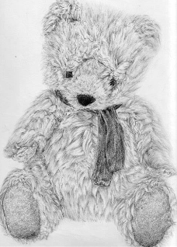
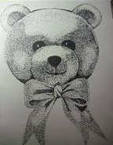
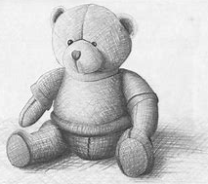
Examples!
hatching
cross-hatching
Circulism/squiggly

Slide 25
DANCE:
Today I would like you to continue working on our dances to this song: Prokofiev’s Dance of the Knights (follow the link below to find it).
https://www.youtube.com/watch?v=bBsKplb2E6Q
We have already put together our sequences for the monks at Lindisfarne and the Vikings getting ready to sail. Now I would like you to create the next minute long sequence imagining the Vikings arriving at Lindisfarne and their meeting with the monks.

Slide 26
Think about the kind of feelings you will need to represent: shock, fear, anger, bravery, violence.
What shapes and movements might show these feelings?
Feel free to record your dance and send it to me at ablakie9erk@nsix.org.uk ☺

