Slide 1
Monday 2^{3rd} March Schedule Monday morning motivation ☺:PE lesson with the body coach (via youtube) MATHS: Can you solve a maths maven mystery? Arithmetic: Multiplying a 3-digit number by a single digit number. brain break! ENGLISH: To Write up our persuasive leaflets Spelling: The ‘f’, ‘l’, ‘s’, ‘z’, ‘k’ sounds at the end of words. Brain break! PSHE:How Does our kindness affect others? Computing:Staying safe online

Slide 2
Morning Warm up!
Please type the link below into your internet browser to find a fun warm up with Joe the Body Coach. This should help to wake up your brain ready for learning! There will also be some 30 minute PE lessons on The Body Coach youtube channel from today.
https://www.youtube.com/watch?v=d3LPrhI0v-w

Slide 3
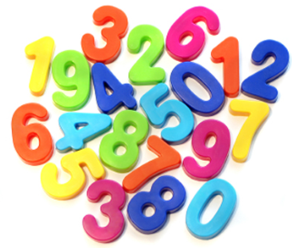
MATHS STARTER:

Slide 4
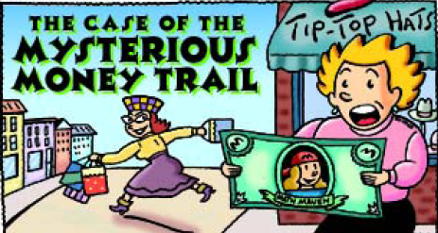
Maths Mystery Challenge!

Slide 5
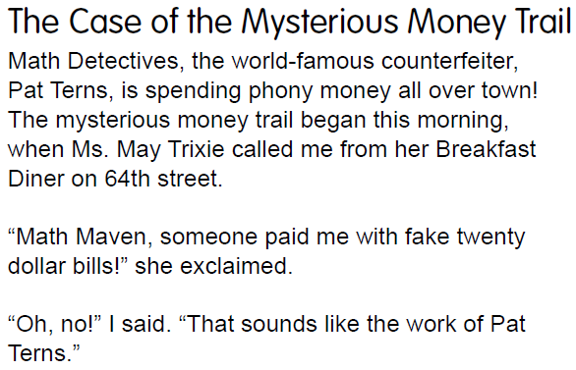
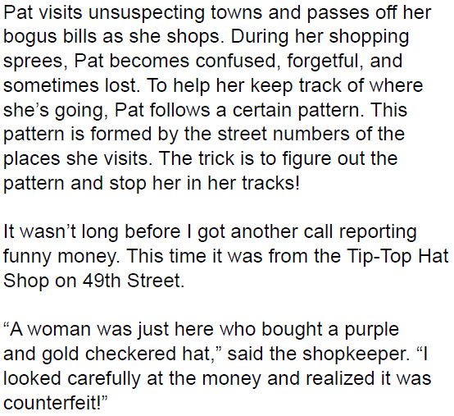

Slide 6
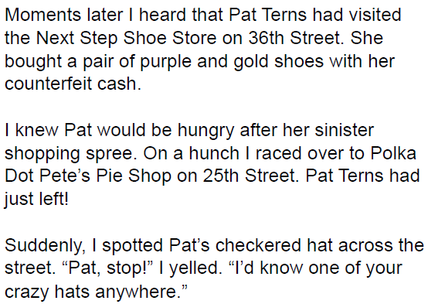
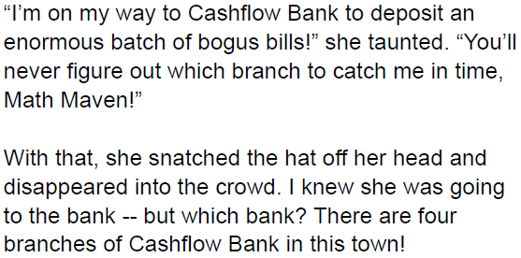

Slide 8
Arithmetic: Multiplying a 3-digit number by a single digit number.
Method 1: Grid method 458 x 4
1.) Split your number on the top row into hundreds, tens and ones. Put your single-digit number underneath the x symbol. Set them up in your grid like the example to the left.
2.) Start by multiplying 4 x 8 = 32
3.) Then multiply 4 x 50 = 200
4.) Now you need to multiply 4 x 400 = 1600
5.) Once you have done that, add up your totals.
x
400
50
8
4
Total: 1600 + 200 +32 = 1832

Slide 9
Use grid method to multiply these numbers:
1.) 342 x 8 8.) 129 x 3
2.) 552 x 4 9.) 482 x 8
3.) 818 x 2 10.) 224 x 4
4.) 267 x 3
5.) 663 x 5
6.) 319 x 8
7.) 512 x 4

Slide 10
Arithmetic extension:
Fill in the ? in the multiplication grid.
x
600
?
3
x
800
?
?
?
4800
320
4
?
240
20

Slide 11
English:
Now that you have planned and designed your leaflet, it is time to write it! Think about how you can persuade the Vikings to come to your chosen country next. Remember to include persuasive devices from the next slide. Use your research to include facts and figures about the country such as population, rivers, physical features like lakes, rivers or mountains and whether the country is more urban or rural.
Think about how these facts will affect the Vikings – for example if the country is an island then it will be easier for the Vikings to sail to.

Slide 12
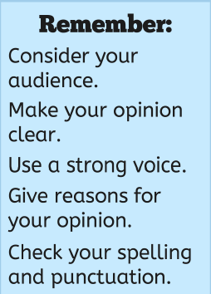
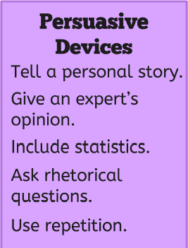
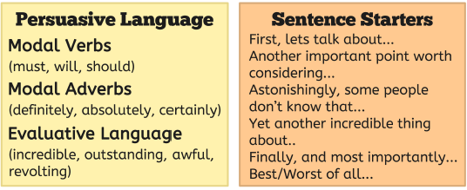
What makes a persuasive argument?

Slide 13
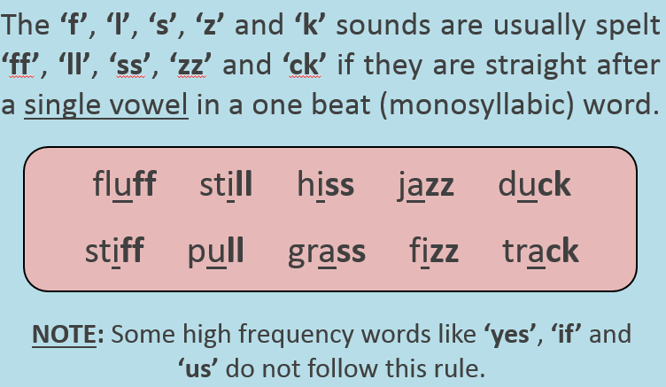
Spelling

Slide 16
Brain break!

Slide 17
PSHE: To explore how kindness makes the world go around.
As you look through the following pictures think about these questions:
What is the act of kindness?
How do you think the people in the photograph feel?
What is the effect of the act of kindness on others?

Slide 18
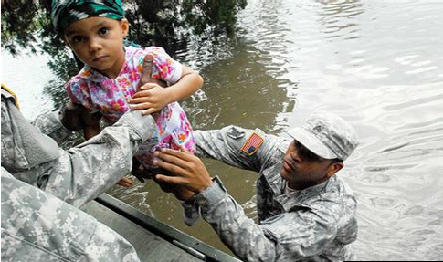
Picturing kindness
What is the act of kindness?
How do you think the people in the photograph feel?
What is the effect of the act of kindness on others?

Slide 19
Picturing kindness
What is the act of kindness?
How do you think the people in the photograph feel?
What is the effect of the act of kindness on others?

Slide 20
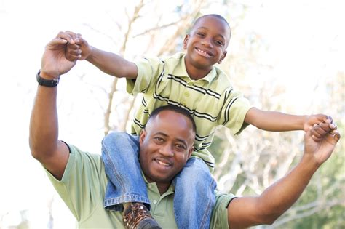
Picturing kindness
What is the act of kindness?
How do you think the people in the photograph feel?
What is the effect of the act of kindness on others?

Slide 21
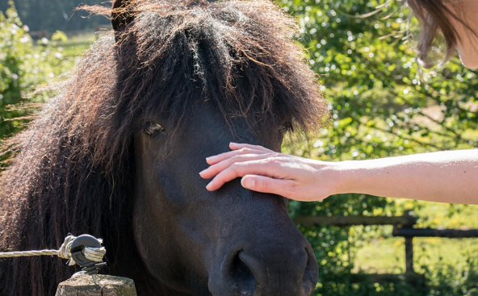
Picturing kindness
What is the act of kindness?
How do you think the people in the photograph feel?
What is the effect of the act of kindness on others?

Slide 22
Stories of kindness
Next we are going to read a story called ‘Warm Glow’. After we read there will be some questions about the story.
Little Carl was grumpy. He was mumbly and grumbly; he was whingy and whiny, and Dad was losing patience.
Dad asked Carl’s big sister, Ellie, to play with him for a while, just while he finished making tea.
‘What’s in it for me?’ demanded Ellie.
‘Um, I suppose you could have a biscuit,’ offered Dad.
Ellie sat with Carl for a bit and helped him build a tower with his bricks. But soon she was bored. Carl seemed to be happy enough stuffing wooden blocks into his mouth, so Ellie got out her phone to check her messages.
When Jack, Ellie’s younger brother, came down, he took one look at Carl, then found his teething ring on the sofa and gave it to him. After a couple of games of ‘bee-bo’, Carl was chewing and gurgling happily, so Jack went into the kitchen and began to lay the table, ready for tea.

Slide 23
Just for a moment, the lines melted away from Dad’s face and he beamed at his boy. Then he reached down the biscuit tin from the shelf and headed out of the kitchen. A deal was a deal.
Ellie had just about managed to stuff her phone back into her pocket and start babbling at Carl when Dad came in.
‘Thank you love, that was a great help. Here you are,’ Dad added, handing Ellie the opened tin. She chose her favourite and stuffed it into her mouth. Surprisingly, it didn’t taste as good as she was expecting. Tea, however, was unusually pleasant. Dad cooed at Carl while he bounced him on his knee and sang him the songs that had given them all a warm glow when they were little.
Warm Glow: Questions
How did Jack’s kindness affect Dad?
2. How did Jack’s kindness affect Jack?
3. How did Ellie’s actions affect her?

Slide 24
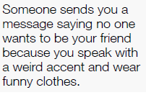
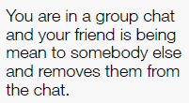
Computing: Staying safe online
Match the scenarios to the correct actions to make sure you are staying safe on the internet. Some scenarios may require more than one action to sort them out. Find the action cards on the next slide.

Slide 25
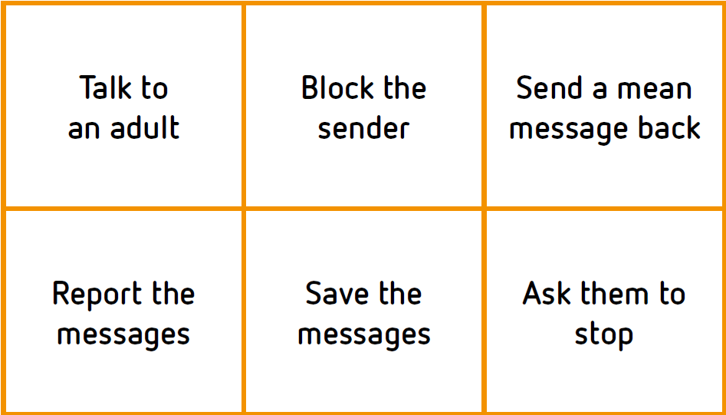
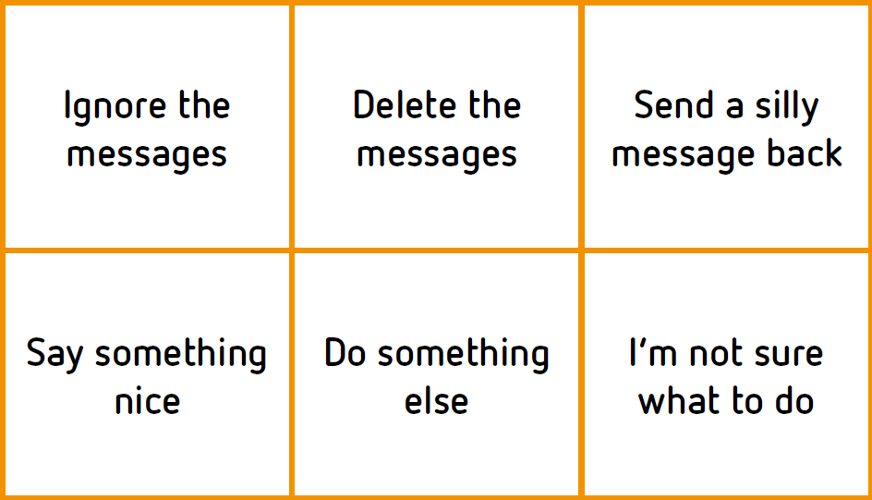
Action cards
Were there any situations where you were unsure about what to do? Why was this?
Task 2: Design a poster using the action cards suggesting things people can do to stay safe and happy online.

