Slide 1
English
Examine a characters feelings

Slide 2
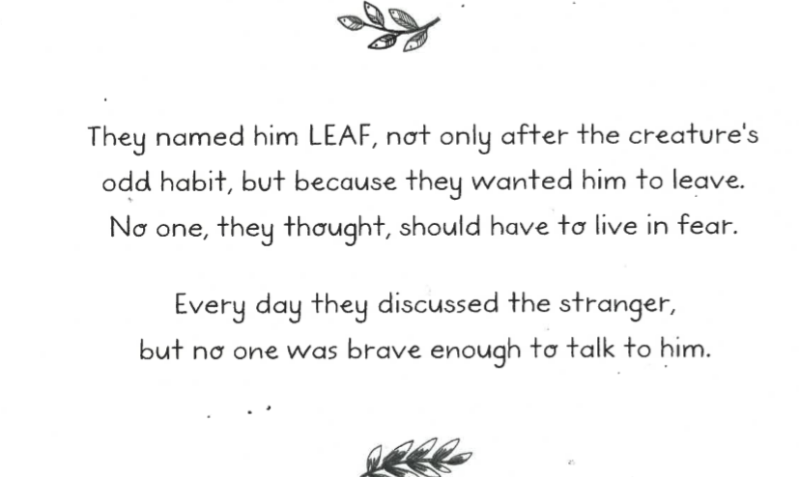
Read the text.

Slide 3
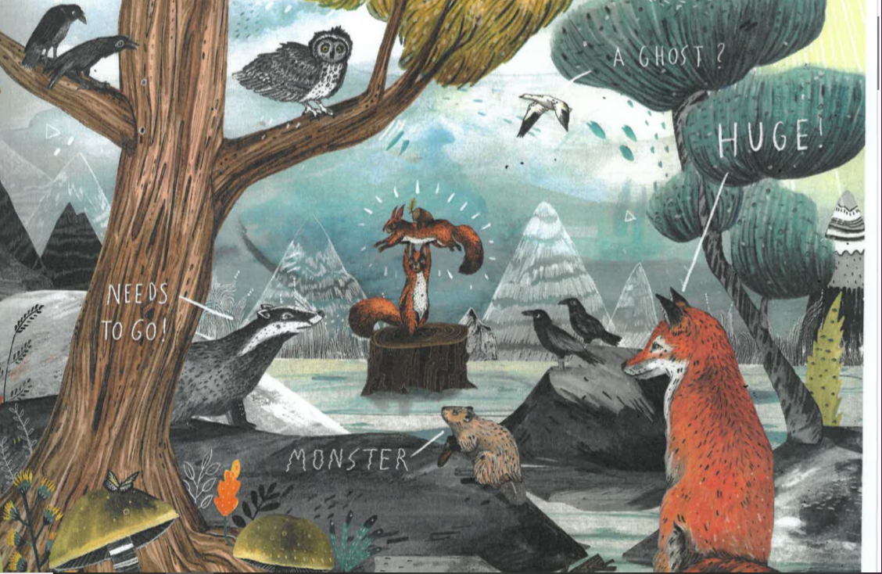
Look around the picture.

Slide 4
Role Play
Imagine you are Leaf.
What if he was able to overhear the animals’ discussion?
How might he feel?
What would he be thinking?
How does it feel to be on the outside looking in; to be talked about but not involved?
What would you say to the animals if you had the opportunity?
Can you write a note to the animals to let them know how they have made you feel?

