Slide 1
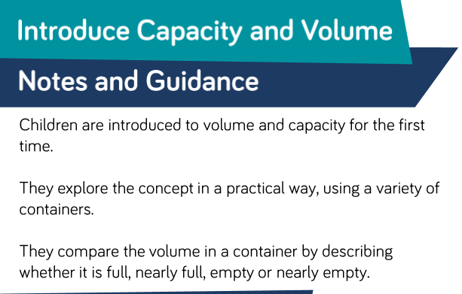
Maths

Slide 2
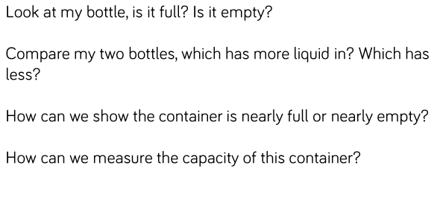
This is the type of language we will use when talking about volume and capacity (Not all today though).

Slide 3
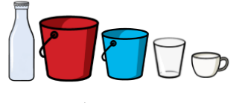
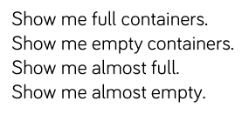
Provide a range of different containers for children to explore practically using water or sand.
This lesson is a discussion and play lesson.

Slide 4
Use the words ‘more’ or ‘less’ to compare the containers.

Slide 5
Put these in order from empty to full.

Slide 6
That’s it for our introduction.
Tomorrow we will look at reasoning skills.
Now feel free to fill a container with a drink (how full is up to you).

