Slide 2
Being online & wellbeing
Identify signs that screen use has become excessive
Understand the negative impacts of too much time online
Take steps toward moderating screen time

Slide 3
Words & phrases I will hear and use
Offline
Physical health
Internet
Online
Safe
Schedule
Feelings
Screen time
Balance
Wellbeing
Limits
Happy
Comfortable
Healthy mind

Slide 4
Discuss the following questions
Mums and Dads often think kids spend too much time online - do they?
Is that a bad thing?
Why do adults think kids spending time online can be bad if it’s too much?
What do you think is too much time?

Slide 5
What are the good & bad things about time spent online?
Good things about time spent online
Bad things about time spent online

Slide 6
A healthy mind means
Having a strong mind to allow you to handle the challenges and opportunities that life puts in front of you, without getting too worn out.

Slide 7
Did you know?
Too much time spent online can negatively impact the physical and mental health of children and teens.

Slide 8
Being online & physical health
Good physical health is when your body is functioning as it was designed to function.
As a group, discuss some of the ways that physical health might be affected from too much time spent online.

Slide 9
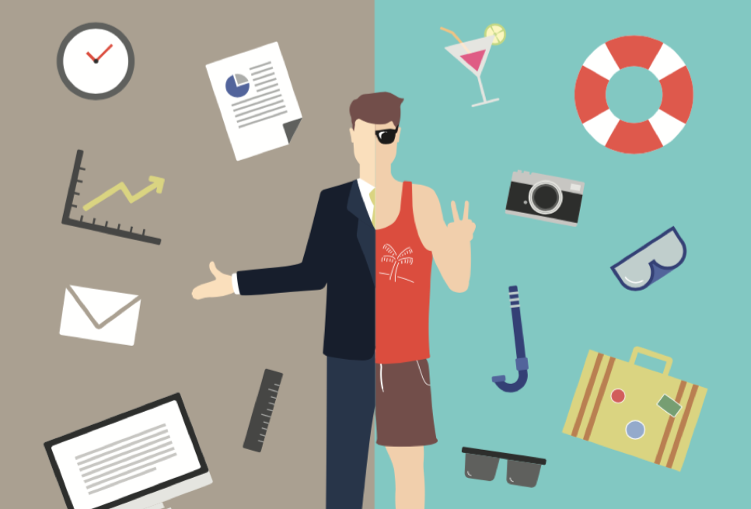
Being online & physical health
TASK: Draw two characters –
one showing signs of excessive use of online technologies
one demonstrating a balanced use of online technologies

Slide 10
Wellbeing is the state of being healthy, safe, comfortable and happy
Discuss how being online and using the internet can make you feel and how it can affect your wellbeing ?

Slide 11
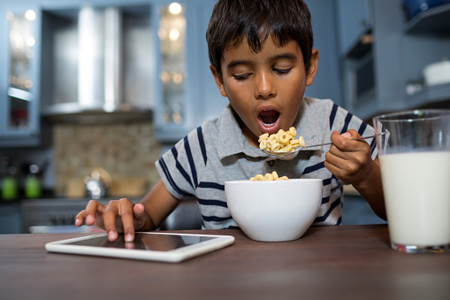
Discuss how can being online and using the internet affect your wellbeing?

Slide 12
Scared
Stressed
Part of something
Write on a post-it note how being online can make you feel at times?
Anxious
Like you are missing out
Worried
Sad
Frustrated

Slide 13
Balancing time online
Perform an audit of your daily activities by filling in the table below. Extra spaces have been provided for you to add any other activities you do each day.
Activity | Details of activity | Hours per day
Eating
Sleeping
Playing
Homework
Being active
Relaxing
Studying

Slide 14
Balancing time online
Activity | Time spent on computer | Time spent on phone or tablet
Searching online – for fun
Searching online – for homework
Sending emails
Instant messaging
Webcam chatting
Social Networking
Watching and sharing video content
Other tasks for homework
Playing games
Sending texts
Estimate how much time you spend on the following activities each week. There are some blank boxes for you to add any activities not listed

Slide 15
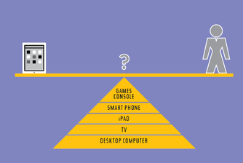
Balancing time online
What did your audit reveal?
Was any amount of time longer than expected?
How much time are you spending on the computer for homework or socialising?
How do these figures compare to time spent on these activities offline?

Slide 16
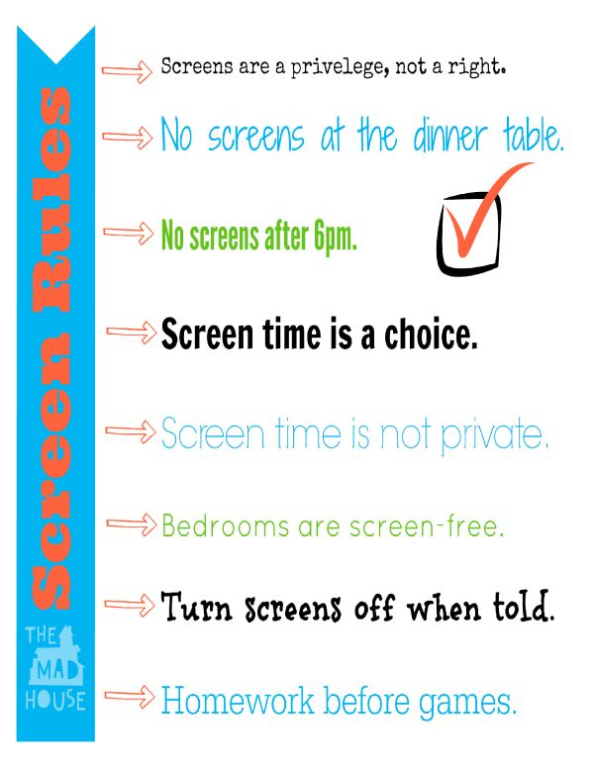
House rules
Create a set of rules about the use of screen time in your house.
Think about tech free zones and time limits

Slide 17
How can we help manage our time online better?
TASK: Create a short video or poster presentation to show young people how they can manage their time online better

Slide 18
Summary & Top tips
Set yourself screen time limits
Create your own schedule for screen time
Have online free zones in your house
Switch off and don’t use technology 1 hour before bedtime
Produce a set of house rules

