Slide 1
Kestrels – Thursday 19th March 2020
Maths- Converting fractions to decimals to percentages and back again.
Arithmetic- Finding percentages of amounts.
Brain break!
English- Compare the identified features of the newspaper with Miss Stanley’s list and write some top tips for writing good news reports.
Grammar, punctuation and spelling- tenses: which words show us this?, I before e except after c.
Brain break!
R.E.- Investigating the resurrection of Jesus. What did the witnesses say they saw?
P.E.- Practise the three types of passes from Netball.

Slide 2
FRACTIONS, DECIMALS &
PERCENTAGES

Slide 3
Fractions, decimals and percentages are just three ways of saying the same thing.
½
0.5
50%

Slide 4
DECIMALS
FRACTIONS
Starting from the decimal point, count the decimal places. If there is one decimal place, put the number with 10 as the denominator, if there are two places, put the number over 100 and so on.
Can you simplify them?
Remember, this is just asking for your place value knowledge!
EXAMPLES:
0.8 =
0.45 =
0.123 =
0.2917 =

Slide 5
DECIMALS
FRACTIONS
EXAMPLES:
0.8 = 8/10
0.45 = 45/100
0.123 = 123/1000
0.2917 = 2917/10000
Starting from the decimal point, count the decimal places. If there is one decimal place, put the number with 10 as the denominator, if there are two places, put the number over 100 and so on.
Remember, this is just asking for your place value knowledge!

Slide 6
FRACTIONS
DECIMALS
EXAMPLES:
¼ =
2/5 =
12/50 =
3/8 =
9/ 12 =
Change denominator to a multiple of 10
OR
NUMERATOR ÷ DENOMINATOR

Slide 7
FRACTIONS
DECIMALS
EXAMPLES:
¼ = 25/100 =0.25
2/5 = 4/10= 0.4
12/50 = 24/100 = 0.24
3/8 = 3 divided by 8 = 0.375
9/ 12 = 9 divided by 12= 0.75
Change denominator to 10 or 100
OR
NUMERATOR ÷ DENOMINATOR

Slide 8
FRACTIONS
PERCENTAGES
EXAMPLES:
2/10 = b) 3/25 =
c) 7/50 = d) 3/16 =
Alternatively…
Divide 100 by the denominator and then times by the numerator.
Make the denominator 100, then the answer is the numerator with a percentage sign

Slide 9
FRACTIONS
PERCENTAGES
EXAMPLES:
2/10 = 20/100= 20% b) 3/25 = 12/100= 12%
c) 7/50 = 14/100 = 14% d) 3/16 = 18.75%
Make the denominator 100, then the answer is the numerator with a percentage sign
Alternatively…
Divide 100 by the denominator and then times by the numerator.

Slide 10
FRACTIONS
PERCENTAGES
A percentage is just a special type of fraction.
1%
means
1 part per hundred
or
1
=
0.01
100
Notes:
Explain the meaning of 1% with reference to fractions and decimals.
We can work out 1% of something by dividing it by 100.

Slide 11
PERCENTAGES
FRACTIONS
Write percentage over 100, then simplify
EXAMPLES:
48% = b) 75% =
c) 92% = d) 63% =

Slide 12
PERCENTAGES
FRACTIONS
Write percentage over 100, then simplify
EXAMPLES:
48% = 48/100 = 24/50= 12/25 b) 75% = 75/100 = 3/4
c) 92% = 92/100 = 46/50 = 23/25 d) 63% = 63/100

Slide 13
DECIMALS
PERCENTAGES
EXAMPLES:
0.23 =
0.8 =
0.56 =
0.231 =
X 100

Slide 14
DECIMALS
PERCENTAGES
EXAMPLES:
0.23 = 23%
0.8 = 80%
0.56 = 56%
0.231 = 23.1%
X 100

Slide 15
PERCENTAGES
DECIMALS
EXAMPLES:
55% =
34.5% =
75% =
97% =
÷ 100

Slide 16
PERCENTAGES
DECIMALS
EXAMPLES:
55% = 0.55
34.5% = 0.345
75% = 0.75
97% = 0.97
÷ 100

Slide 17
Fractions
Decimals
Numerator ÷ Denominator
÷ 100
x 100
Write percentage over
100 then simplify
Percentages
FDP millionnaire.ppt

Slide 18
Convert the fraction, decimal or percentage to the other two types.
Bronze challenge:
½
0.75
0.4
25%
80%
0.13
2/5
44%
0.2
6/10
Silver challenge:
1/5
0.55
0.41
27%
82%
0.132
4/5
44.2%
0.268
13/25
Gold challenge:
18/25
0.552
0.411
27.3%
82.1%
0.1328
7/5
44.21%
0.2618
35/25
Platinum challenge:
Can you come up with your own 10 examples to show what you know?

Slide 19
Arithmetic
Using the method from yesterday find the percentages of the amounts below:
35% of 480
45% of 220
87% of 980
22% of £180
67% of 490kg

Slide 20
English
L.O: To identify the features of a well-written newspaper.
Compare your list of features from yesterday to the ones I have found.
What is the same and what is different?
Did you find any that I didn’t?

Slide 21
Name of the newspaper- catchy!
A short, snappy headline using pun, rhyme or alliteration
Key
Newspaper features are in blue
Grammatical features are in yellow
A sub-headline with more information
A by-line with the writers name
A introductory paragraph (an orientation) including what happened, when, who and where.
A relative clause to add information. This begins with the relative pronoun ‘who’
A picture with a caption

Slide 22
An apostrophe to show possession- the home belongs to Mr Baggins.
Parenthesis using bracketing commas to explain names of things and people.
Past perfect tense used- had asked and had claimed.
Adverb used- subsequently (meaning then)
Key
Newspaper features are in blue
Grammatical features are in yellow
Fronted adverbials used to explain when the action happened. E.g. Following Smaug’s death.
Dashes used for parenthesis.
Third person writing and past tense
Middle paragraphs explore the story in more detail.
Direct (with speech marks) and reported speech used effectively.
Parenthesis using brackets.
Range of vocabulary used to interest the reader.
Range of sentence lengths.

Slide 23
Fronted adverbials used to explain when the action happened. E.g. Early on. These are followed with a comma.
Key
Newspaper features are in blue
Reported speech
Grammatical features are in yellow
Middle paragraphs explore the story in more detail.
Third person writing and past tense
Apostrophes used for possession- Bilbo’s trust and omission- wouldn’t (the ‘o’ in not has been omitted).
Ellipsis used to create some suspense.
Hyphen used to create an adjective from a adverb and a verb. Quick-thinking. This differs from ‘quick, thinking Bilbo’ as he is not fast, he is fast at thinking.
A concluding paragraph to round up the story (re-orientation) and to explain what might happen next.
Direct speech

Slide 24
Your task:
Go through all of the features and write some down which you would like to use in your own news paper report. This will come in handy for next week’s work.
Copy down any words you like or any phrases to use within your own writing.
Extension: Come up with some catchy newspaper names of your own.

Slide 25
Grammar and Punctuation
Think carefully about which kinds of words show us what the tense is.
Extension: Can you rewrite the sentences using some adjectives to add detail?

Slide 26
Spelling Practice
i before e except after c (when the sound is ee)
Starter
Challenge 1
Challenge 2
th___f
rel___f
c___ling
br___f
rec___ve
gr___ving
perc___ve
p___rced
bel___ve
rec___pt
handkerch___f
dec___ved
overach___ved
hyg__nic
miscon___ve
THINK: Which words BREAK this rule? E.g. their, either

Slide 27
R.E.
L.O: To investigate the witness accounts of the resurrection.
First a quiz!

Slide 28
Did you get them all right?

Slide 29
A lot of evidence that we have of historical events comes from witness statements which can sometimes be quite unbelievable!
Today you are going to recap the Easter story and the resurrection before assessing the evidence to see how credible (believable) it is.
The accounts of what happened on the Sunday following Good Friday (known as Easter Sunday) are considered quite remarkable!
Ordinarily, people’s lives end with their death. Despite this, Christian’s believe in the resurrection of Jesus Christ: the idea that He came back to life three days after He dies.
Many people struggle to believe that it really happened. However, Christians believe that, although this explanation is strange and apparently impossible, this is really what happened to Jesus.

Slide 30
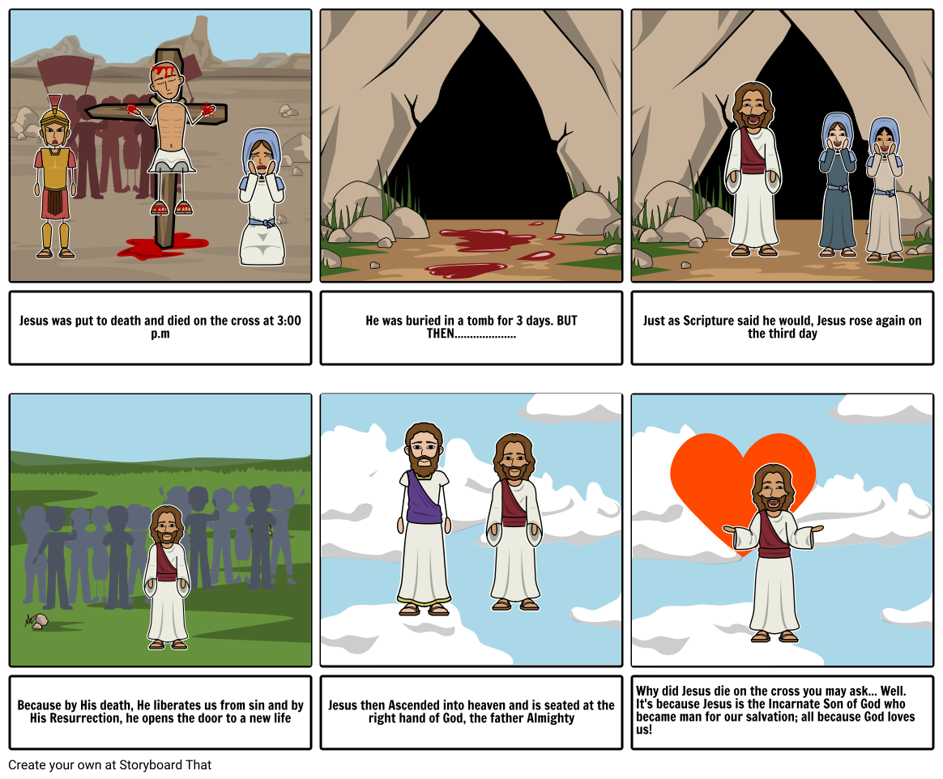
The Resurrection of Jesus

Slide 31
The Resurrection of Jesus
For the rest of this session and tomorrow’s session you are going to be a detective of the Jerusalem Police Department trying to solve the mystery of the missing body which was in the tomb.
You will investigate a number of pieces of evidence: statements from the witnesses; evidence from the crucifixion; and additional evidence from the Bible.
Recap:
Jesus was seen dying on the cross on Friday but according to followers of Jesus by Sunday morning the body was no longer there.

Slide 32
First task:
What could the explanations be for the body going missing?
Write a list of these and then rate them out of 10. (1 = least believable and 10 = most believable)
With each explanation write about the evidence which would be required to prove each one.
After that, write down which explanation you believe and why.

Slide 33
Second task: Time to weigh the evidence (not literally…)
Reflect on each piece of evidence- does it support any of your conclusions? Why/ why not?
The Roman Guard
Pilate, the Roman governor, ordered that the tomb be made as secure as possible. The official Roman seal was placed upon the closed tomb after the body was put inside. This warned grave robbers of serious penalties for breaking it. 16 guards were keeping watch outside the tomb and in the surrounding area.
The body is still missing!
All parties- Roman and Jewish- were in agreement that the tomb was empty on Sunday. Only the empty grave cloths that Jesus had been wrapped in were in the cave. The body has not been found.
The stone was really heavy!
Jesus was placed in a tomb/ cave with a large stone covering the entrance to keep the body safe from robbers. The stone would have taken multiple people and a long time to move it.
Tomorrow we will consider the witness statements!

