Slide 1
Thursday 19th March Schedule Quick morning work: Homophone hunt MATHS: TO COLLECT DATA AND DRAW A PICTOGRAM brain break! ENGLISH: To write persuasively Brain break! SCIENCE: TO COLLECT DATA ABOUT PLANT AND ANIMAL LIFE IN THE GARDEN Music: to listen and appreciate a piece of music

Slide 2
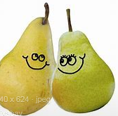
HOMOPHONE HUNT!
A homophone pair is a pair of words that sound the same but are spelt differently and have different meanings – for example:
pear and pair

Slide 3
Go for a homophone hunt around your house – you might find a ‘stair’ and a ‘stare’ or something to do with the ‘sun’ and a ‘son’!
If you can find examples of words that are homophones in your house take a picture or if not, draw pictures of different homophone pairs in your pink work book.
Some homophones you could look out for are: ‘meat’ and ‘meet’ , ‘sea’ and ‘see’, ‘ball’ and ‘bawl’.
What other examples can you find or think of? Can you use your homophones in some sentences?

Slide 4
MATHS STARTER:
Fill in the missing gaps
25 ,….. , 75, 100, ……, ……, 175
Challenge!
80, 60, ….. , 20, ……, -20, ….., ……. , -80, -100

Slide 5
Pictograms
Today we will be carrying on from yesterday’s work on pictograms.
We now know that pictograms have:
rows = going across.
a key = one picture with how many items it represents
A criteria = for example how many gorillas are in different zoos.
Moving on from this work we will be drawing our own pictograms today with data that has been given to us about milkshakes.

Slide 6
Understanding pictograms
If this picture represents 100 daisies, what would the next picture represent? How about the next? Can you carry on the sequence drawing the daisy and writing the number it represents?
100 daisies
? daisies
? daisies

Slide 7
If we halve the picture, we have to halve the number too. So, when we have half a daisy, we halve the number the picture represents.
100 daisies
50 daisies
25 daisies
½ of 100 = 50 ½ of 50 = 25

Slide 8
Can you draw the daisy pictures on the pictogram to show daisies collected in different areas of the garden? Remember sometimes you might need to halve or quarter them! Please draw the table out in your pink book. Front lawn – 100 Back lawn – 50 Under the trees – 25 By the pond - 75
Areas of the garden
Front lawn
Back lawn
Under the trees
By the pond

Slide 9
Challenge 1: To draw a pictogram using data and key provided.
Using the key provided draw the table out in your pink work book replacing the number sold with ice cream pictures.
Remember to look at your key to work out how many ice creams to draw! You might have to halve the milk shake sometimes!
= 2 milkshakes

Slide 10
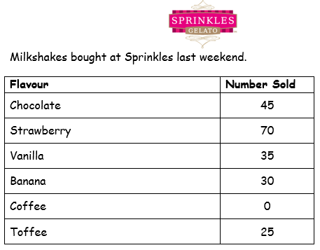
Challenge 2: To draw a pictogram using data provided and creating own key.
Using the key provided draw the table out in your pink work book replacing the number sold with ice cream pictures.
Remember to look at your key to work out how many ice creams to draw! You might have to halve the milk shake sometimes!
= ? milkshakes

Slide 11
Discussion questions Was anything difficult about creating your own key and deciding how many one milkshake picture would represent? What would have happened if you had made one milkshake represent just 1? What would have happened if one milkshake represented 100?

Slide 12
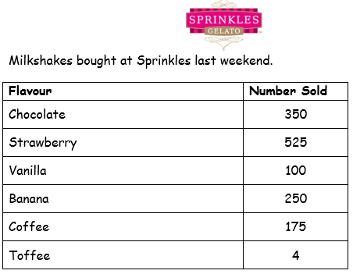
Challenge 3: To draw a pictogram using data provided and creating own key.
Using the key provided draw the table out in your pink work book replacing the number sold with ice cream pictures.
Remember to look at your key to work out how many ice creams to draw! You might have to halve the milk shake sometimes!
= ? milkshakes

Slide 13
Discussion questions Was anything difficult about creating your own key and deciding how many one milkshake picture would represent? What would have happened if you had made one milkshake represent just 1? What was difficult about having a range from 4 milkshakes to 525 milkshakes? Did this make it difficult to draw your key?

Slide 14
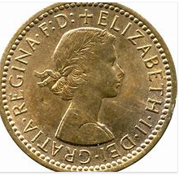
Reasoning:
Oliver has to draw a pictogram for the following data:
Amount of money raised on different stalls at the fete.
Data: Tombola - £52
Raffle - £80
Sweets - £44
Crafts - £16
Hot dogs - £60
Oliver says he will make one pound picture represent £5 raised.
Do you think Oliver has chosen a suitable key? Yes or no? Explain why. Can you think of a better amount for the coin to represent?
= £5

Slide 15
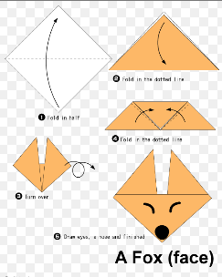
BRAIN BREAK!

Slide 16
English:
You should have brought home with you on Monday some research on a country that you think the Vikings should invade.
You are going to use this information in today’s lesson to write some persuasive arguments as to why the Vikings should choose this country as their next pillaging destination.
In our next lessons you will be putting your persuasive arguments into the structure of a leaflet advertising your chosen country as a great place for a Viking raid!

Slide 17
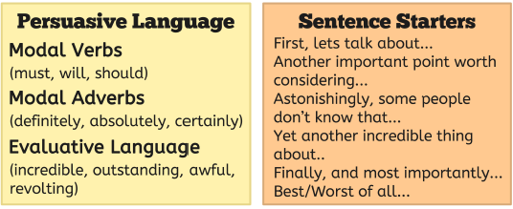
What makes a persuasive argument?

Slide 18
Persuasive or not? Can you spot any of the techniques from the word mat before this slide?
Scotland would be a fantastic place to set your sights on invading! Read on to find out why…
Forests, land and an island. Ireland has everything you need for a great Viking settlement.
You should come to North America but it is a long way.
Make a trip to the wonderful, wealthy island of England. We promise you won’t regret it!
France would be a good place to invade next because it is big.

Slide 19
Examples of persuasive arguments:
You must go and raid Iceland next because they are so sparsely populated that no one will hear you coming!
Brilliantly, Iceland is an island so you can sail there easily in your long ships without having to cross through other countries first.
It’s true that other countries might be wealthier, but Iceland has so much land to take and claim as your own, it would be a shame to waste it.
How do these sentences help to persuade you when you read them? How do they make you feel?

Slide 20
Task: using your information on your country, write some persuasive arguments as to why the Vikings should invade it. Use the examples to help you. Once you have done these, group your sentences into different paragraphs. You could then read your arguments out to a member of your family and see if they would be persuaded to go!

Slide 21
Science:
In Science today we are going to look at data collection from your garden.
This means that we are going to try to find out what plant and animal life might be living there.
We will do this by conducting a scientific study using something called a quadrat!

Slide 22
(Please see separate presentation on quadrats from the website or facebook page at this point to help children understand why we use them).

Slide 23
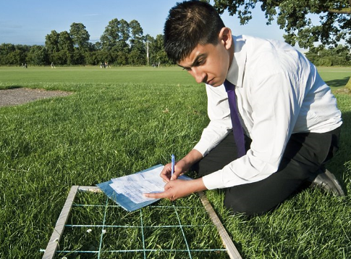
A QUADRAT IS A WIRE FRAME THAT YOU PLACE IN RANDOM LOCATIONS AND COUNT THE PLANTS AND WILDLIFE INSIDE THE SQUARES OF THE GRID.

Slide 24
TO make your quadrat:
You will need:
A large piece of card
Scissors
Method
Measure a square of 20cm – using your shape knowledge you will know this means that each edge must be 20cm. Measure and draw your square using a ruler.
Measure and draw each edge inside your square to 15cm. Cut out the inner part of the square. You should now have a square frame.
This is going to be your quadrant!

Slide 25
Now you will need to go outside and place your quadrant on a random patch of ground. Count what you can see inside the square – you might see plants and maybe some ants or ladybirds.
On a piece of paper, record a tally of what you see in the square. Label it square one.
Repeat the method around different areas of your garden.
Where was the most plant life found?
Where was the most wildlife found?
What does this show about the spread of plant and animal life in your garden?

Slide 26
Extension: Put your findings into a pictogram like we looked at earlier in maths.

Slide 27
Music:
Type this link into your internet browser:
https://www.youtube.com/watch?v=yRh-dzrI4Z4
Listen to the piece of music and answer these questions in your pink work book.
What instruments can you hear?
What is the tempo like? (speed)
What are the dynamics like? (loud and quiet)
Where do these things change in the music?
This piece of music comes from a film. What kind of film do you think it is? Do you think there is a lot of action in the film or is it a calm, quiet film? What tells you this in the music?

