Slide 1
Tuesday 2^{4th} March Schedule Morning Activity: PE with the body coach (youtube link on next slide) MATHS:Tell me what you know about this fraction Arithmetic: Different ways of saying multiply or divide. brain break! ENGLISH: Arthur and the golden rope book work. Spelling: Rule for the week: The ‘f’, ‘l’, ‘s’, ‘z’, ‘k’ sounds at the end of words. Brain break! History: Anglo-Saxon kitchens and food.

Slide 2
Morning Warm up!
Please type the link below into your internet browser to find a fun PE lesson with Joe the Body Coach. This should help to wake up your brain ready for learning!
https://www.youtube.com/watch?v=d3LPrhI0v-w

Slide 3
MATHS:
Can you tell me everything you know about this fraction? You could:
Write it as a decimal
Draw it as part of a bar or shape
6/10
Put it into a word problem
Position it on a number line
Write some equivalent fractions
Write it as a division statement

Slide 4
Maths task 2:
Choose three more fractions and put them in a circle in your books like the one on the previous slide.
Represent them in different ways – you could for example get some objects (socks for example!) and show the fraction that way, draw a picture or write it in a word problem.
Year 4s: Could you please choose fractions that include tenths and hundredths (for example 42/100) and show how you would write these as decimals.

Slide 5
ARITHMETIC: Please set this out in your books under the title Arithmetic.
Draw a line down the middle of your page so you have two columns. Write multiplication at the top of one column and division at the top of the other. Like this:
Multiplication
Division

Slide 6
Sort the following statements into either the multiplication or division side of your columns.
Repeated addition Repeated subtraction
divide share equally divisible by
group multiply product of
lots of split

Slide 7
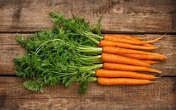
Arithmetic extension:
Can you write some word problems using one of the different ways of saying multiply or divide? You could give them to someone in your family to solve!
For example.
Ellen has 24 carrots. She splits them into bags of 8. How many bags will she have?

Slide 8
English: To infer from a picture and write a letter including feelings
In our English lesson today we will be using our Arthur and the Golden Rope book from the Power of Reading.
Please use the uploaded photos on the following slides and answer the questions about what might be happening in the story based on the pictures.
To help you work out what is happening, think about:
What do we know has happened already from our past reading of this story?
What can you see in the picture? What can you use your own knowledge to make sense of?
Who might this tell us about what is happening in the picture?

Slide 9
Before you look at the text that goes with this picture (text found on next slide), answer these questions in your pink workbook:
1.) Where do you think Arthur is going?
2.) Why are there four different Arthurs going up the staircase? (Clue – think about Joe Todd Stanton’s drawing style for this and what he might be trying to show)
3.) How do you think Arthur is feeling during his climb up the stairs?

Slide 10
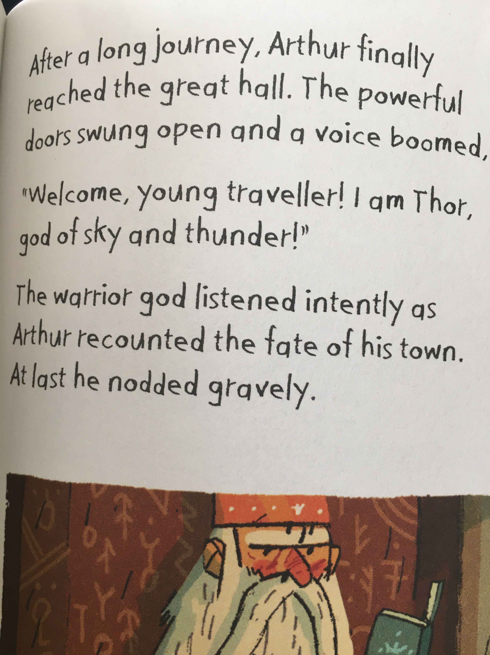
Task 2:
Write a letter to Thor explaining what has happened in Arthur’s town and why he needs Arthur’s help. Include Arthur’s feelings and those of the other villagers.
Try to be as persuasive as you can be to get Thor to help you!
OR:
Write a letter from Thor back to Arthur’s village explaining if you have decided to help or not and why. It’s up to you to make the decision!

Slide 11
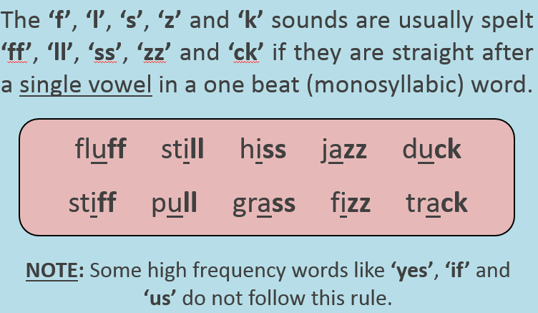
Spelling

Slide 12
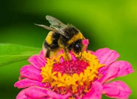
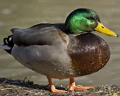
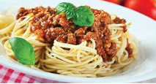
Fill in the missing letters to end the words using the f, l, s, z and k sounds.
The bumble-bee happily perched on a flower. ‘’Bu--!’ He went.
‘’I’m sti _ _ hungry’’, the girl moaned after finishing her spaghetti bolognaise.
The du _ _ waddled slowly to the pond.
The sunshine was beautiful so we all sat on the gra _ _ .
My favourite type of music is ja_ _ .
We couldn’t open the door as the handle was so sti _ _ .

Slide 13
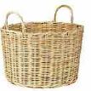
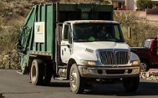
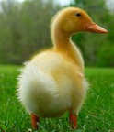
Should these words have a ‘ck’ or just a ‘k’ to make the ‘k’ sound?

Slide 14
Brain break!

Slide 15
hISTORY:
Compare these pictures of an Anglo-Saxon kitchen with your kitchen.
Can you draw a picture of the Anglo-Saxon kitchen?
What is different?
Is there anything we still use now?

Slide 16
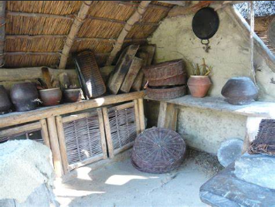
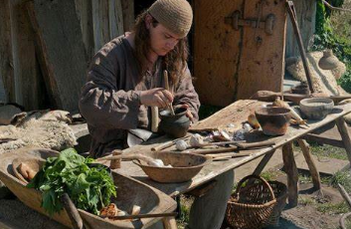

Slide 17
If you have the time/ingredients you might like to try making one of these Anglo-Saxon recipes!
Honey oat biscuits
These are very easy to make and serve 10-15 people.
Ingredients:
350g oats
225g butter
225g honey
Pinch of salt
Method:
1.) Melt the butter in a medium sized saucepan.
2.) Add the salt, honey and oats and stir until they are well mixed.
3.) Spoon the mixture out onto a greased baking tray and press it down well.
Bake at 325F/170C for 30 minutes or until golden brown.

Slide 18
Mushroom Soup Method
50g butter 1.) Melt the butter in a saucepan, add the flour and
40g plain flour cook gently for 3-4 minutes.
600ml chicken stock 2.) Blend in the chicken stock and heat, stirring
450ml milk continuously until the soup thickens and boils.
225g chopped mushrooms 3.) Add the milk and mushrooms and any salt and
Salt and pepper pepper you would like.
Variation: In place of the mushrooms substitute 1 chopped onion fried in melted butter and 450g chopped spinach added with the milk.

