Slide 1
Kestrels – Tuesday 24th March 2020
Maths- Converting units of measure- weight (g, kg, ton).
Arithmetic- Long division using the Knowledge Bank method (or your own method that works).
Brain break!
English- Editing the final paragraph for a news report.
Grammar, punctuation and spelling- Use of Standard English, spelling: -sure, -ture endings.
Brain break!
Science- Dissolving. You are going to create your own dissolving experiment.
PSHE- becoming aware of your own feelings and completing a journal/ drawing about them

Slide 2
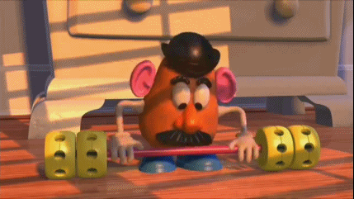
Maths:
L.O: To convert between metric units of weight.

Slide 5
Discuss these questions and then answer them in your book

Slide 21
Arithmetic: Method
This method is slower to write out in full than to actually do!
This part should be done mostly mentally but with some short calculations/ jottings.

Slide 22
Your go… (if you have another method which works, that’s great!)
7594 ÷ 23= ?
6124 ÷ 16= ?
8456 ÷ 31= ?
Find the remainder or carry on to find the decimals…

Slide 23
ANSWERS(if you have another method which works, that’s great!)
7594 ÷ 23= 330 r 4 or 330.173 (330.2 to 1dp)
6124 ÷ 16= 382 r 12 or 382.75 (what is this remainder as a fraction?)
8456 ÷ 31= 272 r 24 or 272.774 (272.8 to 1dp)

Slide 24
English
L.O: To edit the final paragraph of a newspaper article.
Using the list of features which you compiled last week, you are going to edit and improve the final paragraph of a newspaper article.
Write out the article and then edit it (remember to check for misspellings!)
Underneath your edited paragraphs, tell me why you made these edits.

Slide 25
L.O: To edit the middle paragraphs of a newspaper article.
At 4 the dragon had left and some buildings were still on fire. The community all worked together and the fires were stopped. Many of the people are now feeling very scared about the dragon comming back and they dont want him to- Mrs Delve said “We don’t want him back!!!!”. This has been matthew Jones on the scene of the crime. Back to you in the studio Julie.
Write out the article and then edit it (remember to check for misspellings!)
Underneath your edited paragraph, tell me why you made these edits.
Now write yourself some top tips to remember when writing your own Newspaper Report.
Tomorrow you will start your own. Think of some headlines to do with something happening in the war.
Extra challenge: Can you find a positive thing to happen during the war to write your story on?

Slide 26
Grammar and Punctuation – answer to yesterday’s task…
Comma used to separate a relative clause starting with the relative pronoun who.
Comma used to separate items in a list.
Comma used to separate items in a list, however the one after tennis is unnecessary (sometimes you will find a comma here to help clarify, but this one is wrong).
Comma used entirely incorrectly, if you take a breath at each one it just sounds weird…

Slide 27
Grammar and Punctuation – today’s task…
Which ONE of these is in correct Standard English?
Top tip:
Imagine the Queen saying these. You could even read them aloud in your poshest voice.

Slide 28
Spelling Practice
Use your POSH VOICE to decide whether these words should have ‘ture’ or ‘sure’ at the end.
Starter
Challenge 1
Challenge 2
pic_____
mea_____
mix_____
clo_____
na_____
trea_____
struc_____
furni_____
enclo_____
depar_____
signa_____
sculp_____
compo_____
manufac_____
disclo_____
Extension: Write some sentences using these words.
Make sure you check the spelling.
THINK: Which ending is more common?

Slide 29
Science L.O: To investigate dissolving.
For this entire investigation the word disappear is BANNED! It is not magic, nothing will disappear!
Yesterday you completed my experiment about dissolving.
Today you are going to design and complete your own experiment about dissolving.
Consider what you wrote in your evaluation yesterday. What else did you want to investigate?
Some ideas: does stirring more quickly help salt to dissolve? Which dissolves quickest salt or sugar? Does salt dissolve in different liquids?
Pick one and do the experiment. I would like you to write this up in detail, like yesterday’s experiment. Remember all of the different sections:
Aim, equipment list, prediction, fair test, method, results, conclusion and evaluation.

Slide 30
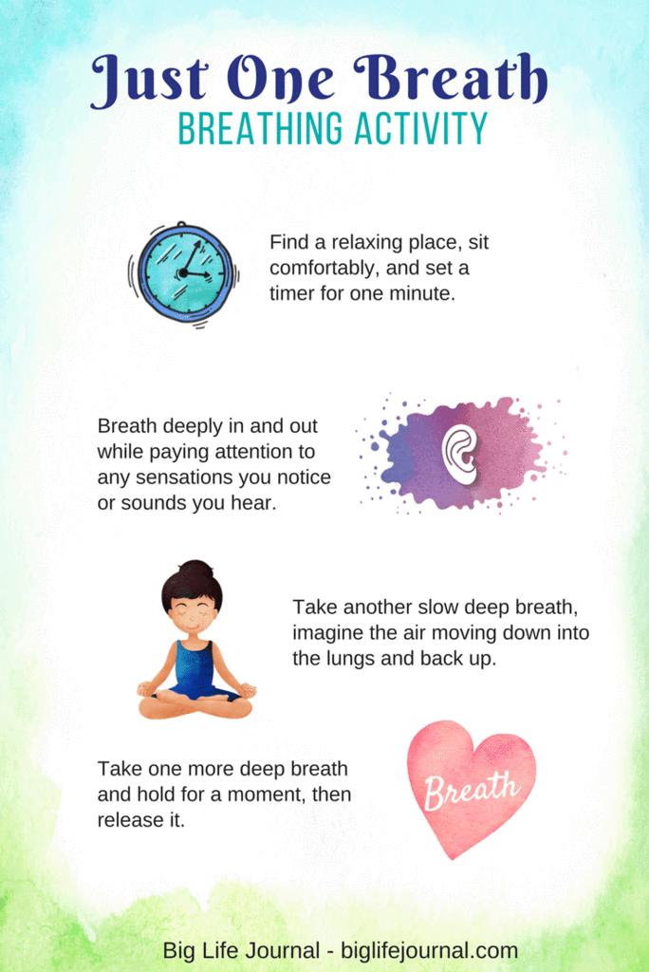
PSHE L.O: To become aware of your own feelings.
Find a quiet place and complete the breathing activity.
After this, consider how you are feeling at the moment.
Are you tense or worried? Are you content and happy?
Take a moment to reflect on these feelings and why you feel this way.
If your feelings are negative, could you talk to someone about the to gain some reassurance that everything is ok?
Finally, complete either some writing about how you are feeling and why or a drawing about how you are feeling.
It is really important to acknowledge your feelings and know that however you feel, that is ok. It is also really important to know what to do when you are feeling sad, angry or worried.

