Slide 1
Wednesday 18th March
Schedule:
Quick Morning work - Boggle game
MATHS – To know how to draw and read a pictogram
BRAIN break!
English – to identify features of a leaflet
Brain break!
SPANISH – Duolingo/Mi familia
HISTORY - LABELLING AN ANGLO-SAXON SETTLEMENT

Slide 2
BOGGLE!

Slide 3
MATHS

Slide 6
Questions to talk through:
How many people like blue?
How many people like green?
How many more people like blue than green?
How many more people like red and green combined than blue?

Slide 7
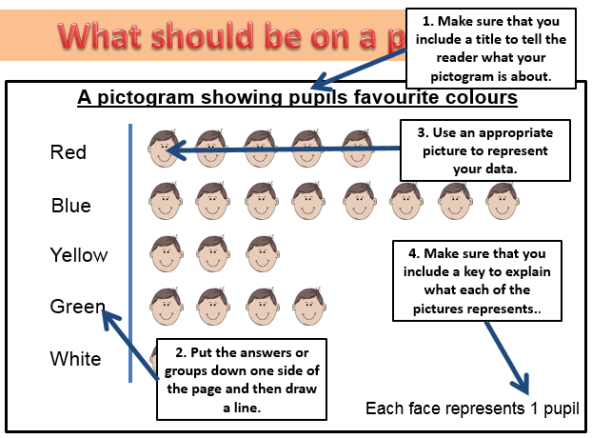

Slide 9
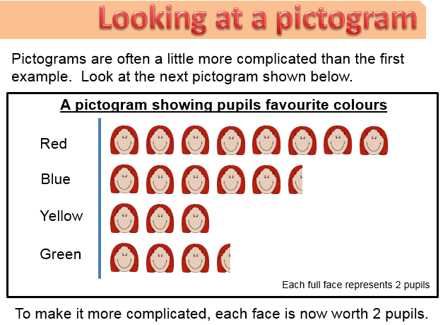

Slide 18
Challenge 1:
Create a poster to show the different things you need on a pictogram. Draw an example one and label the different parts including a title, key, pictures and the different options down the side.

Slide 19
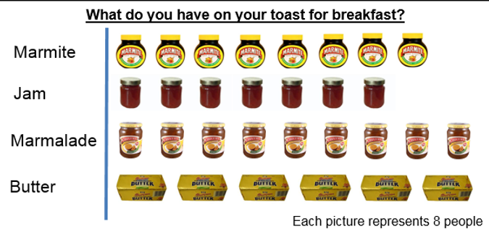
Challenge 2: Answer questions about the pictogram
1.) How many people have marmite?
2.) How many people like jam?
3.) How many people like marmalade?
4.) How many people like butter?
5.) Find the difference between the least popular spread and the most popular.
6.) How many more people liked marmalade and jam combined than butter?
7.) How many people does half a picture represent? (Hint: Divide by 2)
8.) How many people does a quarter of a picture represent? (Hint: Divide by 4)

Slide 20
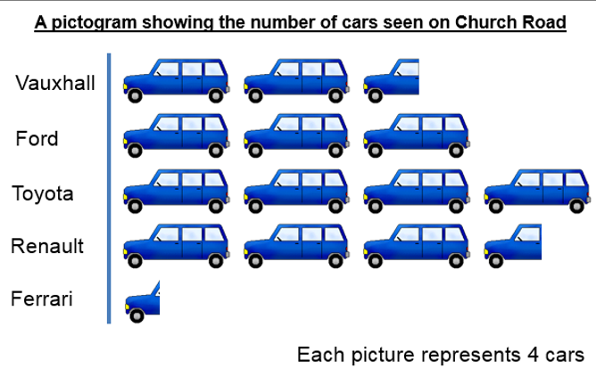
CHALLENGE 3: Use clues in the Vauxhall total to fill in the pictogram key and totals for each row.
Total: 10

Slide 21
BRAIN BREAK!

Slide 22
ENGLISH: talk time – 5 mins Look at the following leaflets and discuss which place you would rather visit – moray or Southwell? Why do you prefer this one? What is persuasive about it? Written task: Use the leaflet writing checklist on the next slide and see if you can spot any of those things in the leaflets. Make a list for each of the different features you can see.

Slide 23
Checklist:
Map Headings and subheadings
Pictures
Captions
Description of the area
Bold writing to draw you in
Bullet points
Bright and colourful
Symbols/logos
Facts and figures

Slide 24
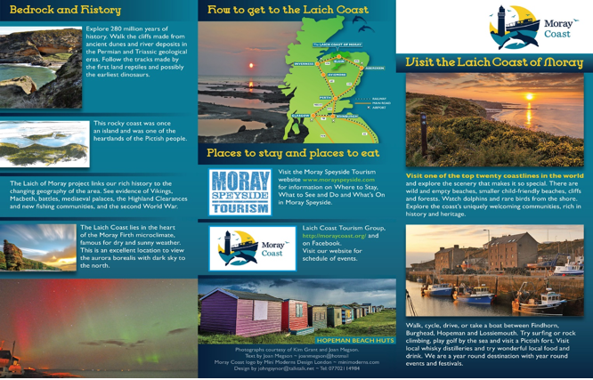

Slide 28
SPANISH:
Google search the website duolingo – you will need to sign up to create an account.
Once you have created an account select Spanish as the language you would like to study.
Complete 30 minutes of activities on the site.
OR
Recently in Spanish we have been learning how to say members of our family. Create a family tree for your family labelling the different relatives in Spanish and English.

Slide 29
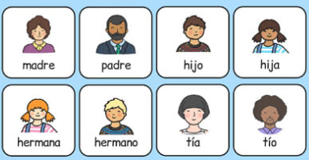
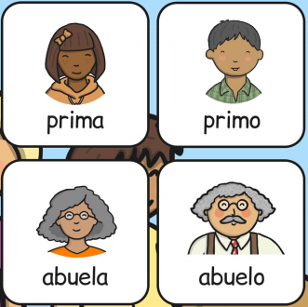
Mi familia
1.) mother 2.) father 3.) son 4.) daughter 5.) cousin (girl) 6.) cousin (boy) 7.) sister 8.) brother 9.) auntie 10.) uncle 11.) grandma 12.) grandpa

Slide 30
History:
Watch the video by copying and pasting the link below into your internet search bar.
https://www.bbc.co.uk/bitesize/clips/znjqxnb
While you are watching, note down some of the materials used and what rooms are in the houses.
Then either draw your own picture of an Anglo-Saxon village and label it OR write a tour of the village imagining you are walking around showing the village to people who want to buy a house there.

Slide 31
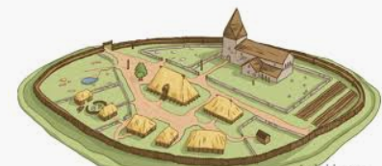
Anglo Saxon settlement

