Slide 1
Kestrels – Wednesday 25th March 2020
Maths- Converting units of measure- capacity (ml, l)
English- Writing your own first paragraph for your News Report.
Music- Write a short paragraph about your favourite type of music and then practise the chords C, F, Am and G on the ukulele.
Weekly tasks to do when possible:
Grammar: Write some sentences in Standard English.
Spelling: -sure, -ture endings. Practise writing words with the suffix and then cover them and rewrite them.
Arithmetic: Practise short/ long division using a method of your choice.
Please make sure you are reading daily, for at least 20 minutes.

Slide 2
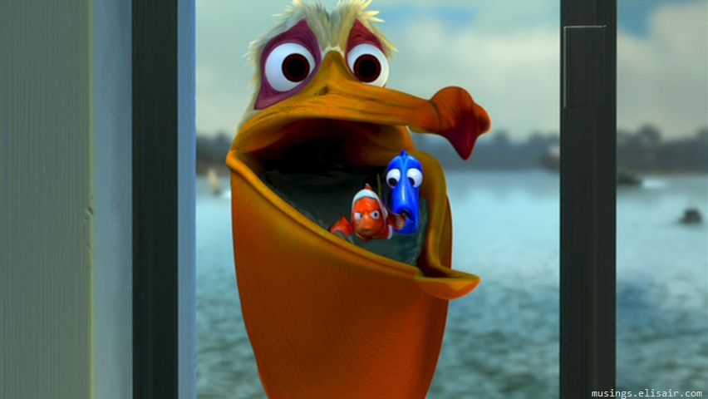
Maths:
L.O: To convert between metric units of capacity.

Slide 3
÷ 1000
Using the method, try the questions below:
ml
l
 | Bronze | Silver | Gold
ml to l | 2000 | 3400 | 3475
 | 3500 | 23000 | 218900
 | 5800 | 4570 | 31879
l to ml | 4 | 32 | 6.82
 | 12 | 3.2 | 13.25
 | 1.2 | 4.12 | 15.238
x 1000

Slide 8
English
L.O: To write the first paragraph of a newspaper article.
Today you are going to write your first paragraph for your News story.
Choose something which happened in the War which you would like to write about. You can take inspiration from Goodnight Mister Tom.
Extra challenge: Write about something positive…
Remember to include information about when, what, who and where.
If you have time, can you edit your piece to make it better?

Slide 9
Grammar and Punctuation – Answers to yesterday’s task…
Which ONE of these is in correct Standard English?
Top tip:
Imagine the Queen saying these. You could even read them aloud in your poshest voice.

Slide 10
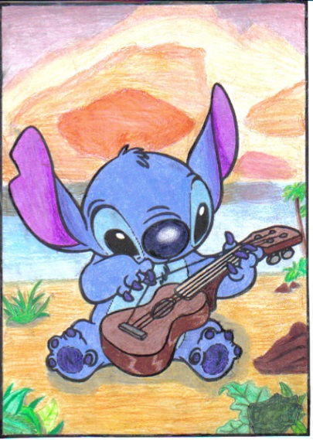
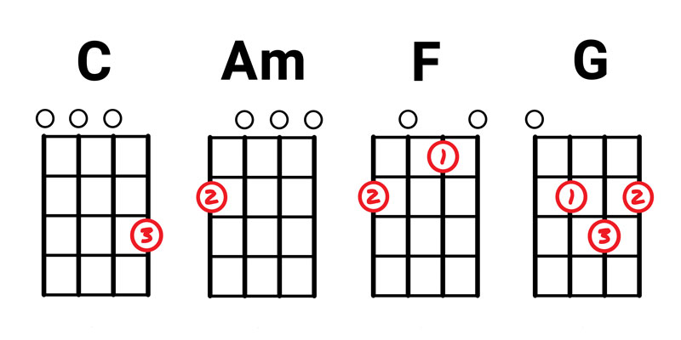
Ukulele L.O: To practise chords which appear in many songs.
Write down a few sentences about your favourite type of music.
Why is it your favourite? What do you like about it? Who is your favourite musical artist and why?
Then practise the following chords on ukulele- C, F, Am, G. Diagrams are below for you to copy. Remember which fingers to use!
These are shown as if you are holding the ukulele with the tuning pegs at the top.
The numbers relate to which finger to use. But remember, you can bar a G chord.
Practise going between these chords and strumming in different ways.

