Slide 1
Kestrels – Wednesday 18th March 2020
Maths- Percentages in the context of money.
Brain break!
English- Identify the features of a well-written newspaper article.
Grammar, punctuation and spelling- Quick quiz, I before e except after c.
Brain break!
Science- What did the results of your Science experiment show?
Art- Find a beautiful picture where the sky is blended, can you replicate it in pencil or paint?

Slide 2

Perfect Percentages
L.O. Find percentages of numbers or quantities including word problems.

Slide 3
What does the term ‘per cent’ actually mean?
I’m only 50% of the cucumber I used to be...

Slide 4
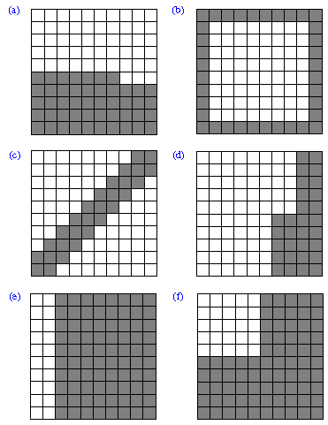
These are hundred squares, what percentages do they show?
Are there any easier methods to work them out?

Slide 5
To find 10% divide the original number by ten.
To find 20% find 10% and double it.
To find 50% half it.
To find 25% half it, and half it again.
To find 5% find 10% and half it.
To find 1% divide by 100.

Slide 6
25%
25%
25%
25%

Slide 7


Derek’s Discounts
Find the new prices of the items in Derek’s shop!
EVERYTHING MUST GO.

Slide 8


EVERYTHING MUST GO.
£15
Summer has officially begun. 50% off all hats!

Slide 9
EVERYTHING MUST GO.
£6.40
Summer has officially begun. 50% off all hats!

Slide 10
EVERYTHING MUST GO.
£8.44
Summer has officially begun. 25% off white T-shirts!

Slide 11

EVERYTHING MUST GO.
£120
Going to a ball? 10% off Men’s formal wear. How much is the Tuxedo now?

Slide 12
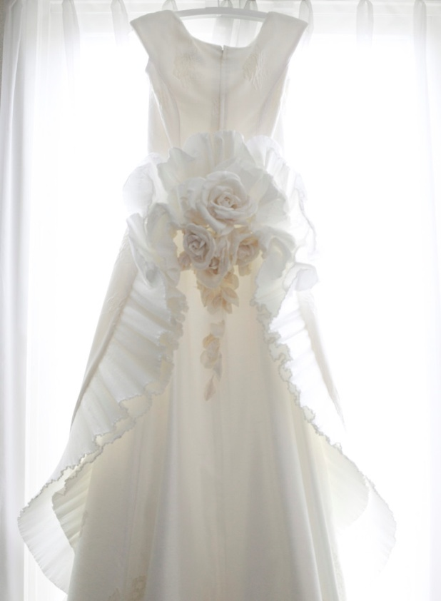
EVERYTHING MUST GO.
£480
Getting married? 20% off WEDDING DRESSES.

Slide 13
EVERYTHING MUST GO.
42 Guilders
40% off quaint attire. How much is this hat?

Slide 14
EVERYTHING MUST GO.
120 Guilders
40% off all quaint attire. How much is this outfit?

Slide 15

EVERYTHING MUST GO.
£5.00
30% off Trendy Specs.

Slide 16
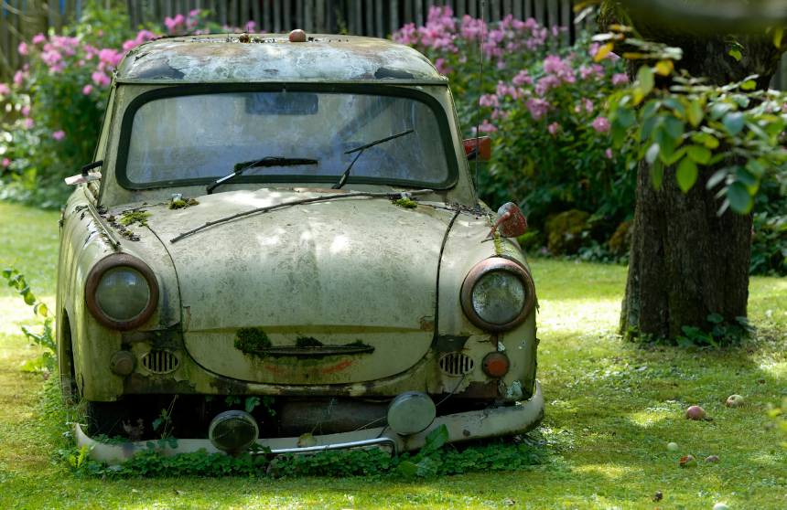
EVERYTHING MUST GO.
£600
1% off second hand car.

Slide 17
EVERYTHING MUST GO.
£600
Still not sold it! 3% off second hand car.

Slide 18
EVERYTHING MUST GO.
£600
Still not sold it!!! 90% off second hand car.

Slide 19
EVERYTHING MUST GO.
£600
Still not sold it!!! 100% off second hand car.

Slide 20
Bronze challenge:
30% of £400
60% of £240
40% of £50
20% of £2.40
35% of £480
25% of £80
75% of £360
85% of £2600
95% of £2.00
15% of £3.20
Silver challenge:
35% of £400
65% of £240
42% of £50
28% of £2.40
35% of £480
27% of £80
78% of £360
82% of £2600
97.5% of £2.00
15.5% of £3.20
Gold challenge:
32% of £400
67% of £240
41% of £50
23% of £2.40
37% of £480
29% of £80
72.5% of £360
87.5% of £2600
95.5% of £2.00
15.2% of £3.20
Method: Find easier percentages first and then add them to make your final amount. If your number has a large decimal, round it to the nearest pence.

Slide 21
English
L.O: To identify the features of a well-written newspaper.
Read the news article on the next few pages and, as you read, identify some of the features which make it a good article.
If you find some words or phrases you like, make sure you note them down to use in your own writing! There is no harm in taking ideas from others!

Slide 22
THE HOBBITON HERALD
www.hobbiton-herald.com THE SHIRE’S FAVOURITE NEWSPAPER 6 pennies
BAGGINS
IS BACK!
SURPRISE RETURN OF HOBBIT THOUGHT DEAD
By Andwise ‘Andy’ Roper
The quiet village of Hobbiton-on-the-Water was yesterday in uproar due to the unexpected re-appearance of Mr Bilbo Baggins, who left the Shire months ago, accompanied by the wizard Gandalf. Where has he been all this time?

Slide 23
A large crowd of Hobbits had gathered at Mr Baggins’ home, Bag End, where his property was being sold off by his cousins, Mr and Mrs Sackville. They had asked some months ago for Mr Baggins to be declared dead and had subsequently claimed Bag End as their
own inheritance.
Having demonstrated that he was very definitely alive, Mr Baggins demanded that everyone should leave his house. Mrs Sackville was heard to say, “It’s outrageous! How can we be sure he’s not an imposter?” However, Mr Baggins has told his story exclusively to the
Hobbiton Herald.
Bilbo Baggins, Gandalf and a party of dwarves (led by Thorin Oakenshield) departed some time ago on a quest to recover lost treasure, stolen centuries before by the fearsome dragon Smaug, hundreds of miles away beyond the Misty Mountains. Their journey through foreign territories was perilous and Bilbo claims that their lives were endangered many times.

Slide 24
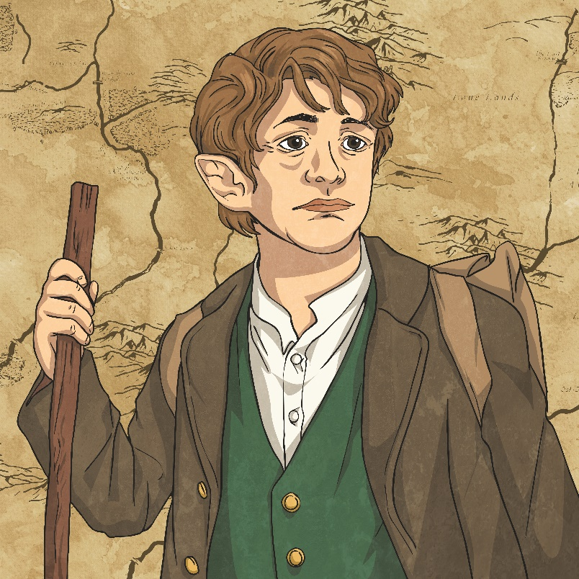
Early on, they were captured by trolls; they only avoided being eaten because Gandalf tricked the creatures and turned them to stone. While sheltering from a violent storm in the Misty Mountains, they were trapped again – this time by hordes of vicious, evil goblins. Bilbo explained they had got away because Gandalf killed the Great Goblin
with magic.
Lost and alone underground, Bilbo next met a strange creature called Gollum, who agreed to help if the hobbit could answer a series of riddles. Unfortunately, this individual betrayed Bilbo’s trust. Mr Baggins wouldn’t detail how he managed to escape – he is strangely reluctant to discuss this
particular event…
Bilbo Baggins

Slide 25
In Mirkwood, the adventurers unwisely strayed from the path and consequently were imprisoned again. Quick-thinking Bilbo saved them from years in the dungeons: “I made everyone climb into barrels and we floated down the river.” he explained.
When they finally reached their destination – the Lonely Mountain – they found a scene of such desolation that the dwarves were initially unable to find the way into their family home. Bilbo saved the day. He not only located the entrance but also devised how to kill the dragon. Following Smaug’s death, they were attacked by the goblins and their allies. Although the evil creatures were defeated, Thorin was unfortunately killed.
Grateful for all his help, the dwarves rewarded Bilbo with treasure and he set off home with Gandalf. After a less eventful journey back, he arrived in Hobbiton only to find everyone thought he was dead!

Slide 26
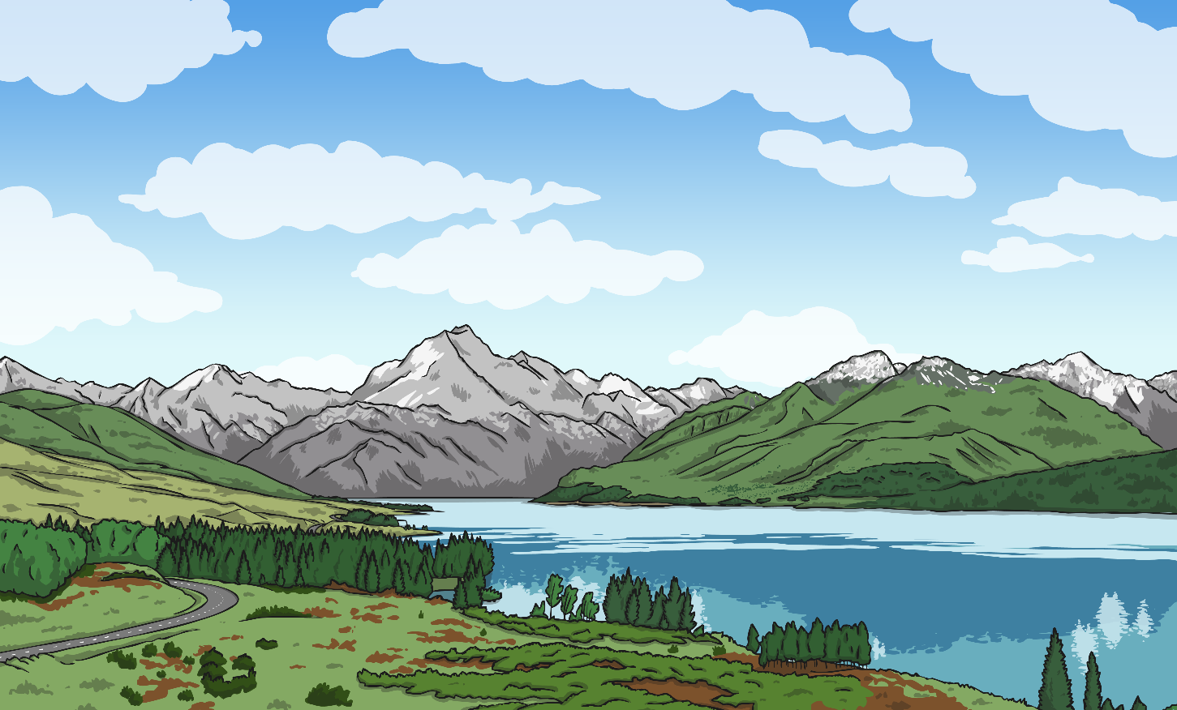
Now that Mr Baggins has recovered from his epic adventure, he says he has asked the police to make the Sackvilles hand back his property. He will be staying at Bag End for the foreseeable future: “No more adventures for me!” said Bilbo, grinning.
The Lonely Mountain

Slide 27
Who do you think the audience for the newspaper article was?
Why do you think it was a ‘newsworthy’ story?
Tomorrow you will compare your list of features to the list I have identified to see if we agree!

Slide 28
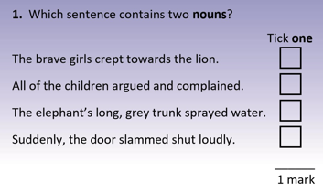
Grammar and Punctuation
Think carefully about what a noun is.
Extension: Can you find the subject and the object of each sentence?
Subject of the sentence does the action.
Object of the sentence has the action done to it.
Eg. The dog caught the ball.

Slide 29
Spelling: i before e except after c when it makes an ee sound.
Which words are spelt incorrectly? Can you correct them?
Reciept
Receive
Percieve
Cieling
Deceive
Can you write some definitions for the words?

Slide 30
Science
L.O: To explain what the results of an experiment show.
Time of day | Length of shadow
9:00 a.m. | 2m 32 cm
10:00 a.m. | 1m 55 cm
12:00 p.m. | 1m 20 cm
2:00 p.m. | 1m 73 cm
4:00 p.m. | 2m 84 cm
What do these results show? Can you write it in a comparative sentence? (e.g. The faster the person ran, the higher their heart rate was.)
Can you explain why these results came out like this?
Extension: Draw a graph of the results.
Now consider your Science experiments from yesterday- can you write a detailed conclusion about the results?
If you repeated the experiment what would you change and why?

Slide 31
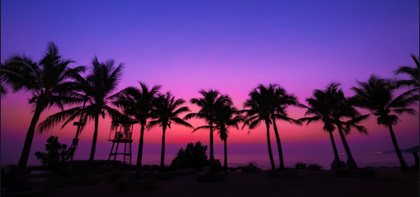
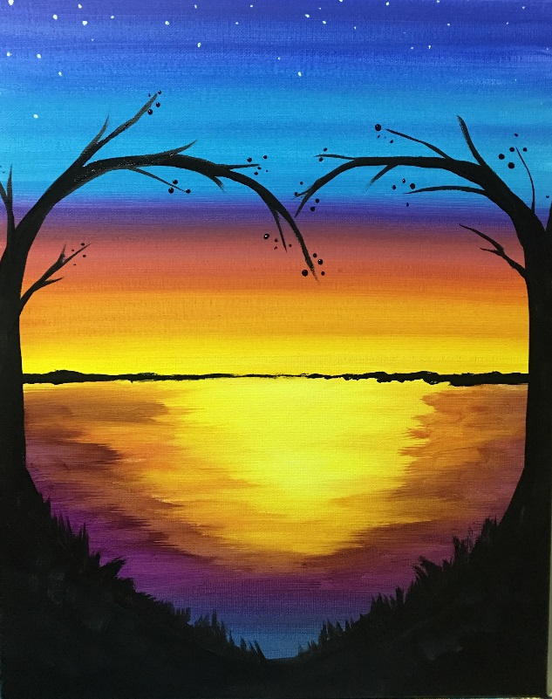

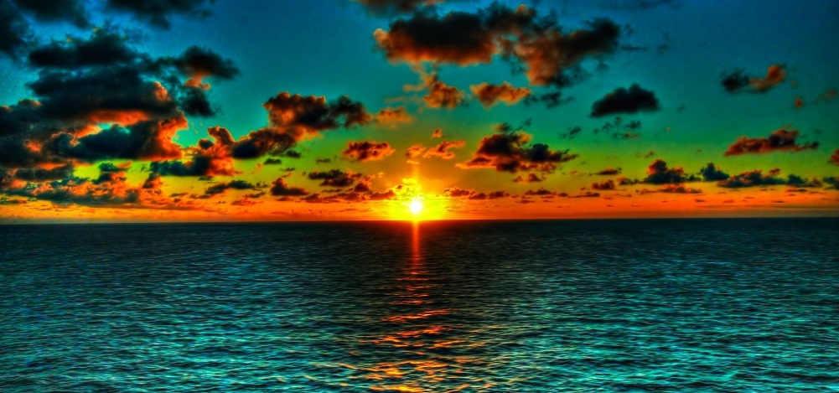
Art
L.O: To find a well-blended picture of a sky.
Find/choose a beautiful picture where the sky is blended, can you replicate it in pencil or paint?

