Slide 1
LO: I can order fractions and decimals

Slide 2
Starter
What would 71/100 be as a decimal?
What would 7/100 be as a decimal?
What would 1 2/100 be as a decimal?
What would 3.004 be as a fraction?

Slide 3
Can you work out these decimals?
0.5
0.7
0.2
0.8
0.9

Slide 4



$$\frac{1}{2}$$
$$\frac{1}{4}$$
$$\frac{3}{4}$$
$$\frac{1}{10}$$
$$\frac{50}{100}$$
$$\frac{25}{100}$$
$$\frac{75}{100}$$
$$\frac{10}{100}$$
$$0.5$$
0.25
0.75
$$0.1$$

Slide 5

Match the fraction to the decimal:
$$\frac{1}{2}$$
$$\frac{50}{100}$$
$$\frac{5}{100}$$
$$\frac{55}{100}$$
0.5
0.05
0.55
0.50

Slide 6
Put these fractions and decimals in order from smallest to largest
½ 0.45 0.9 4/10 0.3
We need to make them the same so we can compare, so convert the fractions to decimals.
0.3 0.4 0.45 0.5 0.9

Slide 7
Put these fractions and decimals in order from smallest to largest
0.003 33/100 0.03 3/10
We need to make them the same so we can compare, so convert the fractions to decimals.
0.003 0.03 0.3 0.33

Slide 8
Task
Answer the blue section of the sheet
Answer the green section of the sheet
Working with the teacher for 5-10mins, then answer red section of the sheet.

Slide 9
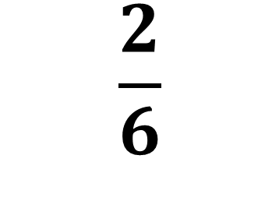
Red Group – How can we turn a fraction into a decimal?
We have to divide the numerator by the denominator.
$$\frac{2}{6}$$
0. 3 3
So our decimal is
0.33
6
2 . ²0 ²0
Try $\frac{3}{5}$ $\frac{1}{7}$

Slide 10
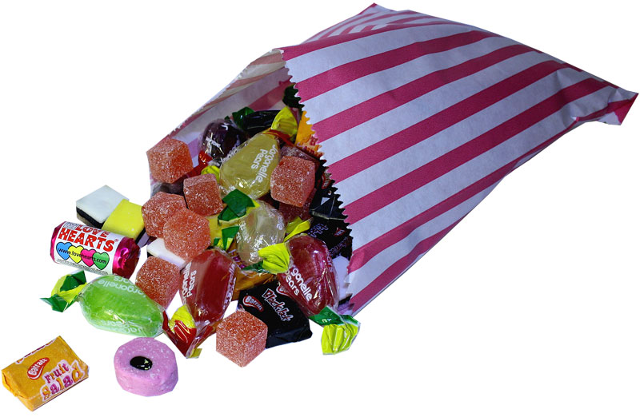
Plenary
I have got 7/10 of a bag of sweets.
I eat 1/10 and give 2/10 away to a friend.
They originally had 0.3 of a bag of sweets. How many sweets do they have now?
Who now has the most sweets?

