Slide 1
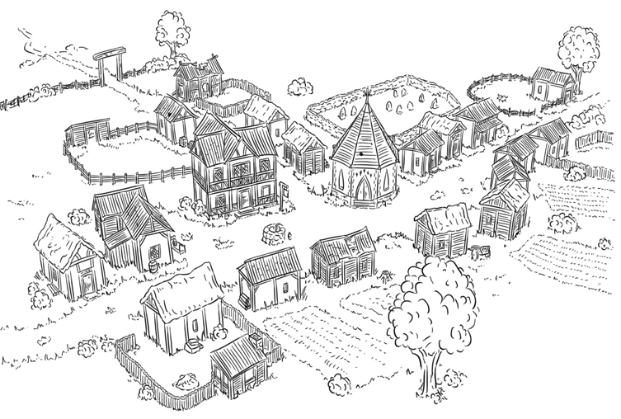
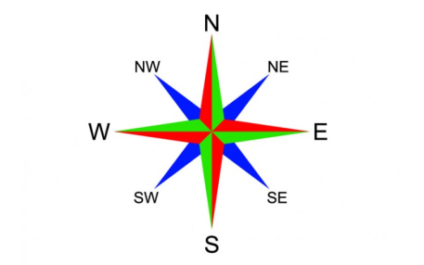
TASK:
Can you create a map of Little Weirwold and include an 8 point compass? Can you instruct another member of your household around the map, using the 8 compass point directions?
Church:
Page 66
Dobbs’ field:
Page 41
Dr Little’s:
Page 42
Graveyard:
Pages 14-15
Post Office:
Page 45
School:
Page 44
Spooky Cott:
Page 263
Tom’s Cottage:
Page 11

