Slide 1
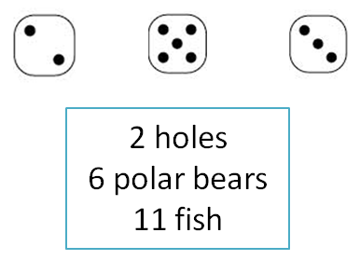
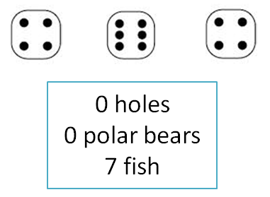
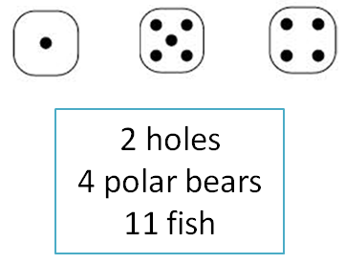
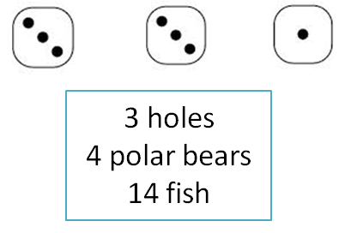
Polar Bears Puzzle
Can you figure out the rule for these dice arrangements and how they link to the number of polar bears, feeding holes and fish?

Slide 2
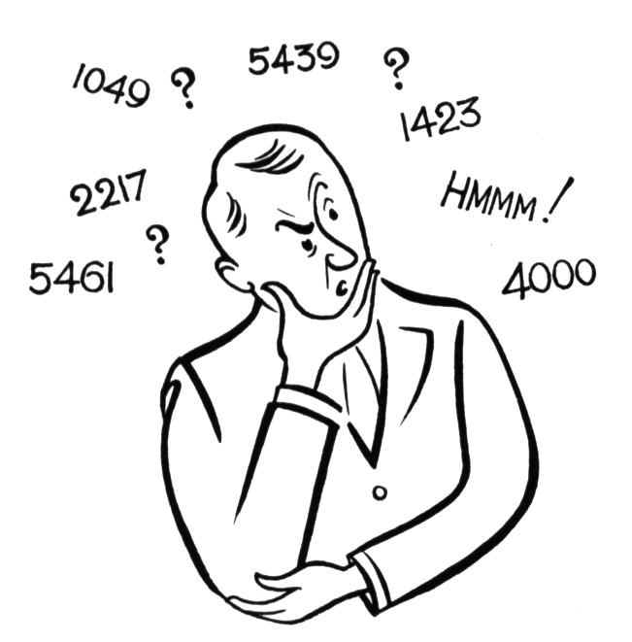
Getting Started: Hints & Tips
Look for patterns.
Can you see a link between the dice and any of the numbers?
Is each dice showing an odd or even number?
Which parts of the dice might represent holes, fish or polar bears?
Try getting some real dice yourself to look at.

Slide 3
Still Stuck? More Hints & Tips
If these were real dice, what numbers would be on the bottom of each? What numbers would be facing you?
Look at the odd numbered dice to find the holes.
Once you have found the holes, remember that polar bears are found around holes.

Slide 4
Solution
Holes are the middle dots on the odd number dice
c
Polar Bears can be found around the holes. No hole, no Polar Bears.
0 Polar
Bears
0 Polar
Bears
2 Polar
Bears
0 Polar
Bears
4 Polar
Bears
0 Polar
Bears
Fish are the numbers on the bottom of the dice

