Slide 1


RSHE 2020- Parents
Churchside Federation

Slide 2
Changes to how Relationship, Sex, Health Education is taught
From September 2020, RSHE is compulsory for every year group.
The rationale behind this is that the children today live in a very different world with technology and attitudes which are ever changing. This programme sets out to provide the children with a wider understanding of relationships, their own bodies and how to keep themselves healthy and seek help if they need it. It incorporates aspects of online safety as well.
If you would like to read the government guidance, it can be found here:
https://www.gov.uk/government/publications/relationships-education-relationships-and-sex-education-rse-and-health-education

Slide 3
Use of language
Key words per year group
EYFS- feelings, comfortable, uncomfortable, hygiene, same, similar, different, like, dislike, difficult, private, special.
Year 1- emotions, feelings, penis, vulva, communication, similarities, differences, disease, bacteria, problem, help.
Year 2- self-esteem, vagina, bullying, unique, personal space, privacy, secret, surprise.
Year 3- aspiration, compliment, self-esteem, penis, vulva, hygiene, relationship, gender, stereotype, testicles, vagina.
Year 4- emotions, empathy, foetus, puberty, public, private, similar, different, identity, marriage, arranged, forced, peer pressure.
Year 5- puberty, penis, erection, wet dream, gender, sex, intersex, transgender, gay, lesbian, personal information, online.
Year 6- body image, homophobic, biphobic, transphobic, vulva, clitoris, circumcision, female genital mutilation, infection, sexually transmitted infection, condom, problems, support, help, trust.
One of the main points which the RSHE guidance discusses is the use of language.
Even though it may feel uncomfortable for us to use specific words to describe the anatomy of a human, it is crucial that we do, and that we use it correctly.
There are several reasons for this:
If a child is describing a pain or injury to you, it is important to know where the pain is. This language makes this easier as it is more specific.
If a child has been subject to (or is being subjected to) abuse, it is highly unlikely that their abuser would use the scientific names for body parts. If we use another term, we may in fact trigger a reaction in the child and cause them unintended distress. It also enables the child to disclose information in a more clinical way so you can understand the extent of the abuse.

Slide 4
How we are going to teach RSHE at Churchside
We will be teaching RSHE on specific days- 1 day each half term.
This is to enable adequate staffing (each RSHE lesson will be done to a specific year group and must have 2 adults present), and also adequate groupings of children.
The days will be called Healthy Body, Healthy Mind, Healthy Me days and will consist of RSHE, PSHE (Paths) and Online Safety Workshops.
It is important to bear in mind that we are Christian schools and so Christian values are woven into the curriculum, without suppressing the content of what we have to teach.
A working agreement will be made with the children for them to understand what is expected of them in the sessions.
If you are concerned about any of the content which is to be taught to your child, please speak to the class teacher or directly to Mrs Godbold. We would be happy to answer any of your questions. Your right to withdraw is discussed on the next slide.

Slide 5
Right to withdraw
The vast majority of RSHE is compulsory. There is no right to withdraw from Relationships Education or Health Education. Parents and carers are only able to request that their child is excused from sex education, taught outside of the national curriculum for science. If a parent wishes their child to be excused from some or all of the non-statutory sex education, they should discuss this with the Executive Head teacher, making clear which aspects of the programme they do not wish their child to participate in. The Executive Head teacher will outline to the parents the benefits of receiving this important education and any detrimental effects that withdrawal might have on the child. This could include any social and emotional effects of being excluded, as well as the likelihood of the child hearing their peers’ version of what was said in the classes, rather than what was directly said by the teacher (although the detrimental effects may be mitigated if the parents propose to deliver sex education to their child at home instead). Once a decision has been made, they must inform the school in writing stating their reasons as to why they would like their child withdrawn.
Once those discussions have taken place, except in exceptional circumstances, the school will respect the parents’ request to have their child excused from non-statutory sex education.
The school will document this process.
If a pupil is excused from sex education, it is the school’s responsibility to ensure that the pupil receives appropriate, purposeful education during the period of withdrawal.

Slide 6
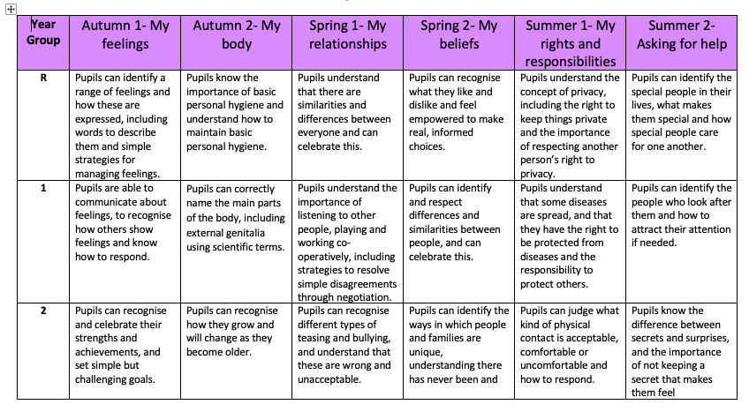
Long term plan for RSHE

Slide 7
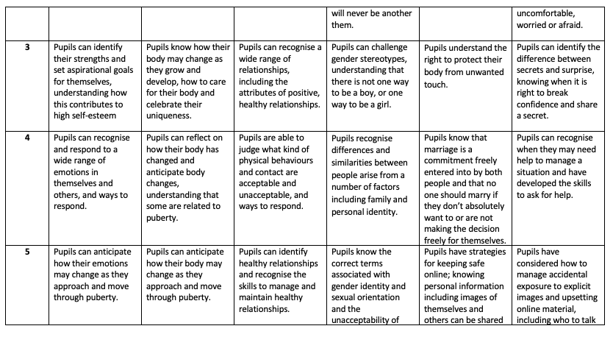

Slide 8
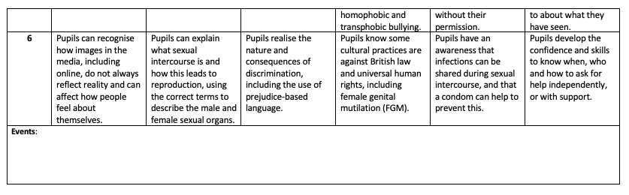

Slide 9
Safeguarding
The school’s responsibility to safeguard pupils through a curriculum that prepares them to live safely in the modern world will remain central to curriculum content, teaching methodologies and supporting resources.
At the beginning of RSHE teaching the class will discuss and create a ‘working agreement’. Confidentiality will be included within this agreement so pupils are clear of the limits of confidentiality that can be guaranteed by a teacher
Distancing techniques such as the use of characters within RSE avoids pupils feeling under pressure to participate or disclose information beyond that which is appropriate or feels comfortable. This strategy makes RSHE more accessible to all pupils, including those who may have experienced unhealthy relationships and/or abuse.
Teachers will signpost pupils to information relevant to the topic being taught to ensure safe sources of information, advice and guidance are provided. Teachers will also work closely with the school’s pastoral system to advise of topic coverage so that the school can be responsive to pupil’s pastoral needs, and safeguarding arrangements can be actioned efficiently if required.
Teachers will conduct RSHE lessons in a sensitive manner, and in confidence. However, if a child makes a reference to being involved (or being likely to be involved) in sexual activity, then the teacher will take the reference seriously, and deal with it as a matter of child protection. Teachers will respond in a similar way if a child indicates that they may have been a victim of abuse. They will immediately inform the named person for child protection issues about their concerns. The designated safeguarding lead will then deal with the matter in line with the Safeguarding policy.

Slide 10
Involving parents and carers
We believe that parents are the primary educators of their children in RSHE and that RSHE is most effective when it is a collaboration between school and home. We therefore wish to build a positive and supporting relationship with parents and carers of children and young people at our school through mutual understanding, trust and cooperation.
The school will provide support to parents and carers through an annual workshop which provides a valuable opportunity to develop awareness of emerging RSHE topics, meet RSHE teachers and review the resources being used as well as consider ways to build on the learning at home, fostering strong channels of communication between parents/carers and their children. The school also operates an open-door policy enabling parents to discuss RSHE at relevant times throughout the school year.

Slide 11
If you have any questions or concerns about anything regarding RSHE, feel free to ask a member of staff.
If you would like a copy of the RSHE policy, please ask the school secretary or download it from the school website.

