Slide 1


RSHE Training- 2020
Churchside Federation

Slide 2
Changes to how Relationship, Sex, Health Education is taught
From September 2020, RSHE is compulsory for every year group.
The rationale behind this is that the children today live in a very different world with technology and attitudes which are ever changing. This programme sets out to provide the children with a wider understanding of relationships, their own bodies and how to keep themselves healthy and seek help if they need it. It incorporates aspects of online safety as well.
If you would like to read the government guidance, it can be found here:
https://www.gov.uk/government/publications/relationships-education-relationships-and-sex-education-rse-and-health-education

Slide 3
Use of language
Key words per year group
EYFS- feelings, comfortable, uncomfortable, hygiene, same, similar, different, like, dislike, difficult, private, special.
Year 1- emotions, feelings, penis, vulva, communication, similarities, differences, disease, bacteria, problem, help.
Year 2- self-esteem, vagina, bullying, unique, personal space, privacy, secret, surprise.
Year 3- aspiration, compliment, self-esteem, penis, vulva, hygiene, relationship, gender, stereotype, testicles, vagina.
Year 4- emotions, empathy, foetus, puberty, public, private, similar, different, identity, marriage, arranged, forced, peer pressure.
Year 5- puberty, penis, erection, wet dream, gender, sex, intersex, transgender, gay, lesbian, personal information, online.
Year 6- body image, homophobic, biphobic, transphobic, vulva, clitoris, circumcision, female genital mutilation, infection, sexually transmitted infection, condom, problems, support, help, trust.
One of the main points which the RSHE guidance discusses is the use of language.
Even though it may feel uncomfortable for us to use specific words to describe the anatomy of a human, it is crucial that we do, and that we use it correctly.
There are several reasons for this:
If a child is describing a pain or injury to you, it is important to know where the pain is. This language makes this easier as it is more specific.
If a child has been subject to (or is being subjected to) abuse, it is highly unlikely that their abuser would use the scientific names for body parts. If we use another term, we may in fact trigger a reaction in the child and cause them unintended distress. It also enables the child to disclose information in a more clinical way so you can understand the extent of the abuse.

Slide 4
How we are going to teach RSHE at Churchside
We will be teaching RSHE on specific days- 1 day each half term.
This is to enable adequate staffing (each RSHE lesson will be done to a specific year group and must have 2 adults present), and also adequate groupings of children.
If you are concerned that a child in a specific year group cannot access the content of the lessons and would benefit form being in a younger setting, the structure of these days allows for this. Please discuss this with Katie Tinkley beforehand to discuss arrangements and appropriateness.
The days will be called Healthy Body, Healthy Mind, Healthy Me days and will consist of RSHE, PSHE (Paths) and Online Safety Workshops.
At Mundford, this will be easier due to the unmixed classes, however it will be necessary to ensure that 2 members of staff are present. A suggested timetable for Gooderstone is on the next slide.
It is important to bear in mind that we are Christian schools and so Christian values are woven into the curriculum, without suppressing the content of what we have to teach.
A working agreement will be made with the children for them to understand what is expected of them in the sessions.

Slide 5
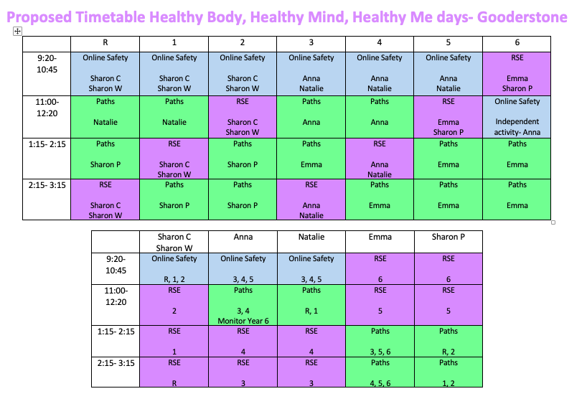

Slide 6
How we are going to teach RSHE at Churchside
We have bought into the planning resource from Educator Solutions which has a full pack of plans and resources for you to use in the lessons.
It is crucial that you look at these plans before the day of the lesson to ensure that you have a good understanding of the content and so you can consider your class specific needs when planning for the activities.
We have access to an online version of the document and a hard copy which will be kept in school. I will download the pack of lessons for each year group and put them on the public drive at each school for you to use.
On the following slides is the long term plan and an example of a lesson from Year 3 from the resource with explanations.

Slide 7
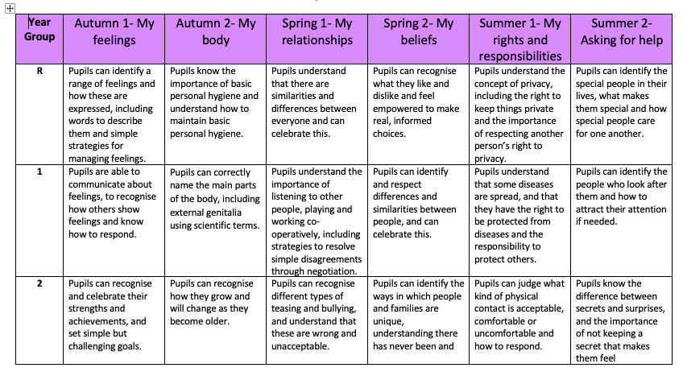

Slide 8
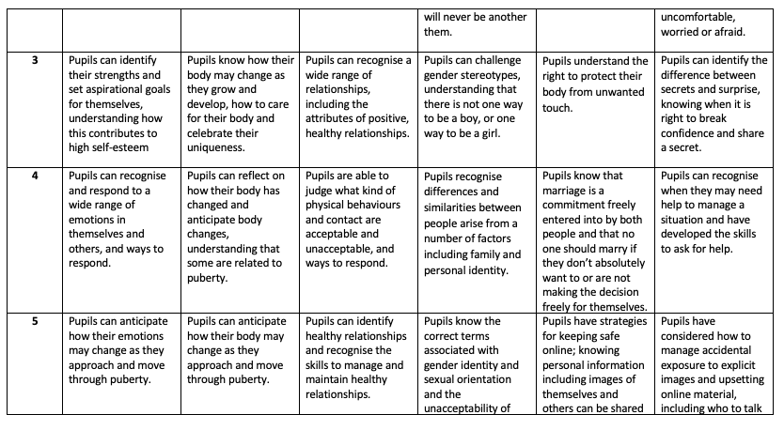

Slide 9
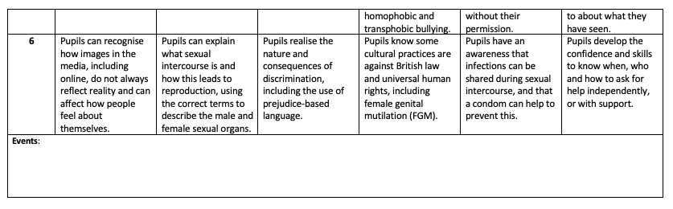

Slide 10
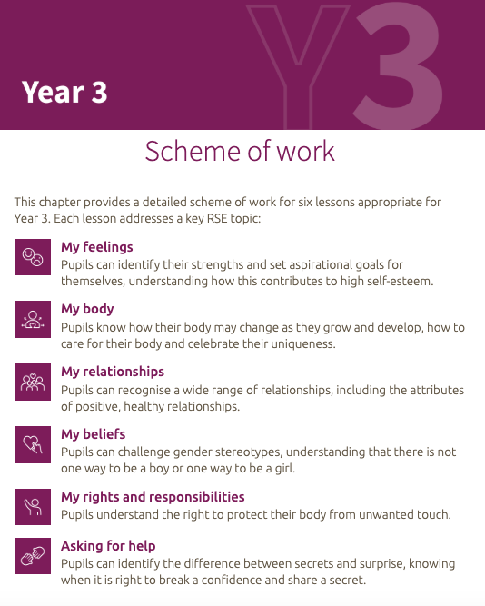
The Scheme of work shows the themes for each of the Healthy Body, Healthy Mind, Healthy Me days and the goal for each day.

Slide 11
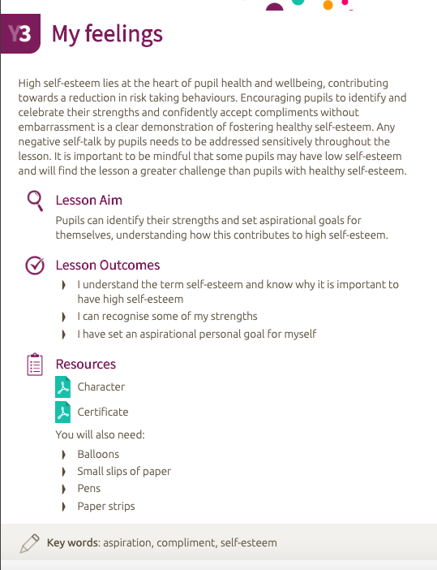
This is the first lesson plan for Year 3- My feelings.
The resources are included in the PDF and hard copy at school.
Additional resources will need to be sourced.

Slide 12
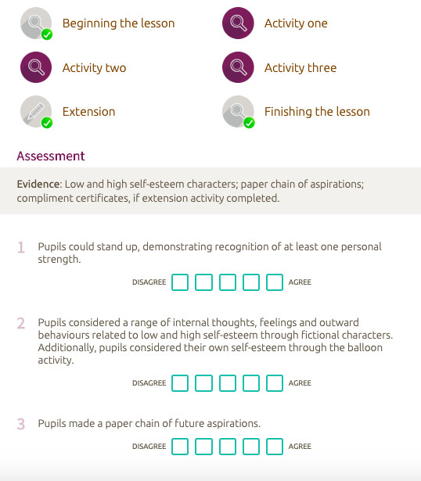
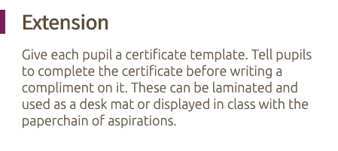
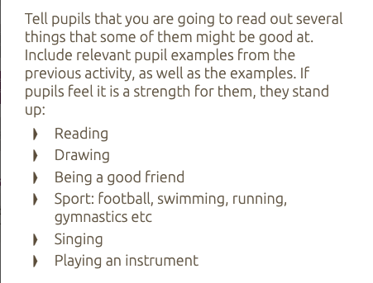
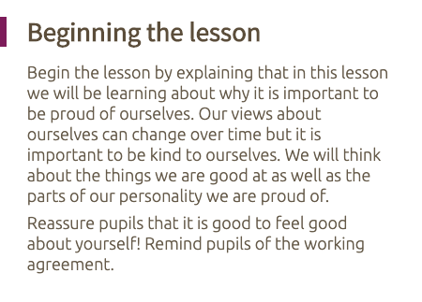
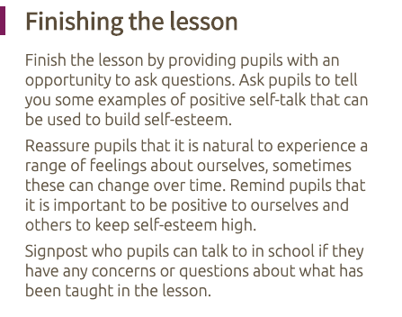
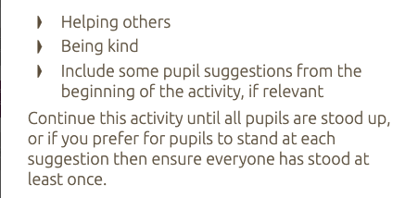
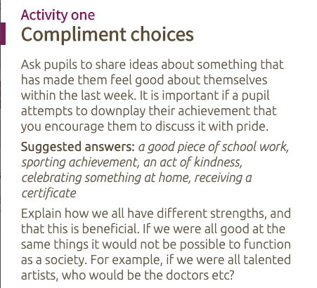
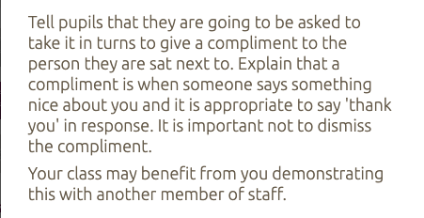
Each part of the lesson has its own explanation.

Slide 13
This is the first part of the assessment process for the lesson and is a quick tick sheet for the activities completed. Additional assessment will be required and is discussed on the next slide.

Slide 14
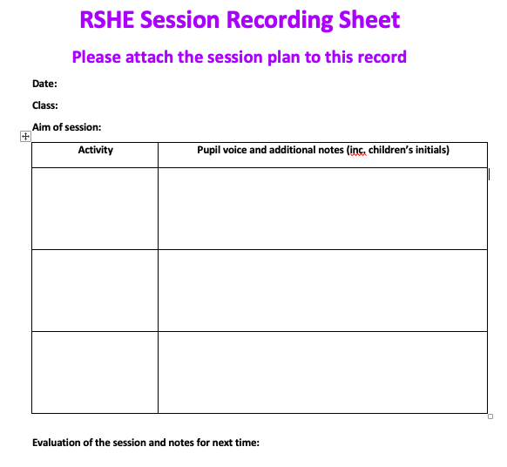
In order to monitor RSHE, and to help with planning the sessions, this recording sheet will need to be completed after the lesson.
The aim is to note down anything of interest which the children say, including misconceptions, and to evaluate the session to help with teaching next time.
If you have not competed the session within the time given, you will need to organise a time to finish the session with two adults present.
After completing this sheet, please put this with your annotated planning sheet in the designated folder.
This sheet is not for recording anything regarding safeguarding, this is discussed next.

Slide 15
Safeguarding
The sessions could cause children to disclose something of concern, either within the session or afterwards. This must be treated like any other safeguarding situation and must be reported quickly.
If something is of immediate concern, a DSL must be made aware of the situation and the information disclosed must be written down immediately.
It may be the case that a child discloses something in front of the whole class. If this occurs, ensure that a teacher/ TA present notes down what was said and follow regular safeguarding guidelines. Do not interrogate the child, or ask the child questions in front of the rest of the class. Ensure that you acknowledge what is said and follow up on it as quickly as possible.
It may be appropriate for your class to have an ‘ask-it basket’ for them to ask anonymous questions. If a safeguarding disclosure is made using thing method, consider who the child may be and discuss with a DSL as quickly as possible.

Slide 16
If you have any questions about anything regarding RSHE, feel free to ask a member of the SLT.
Thank you for completing this training.

